Slide 1

THE TOP HAT
AWARD
Denise Fisher, Council President

Slide 2
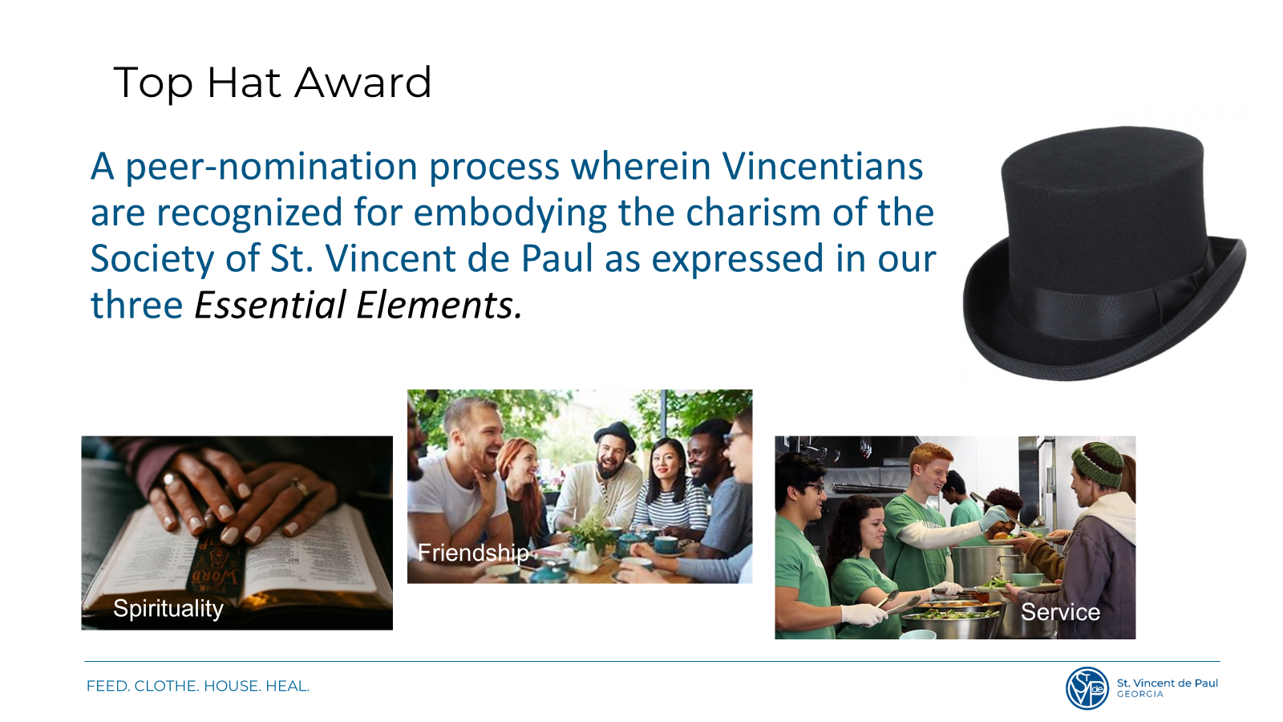
TOP HAT AWARD &
YEARS of SERVICE
Mike Mies, Executive Director
Denise Fisher, Council President

Slide 3

District 1
Betsy Van Etten
St. Joseph,
Marietta
Notes:
As we start out Home Visit section, we should begin in prayer as we would a before a Home Visit.
We have the most unique perspective because of our home visits. No other agency has our understanding of what is happening to cause need in our communities – we need to use that perspective to influence public policy and advocate – Voice of the Poor

Slide 4
District 2
Bernie Gaydos
St. Brigid,
Johns Creek
Notes:
As we start out Home Visit section, we should begin in prayer as we would a before a Home Visit.
We have the most unique perspective because of our home visits. No other agency has our understanding of what is happening to cause need in our communities – we need to use that perspective to influence public policy and advocate – Voice of the Poor

Slide 5
District 3
Patricia Wagner
St. Lawrence,
Lawrenceville
Notes:
As we start out Home Visit section, we should begin in prayer as we would a before a Home Visit.
We have the most unique perspective because of our home visits. No other agency has our understanding of what is happening to cause need in our communities – we need to use that perspective to influence public policy and advocate – Voice of the Poor

Slide 6
District 4
Manny Sequeira
Holy Spirit,
Atlanta
Notes:
As we start out Home Visit section, we should begin in prayer as we would a before a Home Visit.
We have the most unique perspective because of our home visits. No other agency has our understanding of what is happening to cause need in our communities – we need to use that perspective to influence public policy and advocate – Voice of the Poor

Slide 7
District 5
George Spirito
St. Philip Benizi,
Jonesboro
Notes:
As we start out Home Visit section, we should begin in prayer as we would a before a Home Visit.
We have the most unique perspective because of our home visits. No other agency has our understanding of what is happening to cause need in our communities – we need to use that perspective to influence public policy and advocate – Voice of the Poor

Slide 8
District 6
Jim Skehan
Immaculate Heart of Mary,
Atlanta
Notes:
As we start out Home Visit section, we should begin in prayer as we would a before a Home Visit.
We have the most unique perspective because of our home visits. No other agency has our understanding of what is happening to cause need in our communities – we need to use that perspective to influence public policy and advocate – Voice of the Poor

Slide 9
District 7
Cathy Lepkowski
Christ Our King & Savior,
Greensboro
Notes:
As we start out Home Visit section, we should begin in prayer as we would a before a Home Visit.
We have the most unique perspective because of our home visits. No other agency has our understanding of what is happening to cause need in our communities – we need to use that perspective to influence public policy and advocate – Voice of the Poor

Slide 10
District 8
Joanne Mauro
St. Catherine Laboure,
Jefferson
Notes:
As we start out Home Visit section, we should begin in prayer as we would a before a Home Visit.
We have the most unique perspective because of our home visits. No other agency has our understanding of what is happening to cause need in our communities – we need to use that perspective to influence public policy and advocate – Voice of the Poor

Slide 11
District 9
Cindy Kirksey
St. Francis of Assisi,
Blairsville
Notes:
As we start out Home Visit section, we should begin in prayer as we would a before a Home Visit.
We have the most unique perspective because of our home visits. No other agency has our understanding of what is happening to cause need in our communities – we need to use that perspective to influence public policy and advocate – Voice of the Poor

Slide 12
Winner
Congratulations to
George Spirito
St. Philip Benizi,
Jonesboro
Notes:
As we start out Home Visit section, we should begin in prayer as we would a before a Home Visit.
We have the most unique perspective because of our home visits. No other agency has our understanding of what is happening to cause need in our communities – we need to use that perspective to influence public policy and advocate – Voice of the Poor

