Slide 1

Notes:
[Sources]
- Title slide derived from the user-provided PowerPoint template.

Slide 2


Agenda
What we will cover together
1
The new report
What the new Consolidated Conference report is, why it matters, and where to find it
2
How to use it
How to use filters, tabs, and visuals
3
What it tells us
Trends, geography, demographics
4
Why data quality matters
Accuracy, storytelling, assessing efficacy
5
Live demo
Demonstrate the report, navigation, sample questions
FEED. CLOTHE. HOUSE. HEAL.

Slide 3
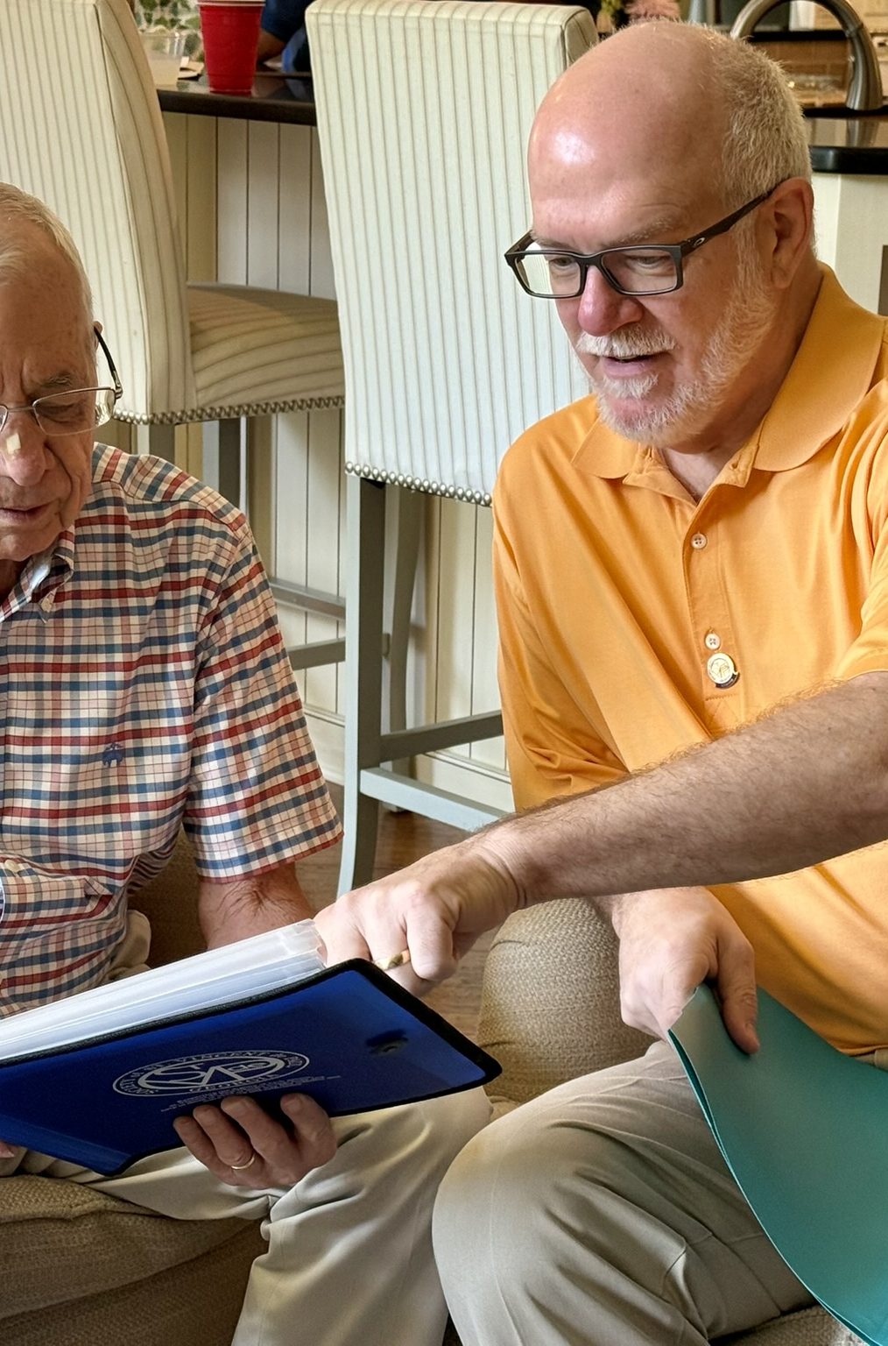
Why this report matters
The goal is better visibility into the ministry.
1
Report back with confidence
Share clear counts, assistance totals, and service trends with parishioners, donors, and parish leaders.
2
Support local grants and partnerships
Use local data to show need in your community and strengthen grant requests with evidence instead of anecdotes alone.
3
Assess how well service matches need
Look for patterns by place, category, and neighbor demographics so conferences can learn and improve over time.
FEED. CLOTHE. HOUSE. HEAL.
Notes:
[Sources]
- Photo extracted from the user-provided PowerPoint template.

Slide 4
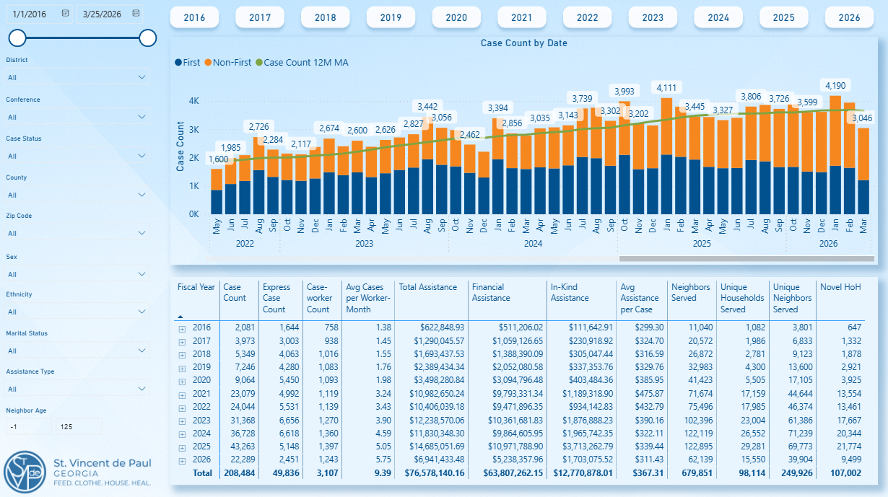
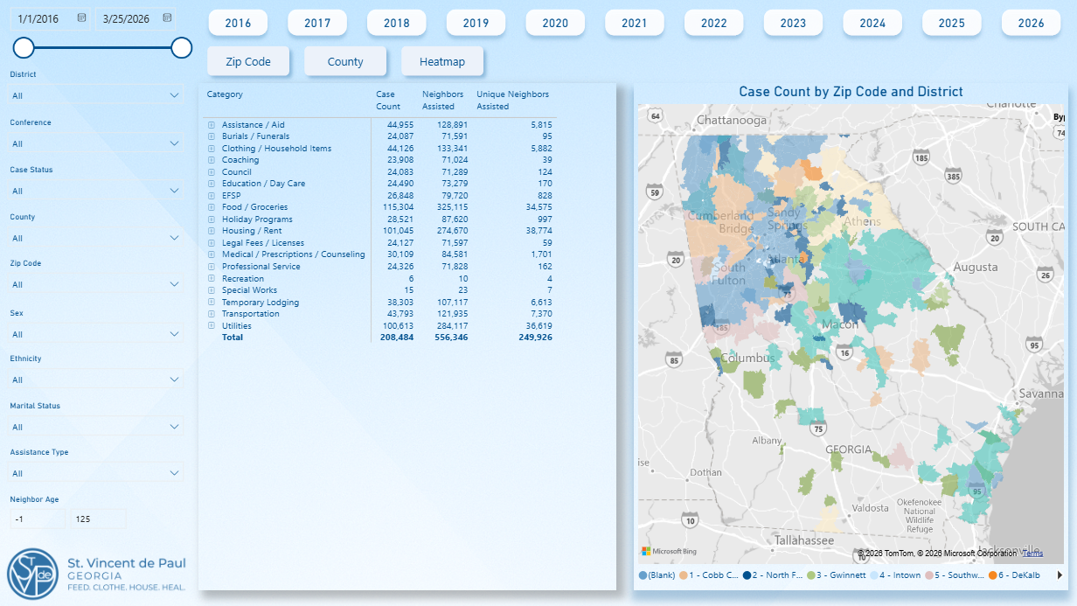
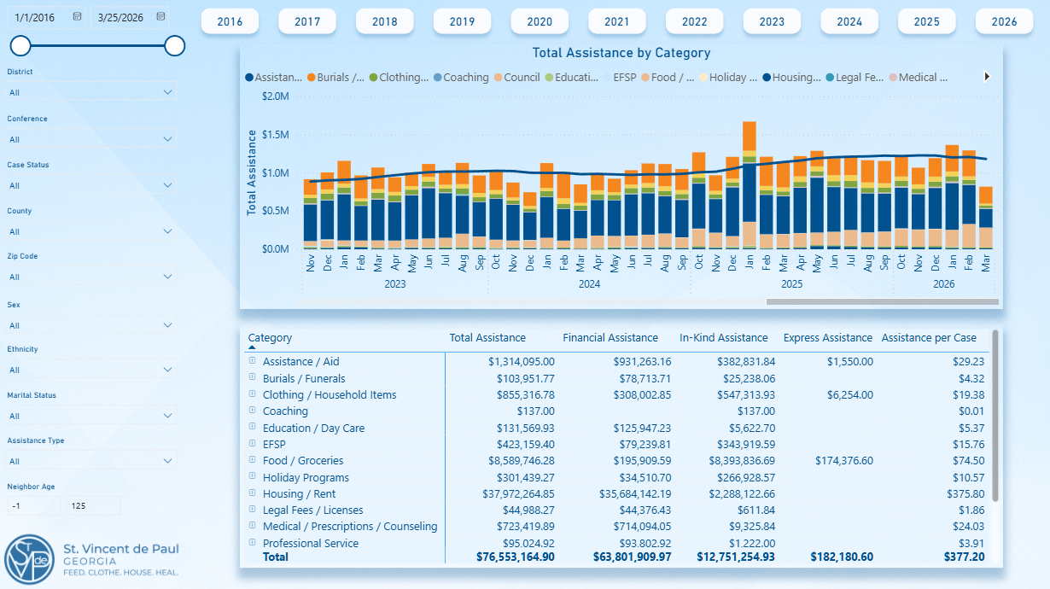
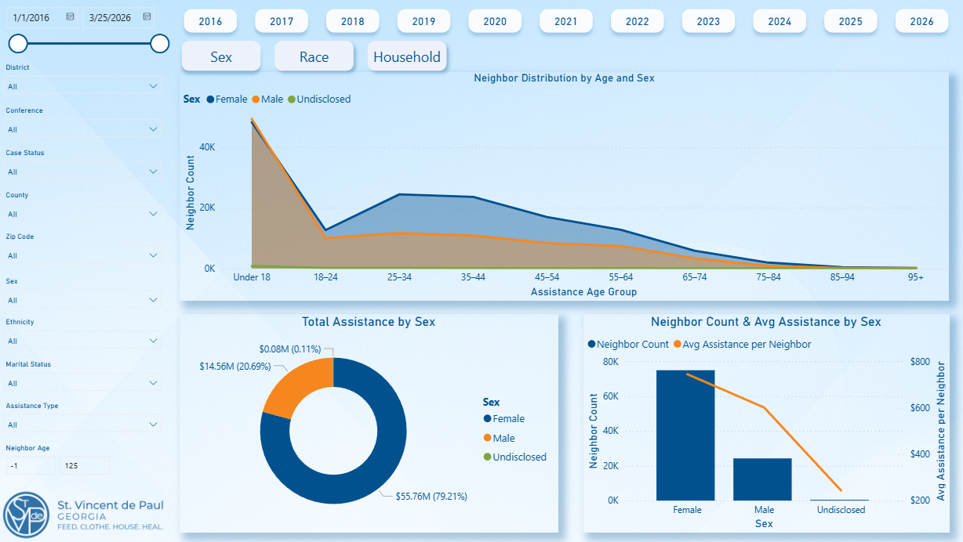
What is in the report?
Filter by time, conference, location, demographics, case status, and assistance type.
Cases over time
Geography & category mix
Assistance dollars by category
Neighbor demographics
FEED. CLOTHE. HOUSE. HEAL.
Notes:
[Sources]
- User-provided Power BI screenshots used on this slide.

Slide 5
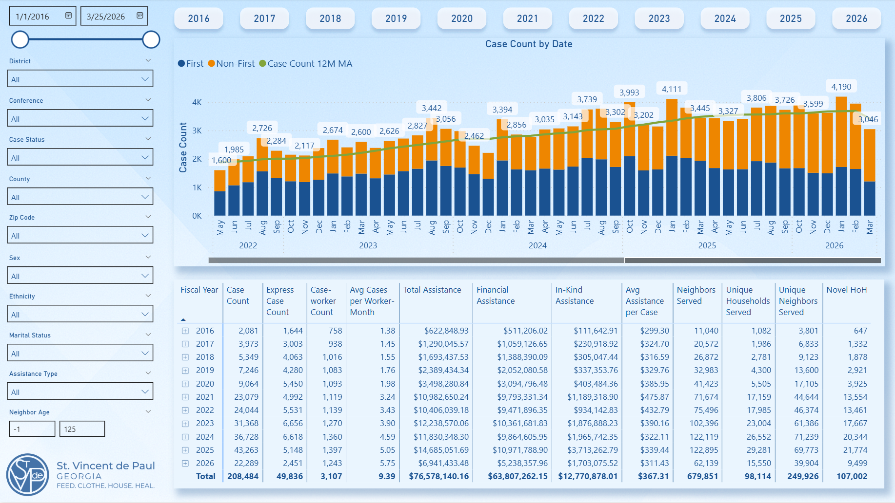
How to navigate the dashboard
Located in the members’ section of our website
1
Set your date range and pick the filters that matter to your conference.
2
Use the page buttons and tabs to move between different views of the data.
3
Click a chart, map, or category to cross-filter the rest of the page.
4
Use the tables for exact values when you need details for updates or reporting.
Tip: if you filter the page first, everything else becomes much easier to interpret.
FEED. CLOTHE. HOUSE. HEAL.
Notes:
[Sources]
- User-provided Power BI screenshot used on this slide.

Slide 6
Questions the report can help answer
These are the kinds of questions parish leaders, donors, and grantmakers often ask.
01
02
03
How much are we serving?
What kinds of help are most needed?
Where and for whom is need strongest?
See case counts, repeat activity, neighbors served, and month-to-month or year-to-year trends.
Compare assistance categories, financial vs. in-kind help, and the share of effort going to different needs.
Look at counties, ZIP codes, demographic distributions, and other filters to understand local patterns.
Used well, the dashboard moves conversations from “we think” to “we can show.”
FEED. CLOTHE. HOUSE. HEAL.

Slide 7
Good data in. Good insight out.
If the record is incomplete or inconsistent, the report will be too.

Slide 8
Why data quality matters
The dashboard can only reflect what is entered into the system.
Common input problems
What that turns into
Missing or vague assistance categories
Wrong or incomplete county / ZIP information
Delayed case entry or cases left open too long
Multiple needs bundled in a way that hides what happened
Demographic fields skipped when the information is available
Totals that are harder to trust
Maps and geographic patterns that mislead
Trend lines that look flatter or noisier than reality
Weaker donor updates and weaker grant narratives
Less confidence when leaders try to compare or learn
Better data does not make the ministry better by itself — but it does help us see the ministry more clearly.
FEED. CLOTHE. HOUSE. HEAL.

Slide 9



What better data makes possible
Clean, consistent records give conferences better stories, better support, and better learning.
Report back to parishioners and donors
Apply for local grants with stronger evidence
Assess the efficacy of service
Show what the conference has done, who has been helped, and how needs are changing — with concrete numbers behind the story.
Use local service volume, category trends, and place-based need to support grant requests and community partnerships.
See whether assistance patterns line up with actual need, and where conferences may need to adapt, partner, or learn more.
FEED. CLOTHE. HOUSE. HEAL.
Notes:
[Sources]
- Line-art icons extracted from the user-provided PowerPoint template.

Slide 10




Five habits that make the report stronger
The goal is consistency, not perfection.
1
Enter cases promptly
Late entry makes month-to-month trends less reliable.
Especially important for category coding
2
Use the right assistance type
Pick the category that best describes what was actually provided.
3
Complete place fields carefully
County and ZIP are especially important for local reporting and maps.
4
Capture demographics when known
Even partial demographic data can improve how clearly we understand who is being served.
5
Review your data regularly
A quick monthly scan can catch gaps before they become a bigger reporting problem.
When assistance is entered into the right category, the dashboard becomes much more useful for local storytelling and trend analysis.
FEED. CLOTHE. HOUSE. HEAL.
Notes:
[Sources]
- Category icons extracted from the user-provided PowerPoint template.

Slide 11
Next steps
A simple way to start: open the report, filter to your conference, and test one question you care about.
1
2
3
Access the report
Try your own lens
Use one output
Open the Members section and get familiar with the main pages and filters.
Filter by your conference, time range, county, or assistance type.
Pull one chart or table into your next parish, donor, or leadership update.
Questions, ideas, or fields you wish you could see? Feedback will help make the report better for Vincentians over time.
FEED. CLOTHE. HOUSE. HEAL.

Slide 12
Meet the new Conference Report

Slide 13

Notes:
[Sources]
- Closing slide derived from the user-provided PowerPoint template.

