Slide 1

SPIRITUAL
ADVISOR
Deacon Tim Tye

Slide 2
Agenda
Quarterly Meeting for Spiritual Advisors and Anyone Interested in the Role
Opening Prayer and Mission Statement
Testimonial, How SVdP Transformed my Spiritual Life, Joaquin Pericas
The Role and Responsibilities of the Spiritual Advisor
Available Resources
Wrap up and Closing Prayer

Slide 3

We Heed the Inspiration of the Holy Spirit
- Opening prayer by Bailly at first meeting “Come Holy Spirit fill the hearts of Thy faithful, and kindle in them the fire of Thy love.”
“Send forth Thy Spirit, and they shall be created.”
“And the whole face of the earth shall be renewed.”

Slide 4
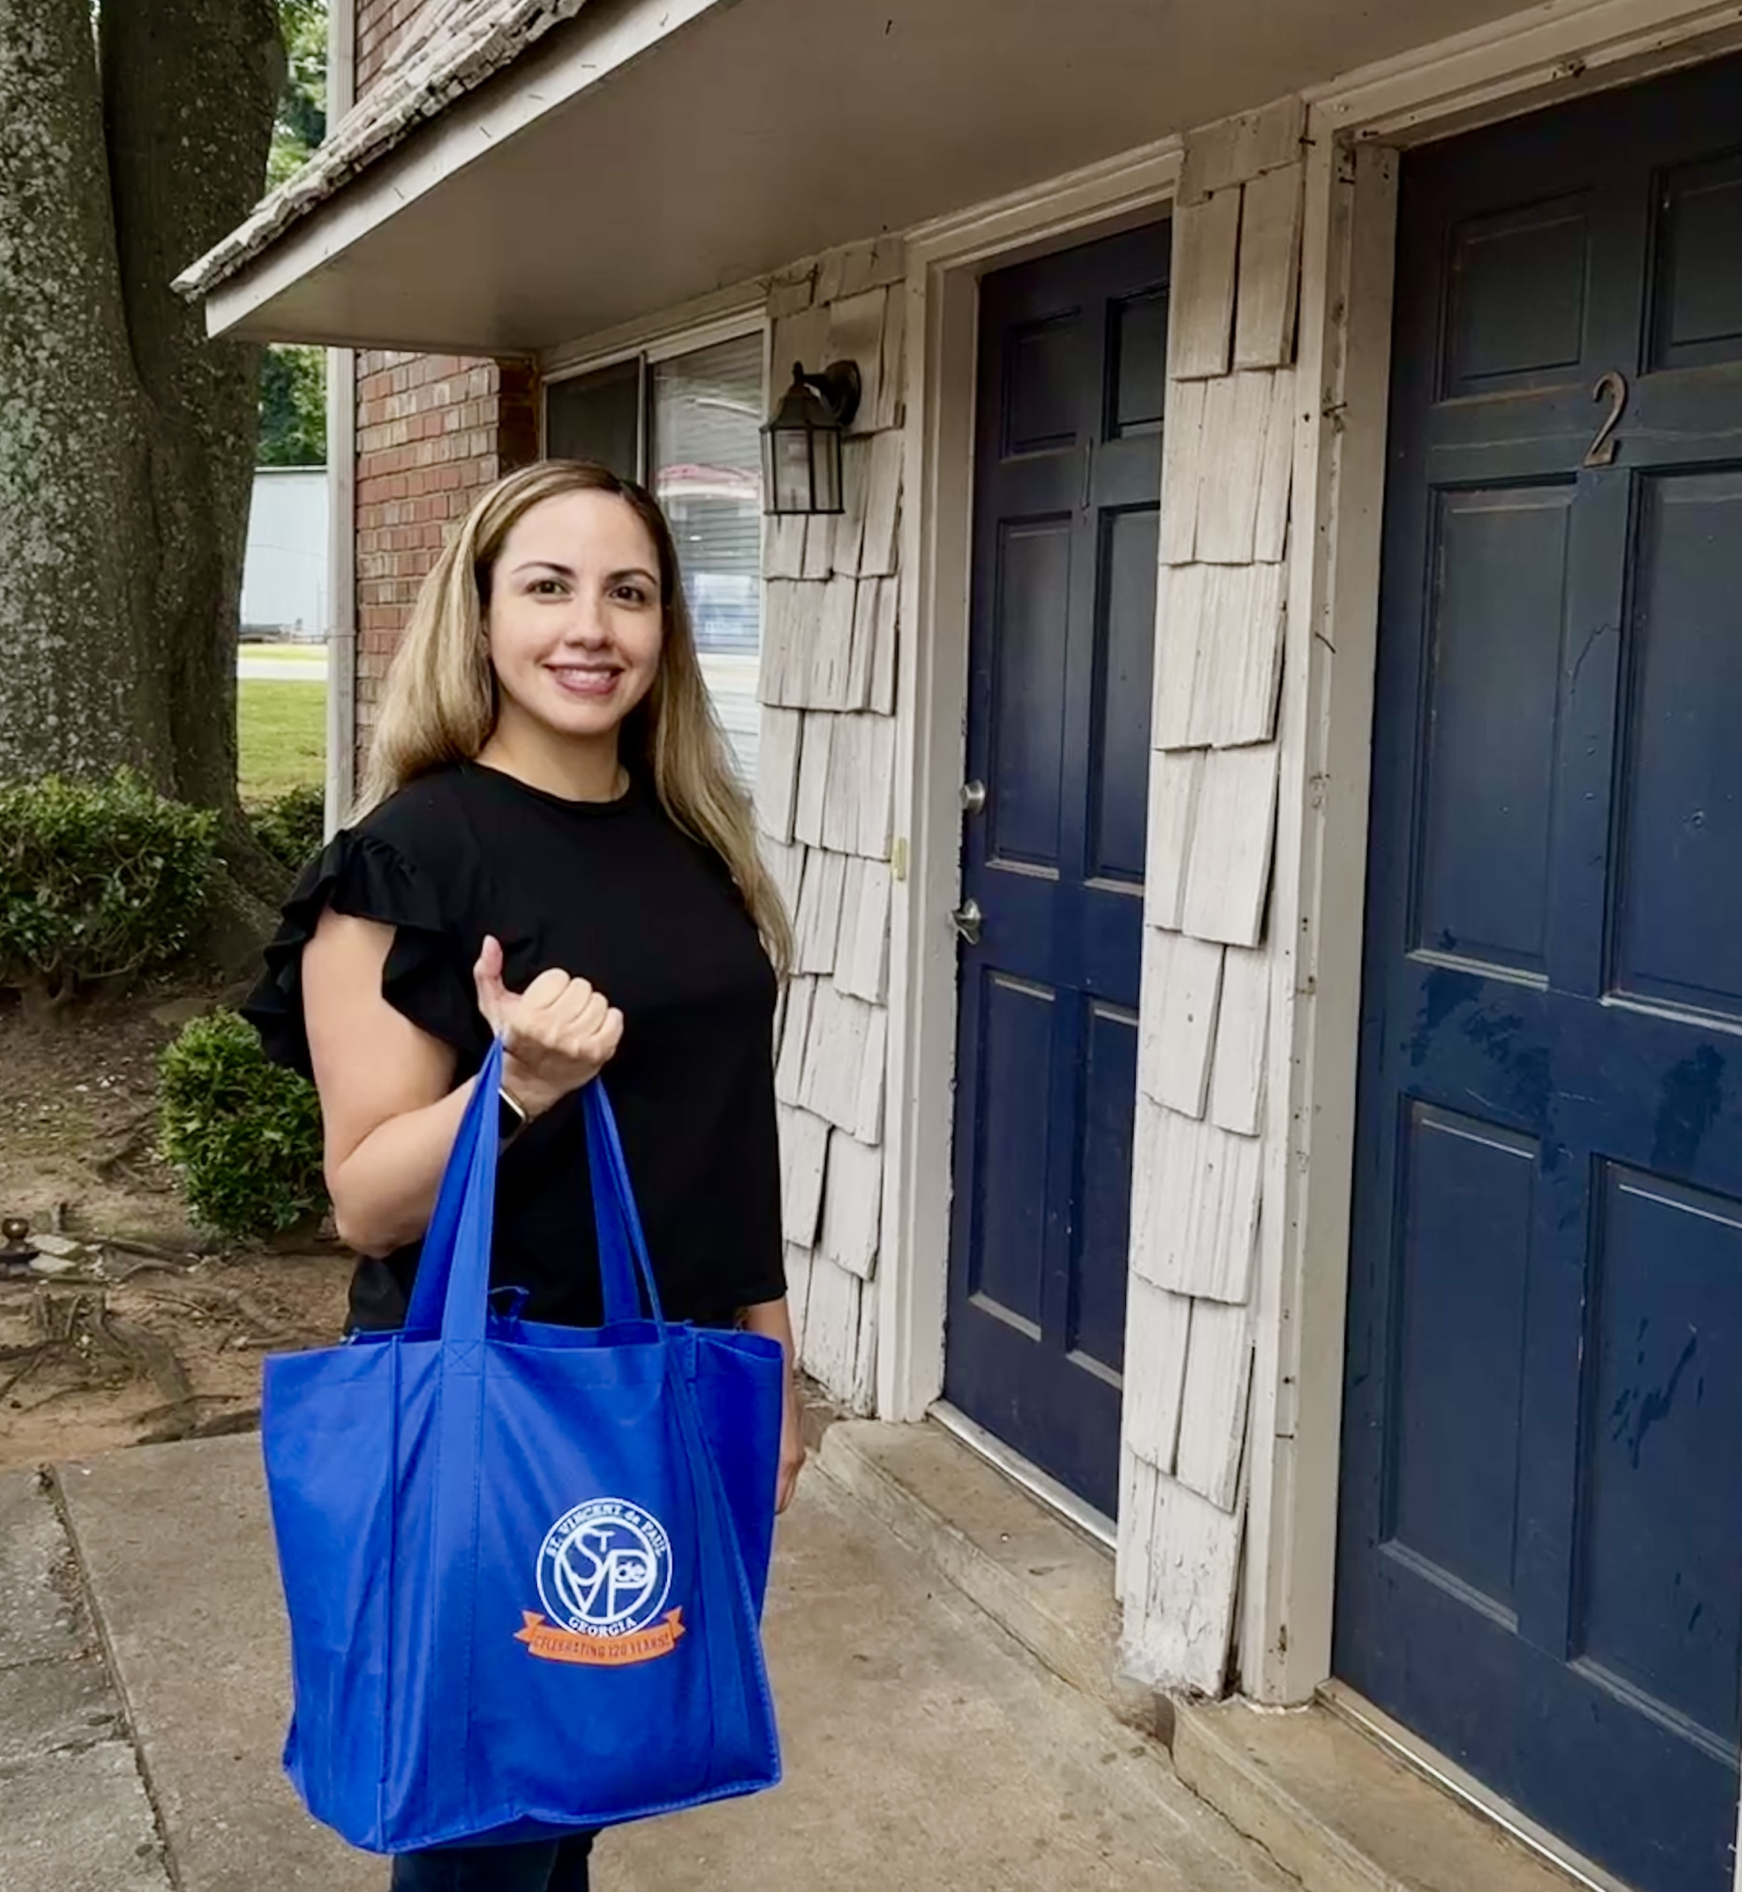
Our Mission
Rooted in Love. Focused on Impact.
Our Mission:
To Serve our Neighbors with Love and Respect: Delivering Help, Hope, and Pathways to Self-Sufficiency
Our mission explains why we exist and who we are at our core— a community rooted in love, respect, and action.
We speak of neighbors because relationships matter, and our care is always personal.
“Help, hope, and pathways” reflects both our compassionate response in times of crisis and our commitment to long-term sustainability.

Slide 5
TESTIMONIAL Joaquim Pericas, SA at SVdP St. Brigid Conference

Slide 6
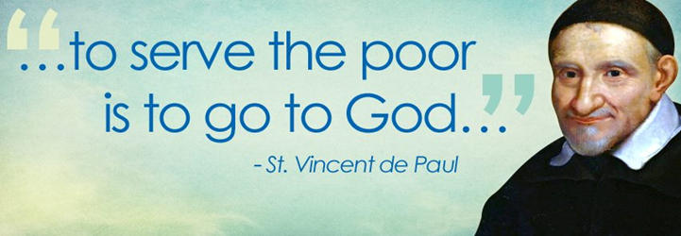
How SVDP Has Transformed my Spiritual Life
My Journey from Faith to Mission

Slide 7
Faith Began in My Family
Born in Barcelona, Spain, in a family of 11 Children
Raised Catholic—faith was part of everyday life
Prayed the Rosary daily as family
Faith was not discussed -- it was simply lived
Educated at a Jesuit School
Lesson: Seeds of faith are often planted long before we realize it.
'
Notes:
Jesus knew we would need help. He didn’t want to live us alone. The Eucharist is like spiritual food-it gives us strength from the inside

Slide 8
God’s Plan Often Leads Us Far from Home
Met my soul mate, Christina from CA in 1975
Wrote letters to each other for 5 years (600 letters!)
Faced a difficult decision: Leaving family, culture and country to build a life together in the US
Looking back now, I see God was already guiding our path
Notes:
Jesus knew we would need help. He didn’t want to live us alone. The Eucharist is like spiritual food-it gives us strength from the inside

Slide 9
Learning to Trust God Through Life’s Journey
“Trust in the Lord with all your heart…” (Proverbs 3:5-6)
Married in CA, blessed with three children and four granddaughters
Career of 38 years with companies such as Coke, Gerber, Kellogg’s, Ralston Purina and AT&T
Became a modern-day gypsy family, living in 9 different cities, 3 countries and moving 13 times.
That trust carried us through marriage, children, constant moves and a demanding career
Notes:
Jesus knew we would need help. He didn’t want to live us alone. The Eucharist is like spiritual food-it gives us strength from the inside

Slide 10
A Spiritual Turning Point
For many years, my spiritual life was lukewarm
I had heard about Christ Renews His Parish (CHRP) but never signed up. I was simply too busy.
Deacon Tom at St. Brigid: Heard and inner calling.
That weekend became a turning point in my spiritual life.
Notes:
Jesus knew we would need help. He didn’t want to live us alone. The Eucharist is like spiritual food-it gives us strength from the inside

Slide 11
The Power of Witness!
Pope Paul VI said: “In the modern world people listen more willingly to witnesses than to teachers…”
During the retreat I listened to powerful personal witnesses
That weekend didn’t just renew my faith—it gave me a new life!
Joined several ministries at St. Brigid: KOC, Bible Study, Man to Man ministry
Notes:
Jesus knew we would need help. He didn’t want to live us alone. The Eucharist is like spiritual food-it gives us strength from the inside

Slide 12
My Journey with the Society of SVDP
Joined SVDP in 2018
Inspired by the words of Jesus: “For I was hungry and you gave me food… (Matthew 25:35-36)
Worked with about 300 families including many Hispanic families
At SVDP meetings, I have stated that our goal is not only to provide financial assistance and emotional support but also spiritual encouragement: church attendance, sacraments, OCIA
Notes:
Jesus knew we would need help. He didn’t want to live us alone. The Eucharist is like spiritual food-it gives us strength from the inside

Slide 13
Miracles Are Real!
One story deeply moved me: a Hispanic family, with two daughters was about to be evicted
We were able to pay the rent but their home was almost empty
Asked at a SVDP meeting but no one had furniture
Received a call from a parishioner whose 31-year- old son had just died unexpectedly
He told me: “This is what my son would have wanted me to do”
That moment reminded me: God works through ordinary people.
Notes:
Jesus knew we would need help. He didn’t want to live us alone. The Eucharist is like spiritual food-it gives us strength from the inside

Slide 14
Saying “Yes” to God’s Call
After just one year, I was asked to become Spiritual Advisor.
My first reaction was: “I am not qualified”
I decided to pray and discern over the weekend.
During prayer, I felt a clear invitation: Say yes—and trust the Holy Spirit
That “yes” created a desire for deeper formation:
Bible Studies
The Bible in a Year
Spiritual Reading
Eventually pursuing a Master’s Degree in theology
Notes:
Jesus knew we would need help. He didn’t want to live us alone. The Eucharist is like spiritual food-it gives us strength from the inside

Slide 15
Discovering My Purpose in Life?
Even as my spiritual life improved, I still wrestled with purpose: What is God asking of me? Am I serving where I should?
My Mission became clear: To LEARN, LIVE and SHARE the Gospel/Faith
LEARN
(foundation)
MTS Classes at SHC
The Bible in a Year
The Catechism of the Catholic Church
Bible Studies
Spiritual Reading and Formation
LIVE (discipleship)
Family/ Friends
Saint Vince de Paul
The Church-Sacraments
Celebration Village
Regnum Christi
Lectio Divina
SHARE
(evangelization)
Catechism
RCIA
Spiritual Advisor at SVDP
Spiritual Advisor at CHRP
Spiritual Advisor at Regnum Christi

Slide 16
What SVDP Has Taught Me…
Serving in SVDP has transformed my spiritual life
I have learned that:
Faith grows when we serve others
Christ is truly present in the poor
And sometimes we receive far more than we give
St. Vincent de Paul one said: “Go to the poor: you will find God”
My experience in this ministry has shown me that this is absolutely true
Notes:
Jesus knew we would need help. He didn’t want to live us alone. The Eucharist is like spiritual food-it gives us strength from the inside

Slide 17
What SVDP Has Taught Me…
Serving in SVDP has help me discover
That the deepest meaning of life is simply this:
To love Christ by loving those in need
Thank-you
Notes:
Jesus knew we would need help. He didn’t want to live us alone. The Eucharist is like spiritual food-it gives us strength from the inside

Slide 18
ROLES and RESPONSIBILITES

Slide 19
Who is the Vincentian Spiritual Advisor?
A Journey, not a Destination

Slide 20
The Spiritual Advisor in the Society
The Spiritual Advisor within the Society of St. Vincent de Paul holds a key role in helping Vincentians to achieve their primary purpose within the Society: growth in holiness.
The Spiritual Advisor helps Vincentians strive to see the face of Jesus in the poor and needy whom they serve. This is the essence of Vincentian spirituality.

Slide 21
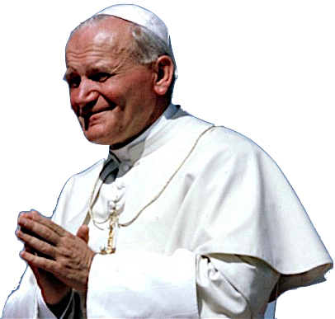
Apostolate of the Laity
Spiritual Life
The Whole of Life
Secular Life
“Spirituality is life in Christ and in the Spirit, which is accepted in faith, expressed in love, and inspired by hope…not a part of life, but the whole of life guided by the Holy Spirit.”
Pope Saint John Paul II

Slide 22
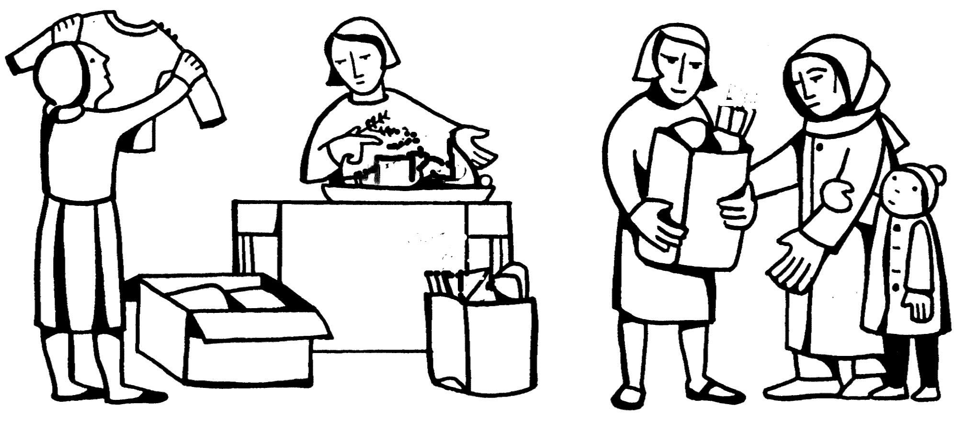
Vincentians are called to love God, with the sweat of our brow and the strength of our arms

Slide 23
Our Primary Purpose
The primary purpose of the Society of St. Vincent de Paul
TO INCREASE THE HOLINESS OF ITS MEMBERS
- The Rule, Part 1, Section 1.2

Slide 24
The Spiritual Advisor in the Conference
Inspires and challenges new works
Assists in the development of Vincentian spiritual formation
Provides guidance on spiritual matters
Keeps focus on practical love toward the poor
Reinforces our Virtues and keeps them at the forefront of our work

Slide 25
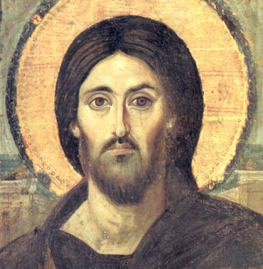
Be a Spiritual Animator
Bring to life
Enliven
Rouse
Stir
Stimulate

Slide 26
Responsibilities of Conference Spiritual Advisors
At Conference Meetings:
Lead/delegate opening and closing prayers
Utilize published Society resources or provide appropriate Vincentian or scriptural readings
Lead discussion/reflection after each reading
Ensure all meetings are conducted in a spirit of Vincentian friendship

Slide 27
Responsibilities of Conference Spiritual Advisors
Commissioning of New Members
Choose an appropriate time & occasion
All members should annually renew their commitment
Attending Eucharist Together
Celebrate Eucharist together for six Vincentian feasts
Commissioning/Commitment at Mass
Special Events
Collaborate with Council on spiritual development
Encourage Conference members to attend training, liturgies, and social events

Slide 28
Spiritual Advisor Guidelines
“Members of the Society are united in the same spirit of poverty and of sharing. They encourage one another to live a profound spiritual life and spirit of prayer. For this purpose, the role of a Spiritual Adviser is very important.”
Rule, 3.13
Focus on Vincentian Spirituality and Vocation
Animators, facilitating the spirit at all levels
Promotion of the Mission of the Society
Cultivating friendship among members

Slide 29
RESOURCES

Slide 30
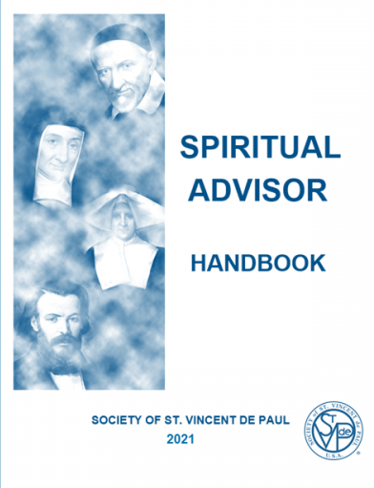
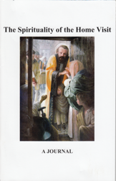


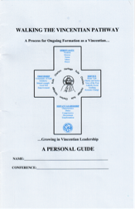
The Spiritual Advisor Handbook
Revised in 2018 (updated 2024)
A more integrated approach
Additional, practical tools

Slide 31
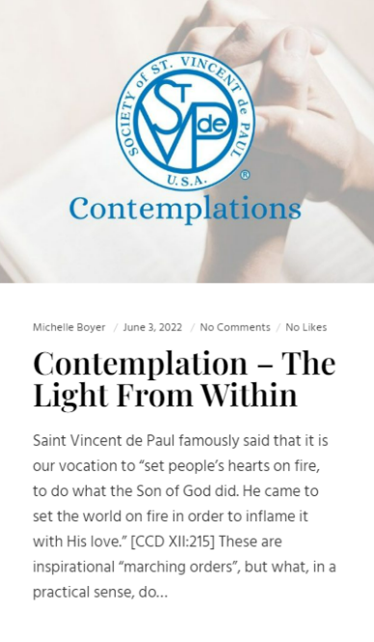

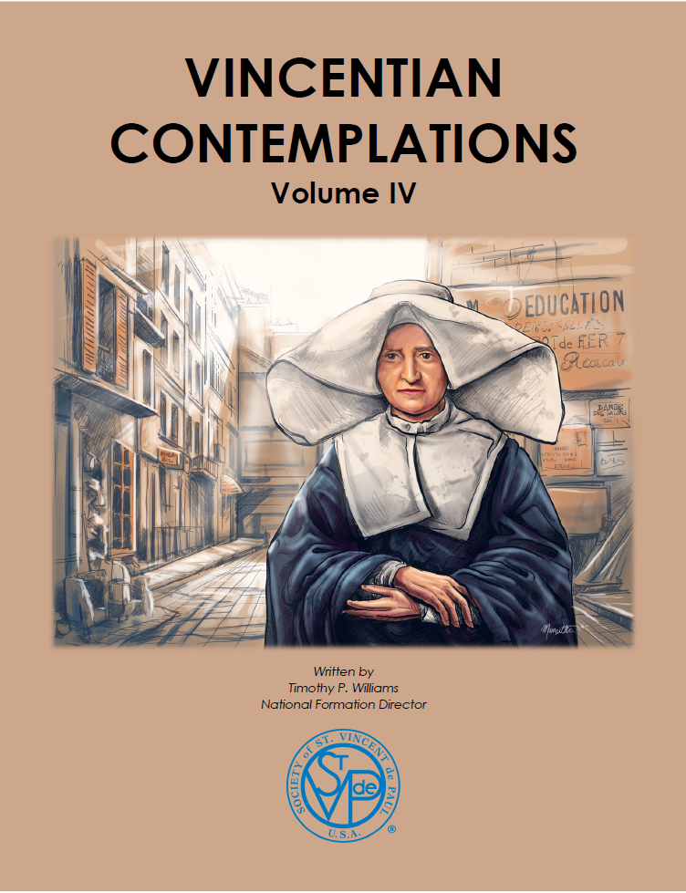


Contemplations

Slide 32
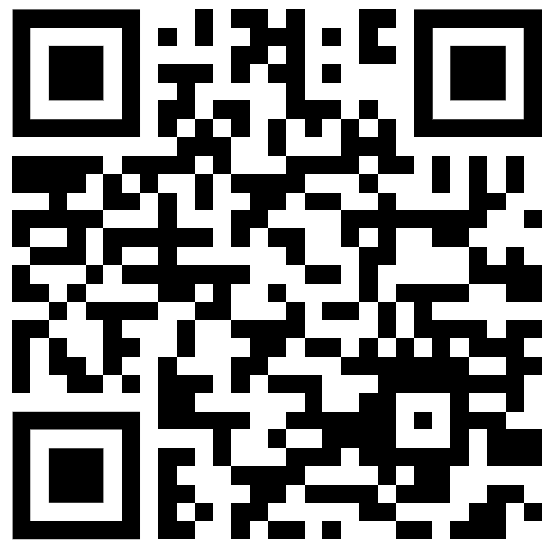
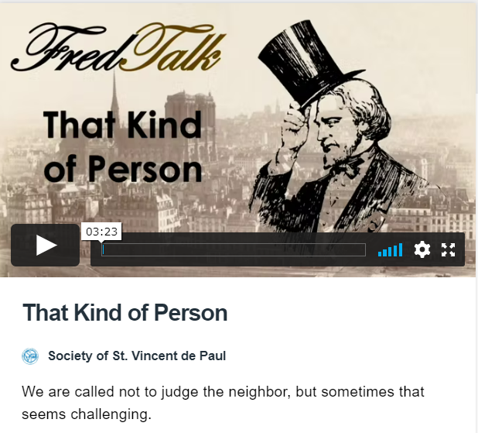
Fred Talks
https://vimeo.com/showcase/6978890

Slide 33
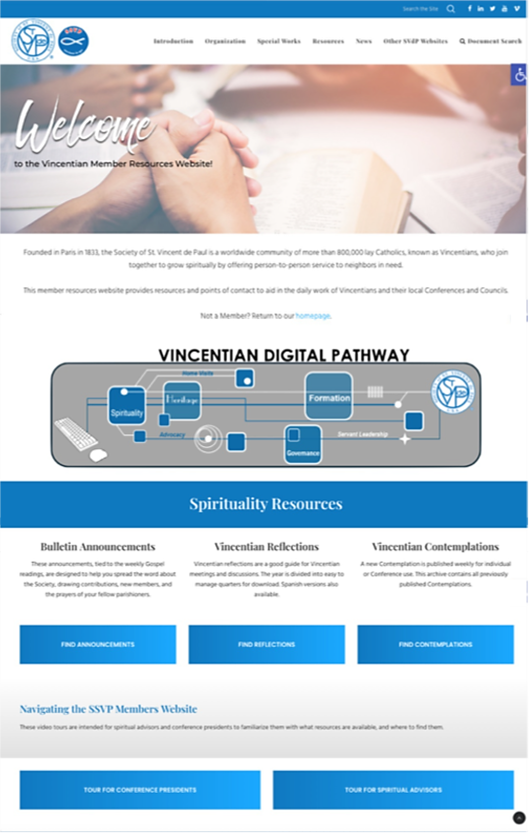
Digital Resources

Slide 34
WRAP UP and CLOSING PRAYER

Slide 35
QUESTIONS
?

Slide 36

Closing Prayer
Noble Saint Vincent de Paul,
beloved servant of the poor,
may we follow your example and do good works
among those whom society has abandoned,
enslaved, or forgotten.

Slide 37
Closing Prayer
Inspire us to feed the hungry,
to love a child,
to provide comfort and medicine to the sick,
to clothe those whose garments are threadbare,
and to offer hope and our Lord's words
to all who need respite.

Slide 38
Closing Prayer
Pray for us to our beloved God
that we may commit ourselves selflessly
to doing the same charitable acts
that you did all your life.
Intercede with Him
that we may have the favor of His guidance
and strength and love upon this important and meaningful work.

Slide 39


