Slide 1

SERVING HOMELESS NEIGHBORS
Christa Frye, Council Casework Manager,
Mariel Risner-Sivley, Director of Housing

Slide 2
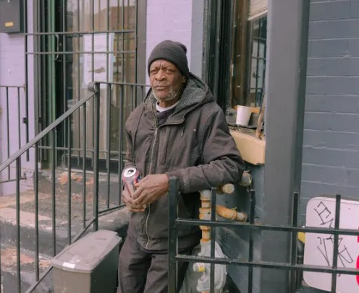
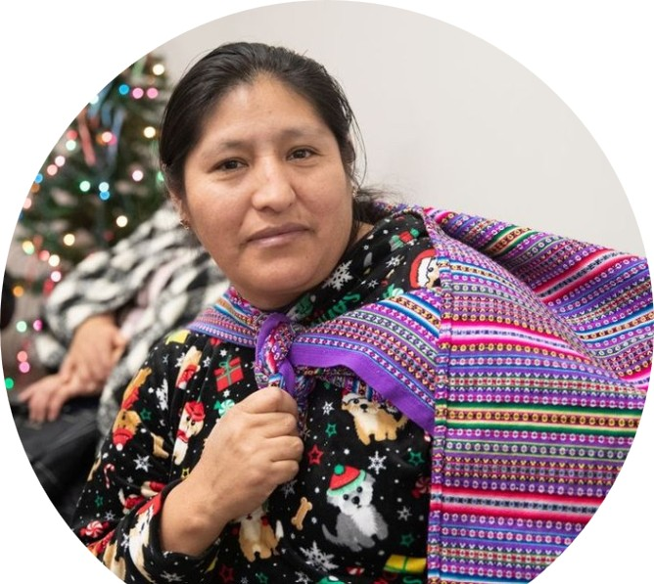
Who are our Unhoused Neighbors?
Homelessness is an experience- not a defining trait
People experiencing homelessness are all around us- in the grocery story, a parking lot serving us at McDonalds, or on a street corner.

Slide 3

Who are our Unhoused Neighbors?
Single Adults
Children and Families
Domestic Violence Victims
Veterans
Seniors
The Disabled
Unaccompanied Youth

Slide 4
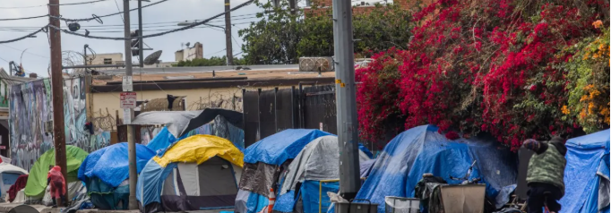
What Causes Homelessness?
High cost of Housing
Low Income
Poor Health
Domestic Violence
Racial Disparities
Many people spend 50% or more of their income on rent
People experiencing homelessness are often working
Mental Illness and Shelter-Living play a role
Women fleeing relationships leave without a plan or savings
Minority groups are disproportionally affected

Slide 5
How is Homelessness Defined by HUD?
Literally Homeless- lack a fixed, adequate nighttime residence
Places not meant for habitation, like cars, parks, abandoned buildings, sidewalks
Public and private shelters
transitional housing
motels paid by programs
Exiting an institution (jail, hospital, etc.) after 90 days or less and they were unhoused beforehand
Imminent Risk of Homelessness
Will lose their residence within 14 days and have no subsequent residence or resources
Homeless Under Other Federal Statute – requires specific approval to use HUD CoC funds
Fleeing/Attempting to Flee Domestic Violence and hae no other residence or resources

Slide 6
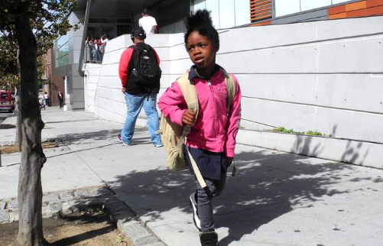
How is Homelessness Defined by other Laws?
McKinney-Vento* Act Definition:
Includes the HUD definition of homelessness and further expands the definition to include people living doubled up, couch surfing, or living in an extended stay motel for which they are paying, campgrounds, and substandard housing.
*McKinney Vento is a federal law that provides important educational rights and services to PreK-12 children and youth experiencing homelessness.

Slide 7

Serving Unhoused Neighbors: It’s Complicated
Intake: Keep It Conversational
Where are they residing currently?
How long have they been there?
Individual or family? How many and what are their ages?
Is anyone in the family working, or have another source of income such as unemployment, SSI or Disability?
Are children in school?

Slide 8
Serving Homeless Neighbors: It’s Complicated
Unhoused Family Casework: Dive in
Recommendation: Use a standardized assessment tool in your conference to serve unhoused neighbors
(example: VI-SPDAT indicates recommended intervention – diversion, rapid rehousing, supportive housing)

Slide 9
Serving Homeless Neighbors: It’s Complicated
Unhoused Individual Casework Checklist:
Questions to Ask:
Basic demographic information (age, gender, race/ethnicity)
Current living situation (e.g., homeless, temporarily housed, living with friends or family)
History of homelessness (how long homeless, previous episodes of homelessness)
Household composition (number of adults, children, any disabilities)
Income and employment status
Health status and access to healthcare services
Substance use and mental health history
Needs assessment (food, clothing, shelter, transportation, employment assistance, etc.)
Social support network (family, friends, community resources)
Any history of domestic violence or abuse

Slide 10
How to access Federal/State resources?
What are CoCs?
A Continuum of Care (CoC) is a HUD-designed local planning body that coordinates housing and services for homeless individuals and families.
What is Coordinated Entry?
A HUD-designed process for unhoused neighbors to access resources. It uses an assessment tool to align interventions.
Who Is it For?
Neighbors who meet the HUD definition of homeless

Slide 11
How to access Federal/State resources?
There are 9 CoCs in GA
Balance of State
City of Atlanta
Fulton County (excluding Atlanta)
Athens-Clarke County
Augusta-Richmond County
Columbus-Muscogee/Russell County
Marietta/Cobb County
Savannah/Chatham County
DeKalb County (excluding Atlanta)

Slide 12
How to access Federal/State resources?
LINK to each CoC:
https://dca.georgia.gov/affordable-housing/homelessness-assistance/georgia-balance-state-continuum-care/i-am-homeless-and
HomeFirst Gwinett - https://thelaa.org/gwinnett/
Shower resources: First Thursday of the month at the CSC

Slide 13
Family Stability Funding available for Conferences
Family Stability Matching Fund
Georgia Rehousing Initiative
svdpgeorgia.org/family-stability-matching-fund
Up to $500 per family for hotel stays
$1-for $1 Match from Council to double the length of stay
Homeless family with
at least 1 child under 18
Council reimburses the Conference
svdpgeorgia.org/gri
Up to $2000 provided for move-in costs associated with Lease
Homeless family with
at least 1 child under 18
Has approved welcome letter
At least 1 household member earns any type of income
Transfer case to Council
Notes:
LISA

Slide 14
Family Stability Matching Fund:
$250,000 available for Conferences
What is the Matching Fund?
Offers support for Conferences providing direct aid to homeless families including shelter, housing and wrap-around support.
How do we define Homeless for this purpose?
Families who do not have a permanent home are considered to be homeless. That includes those who are in motels, couch-surfing, in a car, or emergency shelter.
What type of aid is eligible for matching funds?
Aid that provides emergency services and immediate relief for homeless families is eligible for matching funds. This includes motel stays, transportation-related aid, and storage unit fees. Other forms of aid may be considered, provided it serves as an immediate stabilizing resource.
Notes:
LISA

Slide 15
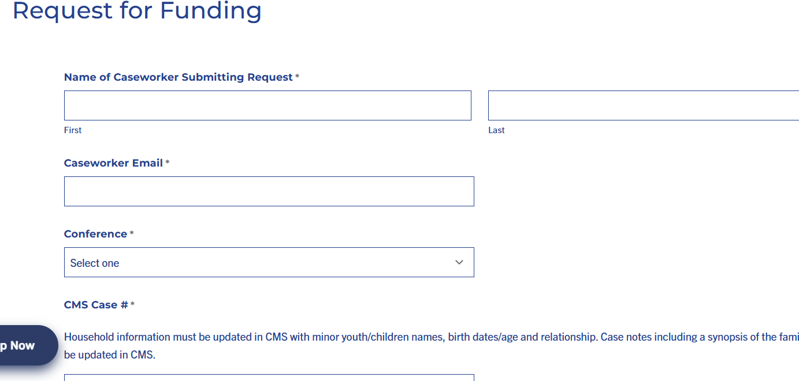
Family Stability Matching Fund
How does the grant work?
Conferences make a request by webform for a match of direct aid that is planned to support a homeless family, up to $500 per family.
svdpgeorgia.org/family-stability-matching-fund
Notes:
LISA

Slide 16
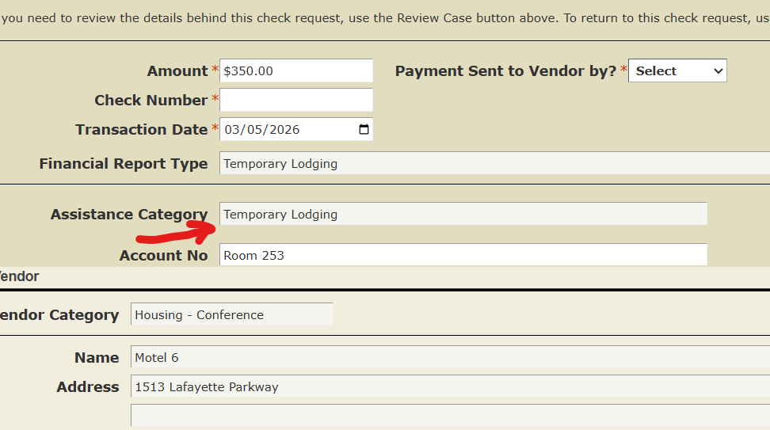
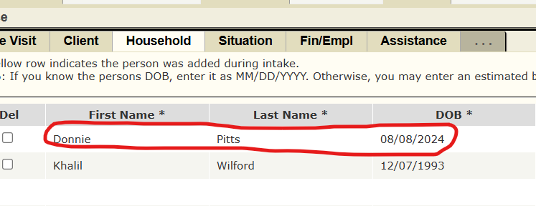
Family Stability Matching Fund
What is required to show that aid is “planned?”
A CMS case must be opened with case notes, household information populated and a check request submitted to the Conference Treasurer. The check request can be open or show as “paid.”
Notes:
LISA

Slide 17
Family Stability Matching Fund
Can Conferences apply for reimbursement of past aid for homeless families?
No. We ask that this Family Stability Matching Fund be used for current and future casework. This Fund is an encouragement for Conferences and Council to work together to serve more homeless families, not to reimburse for past services.
Will Council pay vendors directly?
No. The Matching Fund is a cash transfer by ACH to Conferences, allowing for expanded aid to homeless families.
How much funding can I request per family?
Conferences may apply for a up to $500 of matching aid per family.
How quickly can Conferences expect funding to be received?
Conferences can expect to have funds in their account within a week to 10 days of submitting the request. If Council identifies an issue with the request or if more information is needed, we'll reach out in 3-5 days.
Notes:
LISA

Slide 18
SVdP's Georgia Rehousing Initiative (GRI):
$150,000 available for conference referrals
What is the Georgia Rehousing Initiative?
GRI provides up to $2,000 of rehousing expenses for move-in costs, including apartment deposit and first months' rent for homeless families who are transitioning to permanent housing.
Who is eligible?
Families with a minor child who are currently homeless but have income available to sustain permanent housing are eligible. This may include income from SSI (Social Security) SSDI (Disability), retirement plans or employment.
What gap are we trying to fill for families with available income who have not been able to secure housing?
Hefty deposit fees and move-in costs are typical barriers to securing permanent housing. This program provides support for those expenses.
Notes:
LISA

Slide 19
SVdP's Georgia Rehousing Initiative (GRI):
How do I refer a family for this program?
Complete the referral webform to refer a family to the Council office:
https://svdpgeorgia.org/gri/
Will Conferences need to fully vet families who may be eligible for this program?
No. Conferences refer families whom they believe may be eligible based on their knowledge of the family’s situation. Council caseworkers will contact the families and request additional information to determine if they are eligible for this or another Council program.
How will Conferences know if their neighbors have been approved for the program?
Council will work independently with the families who have been referred to this program; Vincentians are welcome to reach out to Vincentian Services staff at gri@svdpgeorgia.org if you would like more information on the status of the referral.
Notes:
LISA

Slide 20
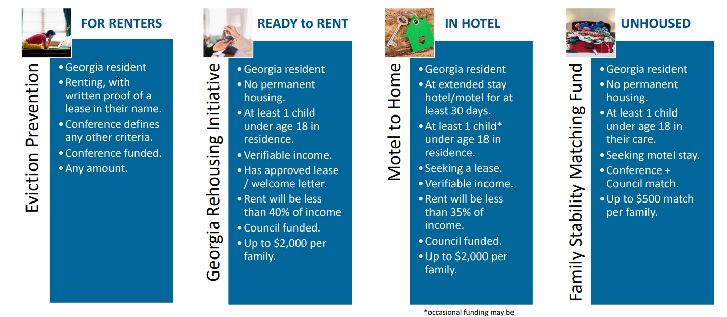
SVdP GA Housing Program Overview

Slide 21
Questions
Christa Frye, Council Casework Manager, cfrye@svdpgeorgia.org
Mariel Risner-Sivley, Director of Housing
msivley@svdpgeorgia.org

