Slide 1

JUST ASK &
WHO’s NEXT?
Christine McCarthy,
National Committee on
Membership & Leadership

Slide 2
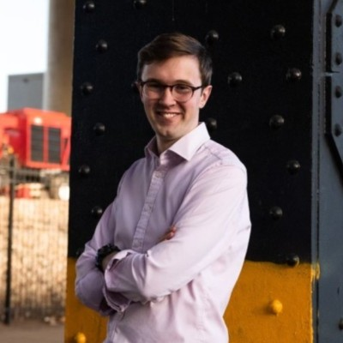
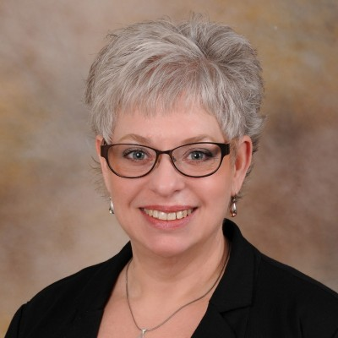
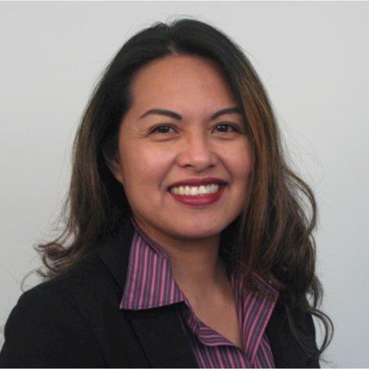
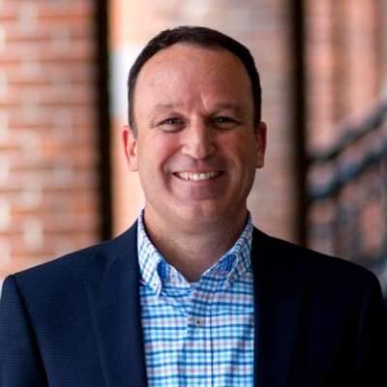
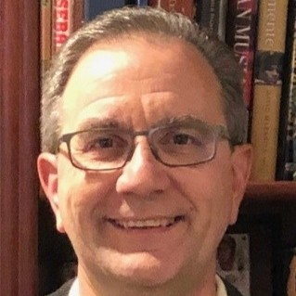

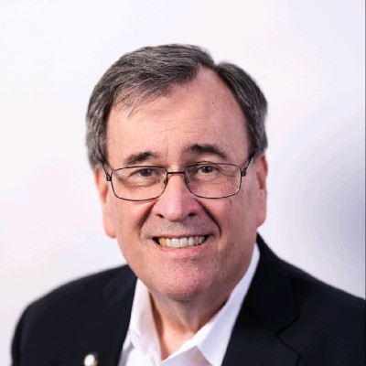
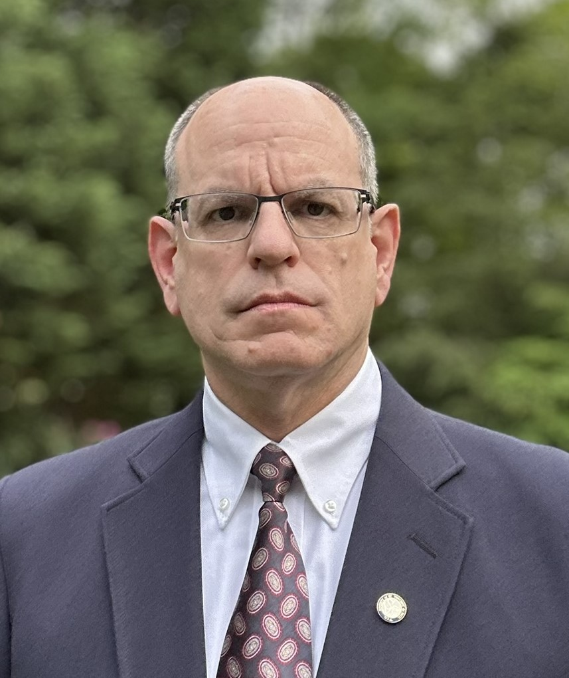
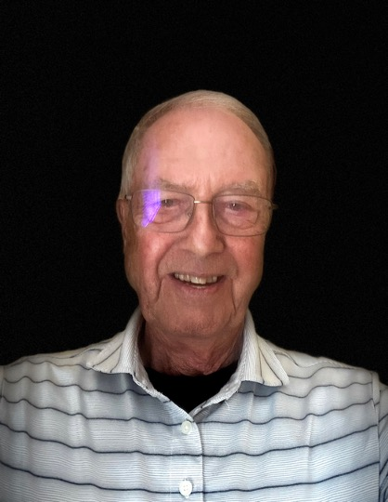
Who is the MGLD Committee?
Youth & Young Adults
Vincentian Leaders
Council Leadership
National Board Members
Regional leaders from NE, SE, SW, MW, NW
Commercial Leaders

Slide 3
Mission | Vision | Charter
Mission: With the inspiration and support of our Clergy, a growing # of servant leaders in Catholic communities across the United States identify The Society of Saint Vincent de Paul as their vocation, have the knowledge and tools needed to excel, and are engaging increasingly at the Conference, Council, and National level.
Vision: A bench of engaged Vincentian leaders ready to serve neighbors in need at Conference, Council, Regional, and National level
Charter: The Member and Leadership Development Committee of the National Council Board of Directors is charged with defining best practices for membership growth, onboarding processes, spiritual enrichment, and identifying and advancing Vincentian leadership in a society and Catholic church that is changing rapidly.

Slide 4


Our Goals
Add 10,000 new members
Create a culture of mentorship

Slide 5
Membership In Decline
We are down 13% over the past 5 years. We have 12,000 less Vincentians today than we did in 2019.

Slide 6

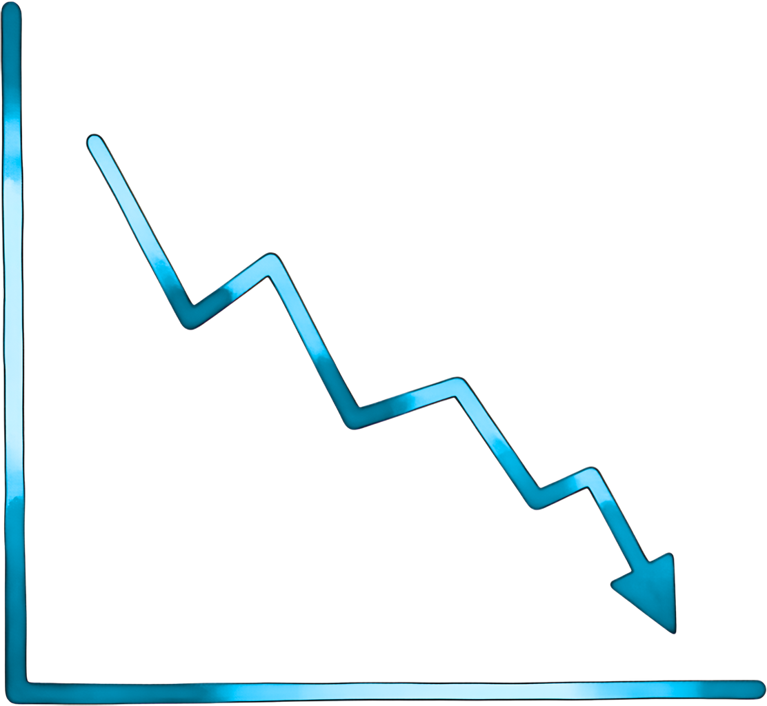



Purpose
Membership is down
Leadership void
Time for new ideas
Jesus is challenging us, just as he did with the apostles - go out and spread the word - in our case, the Vincentian transformation through encounter
Society of St. Vincent de Paul
National Council of the USA

Slide 7
Just Ask! | Who’s Next?
National Vice President: Sean Myers (Dallas, TX)
Chairperson: Alec Jewell (Cincinnati, OH)
Membership Growth
Leadership Development
Chair: Christine McCarthy (Wausau, WI)
Objective: Add 10,000 new members
Tactic: “Just Ask”
Measure where we are today
Every Vincentian to ask just 1 person to join
Make it fun and “Game-ify” it
Chair: Doug DeCosta (Cape Cod, MA)
Objective: Establish a culture of mentoring
Tactic: “Who’s Next"
Succession Planning
Advance partnership with our Clergy
One day annual leadership retreats
Advancing Diversity (Multicultural | Age | Location)

Slide 8
Membership Growth
Goal: 10,000 New Members through “Just Ask” campaign
Implement the “Just Ask” Campaign
Regional Meetings + Thursday Workshop
Launch Just Ask Scorecard Site
https://svdpjustask.com/
Action Next 6 Months:
Recruit & engage regional volunteers to champion
Present at every Region Meeting
Push out the presentation & program highlights & challenge to all Conferences
Benchmark the Membership Database
National Assembly Marketing & Recognition
Add 2-3 new members per Conference
Core part of “Just Ask” is measurement
Add 20 new youth & young adult Conferences
Partner with Youth & Young Adults

Slide 9
Leadership Development
Goal: Foster a thriving ”Culture of Mentorship” through Who’s Next campaign
Build effective succession plans to ensure enduring mission impact, addressing leadership turnover (Rule 3.14).
Ignite passionate leadership through mentorship across all levels, empowering Vincentians to guide others confidently (Rule 3.10).
Amplify service impact by equipping Vincentians with mentorship-driven skills for compassionate outreach (Rule 7.2).
Action Next 6 Months:
Recruit & engage regional volunteers to champion
Succession Plan in place at every Conference
Launch One-Day Annual Leadership Development Retreat
Promote the leadership webinars, retreat, regional & national meeting attendance
Lead the Leadership Training breakout at National Assembly
Finalize & Initiate Clergy Campaign

Slide 10

National Marketing Program
See the Face of Christ.
Be the Face of Christ.
10,000 new members
Introduced 2024
Brought in an estimated 500+ new Vincentians

Slide 11

The most effective way to grow conference members
At the National meeting we asked 200 participants in a membership workshop how they came to join SVDP
80% said they were asked by a Vincentian!
This led to our new membership Campaign:
“Just Ask”
For this campaign to be successful we needed it to be:
Simple
Doable
Finite
Trackable
Inclusive
and FUN!!

Slide 12

“Just Ask”
What is the “Just Ask” Campaign?
It is the program to bring 10,000 new members into the society by Sept. 30, 2026.
How does it work?
We want every Vincentian to “Just Ask” one person to join the Society this year.
Just Ask one person!

Slide 13
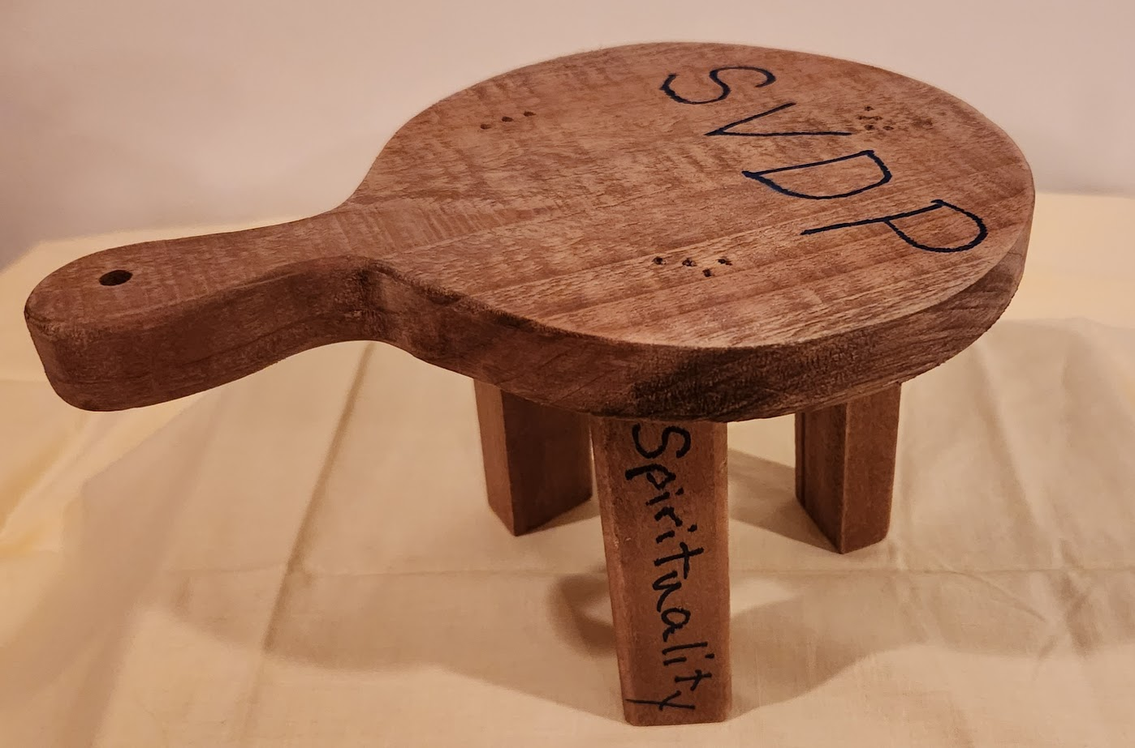
BEFORE YOU EXPECT OTHERS TO JOIN YOU NEED TO ASK YOURSELF WHY DID YOU JOIN?
The 3 basic tenets of being a Vincentian are:
Spirituality
Friendship
Service to the Poor

Slide 14
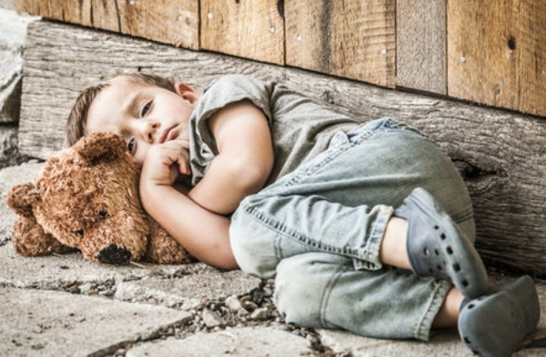
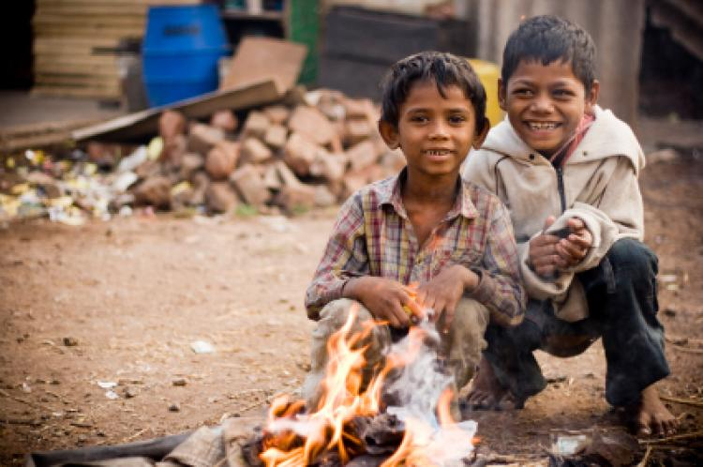
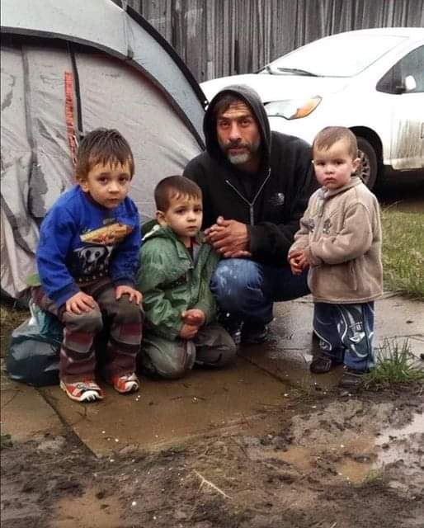
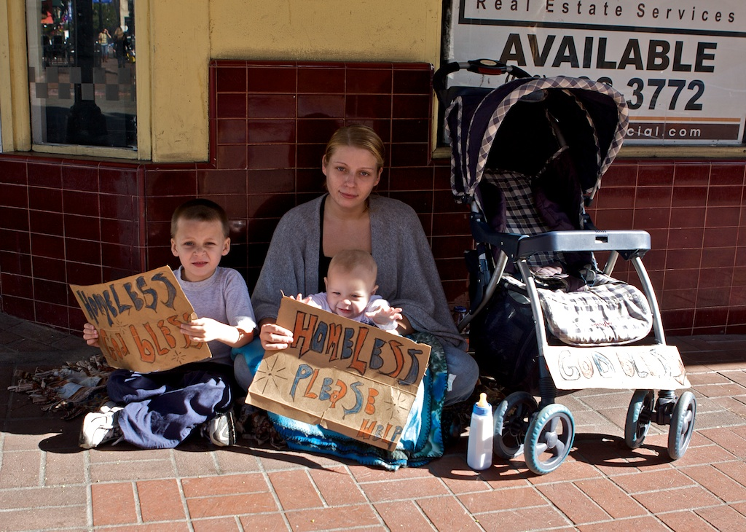
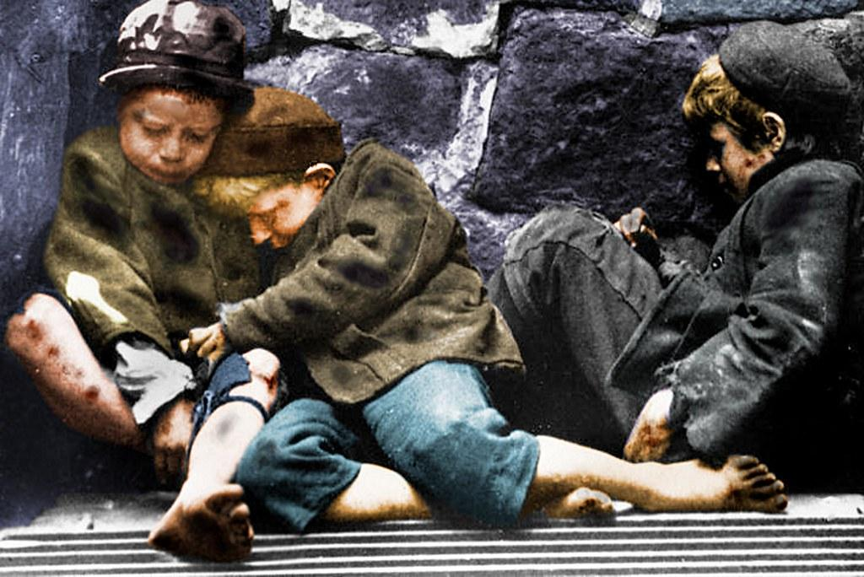
MOST ANSWER “I JOINED TO HELP THOSE LIVING IN POVERTY”
This Photo by Unknown Author is licensed under CC BY-NC-ND

Slide 15

MOST STAY
Spiritual enrichment of seeing and being the face of Christ
Friendships developed with other Vincentians & Neighbors
Serving our friends and neighbors who live in poverty

Slide 16
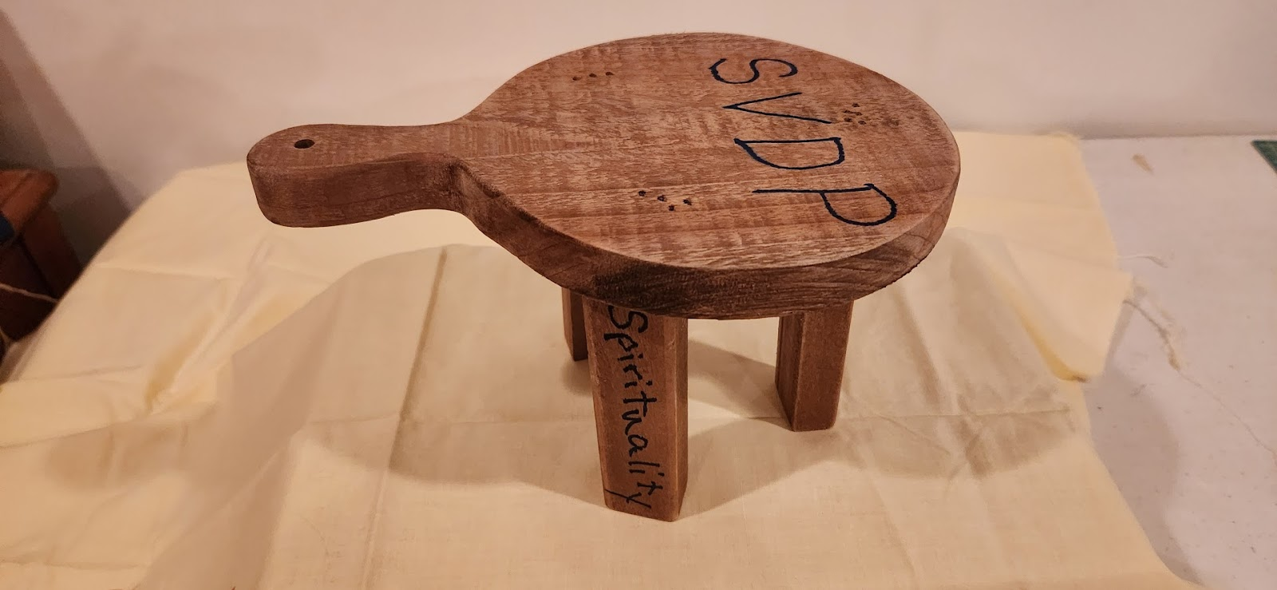
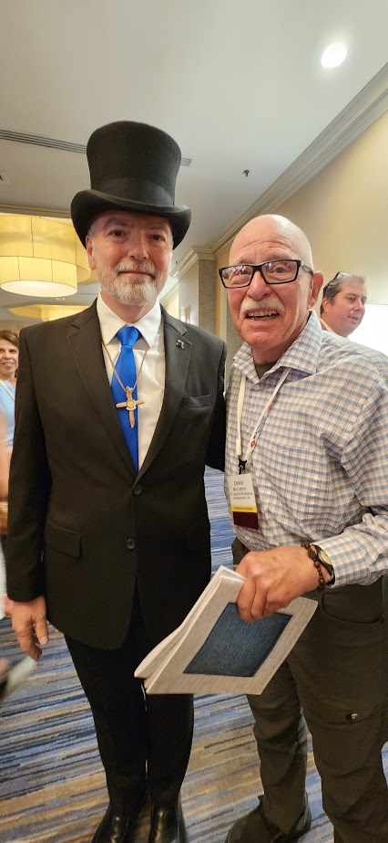
SPIRITUALITY ON THE CONFERENCE LEVEL: 1. GO TO MASS TOGETHER. ESPECIALLY ON VINCENTIAN FEAST DAYS 2. GOSPEL REFLECTION AT MEETINGS 3. USE THOUGHT PROVOKING PRAYERS FOR OPENING AND CLOSING MEETINGS 4. USE MUSIC 5. PASS THE CRUCIFIX! VERY POWERFUL ON THE DISTRICT LEVEL: 1. SPIRITUAL RETREATS WITH BIG NAME SPEAKERS 2. MASS AT DISTRICT COUNCIL MEETINGS 3. ALWAYS BEGIN WITH A SPIRITUAL REFLECTION BE CREATIVE AND BE BRAVE….JUST ASK!

Slide 17
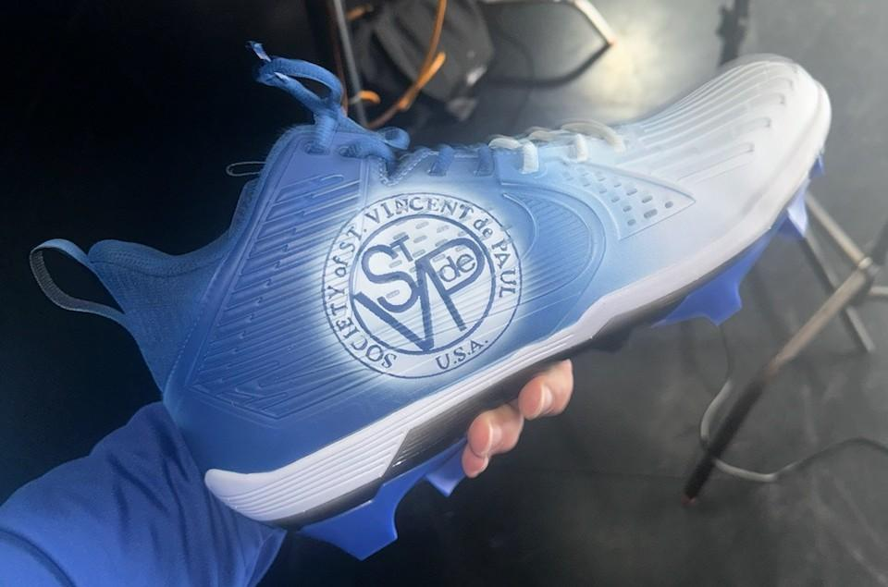
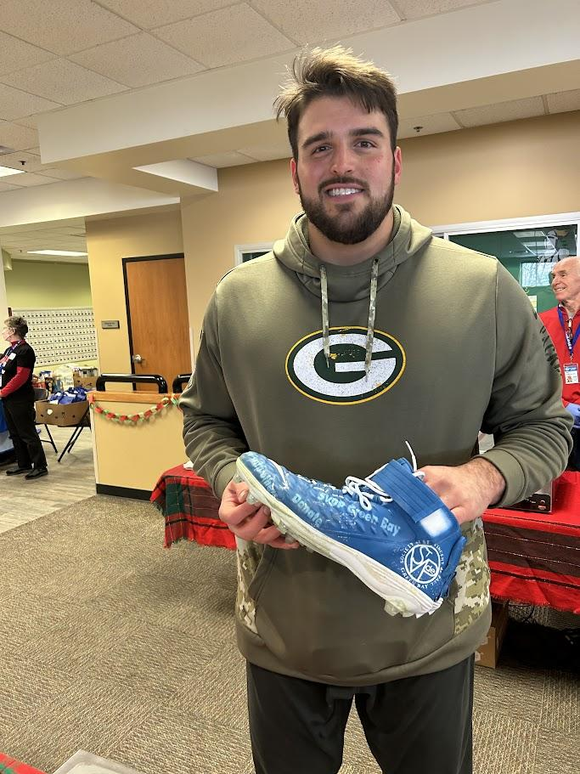
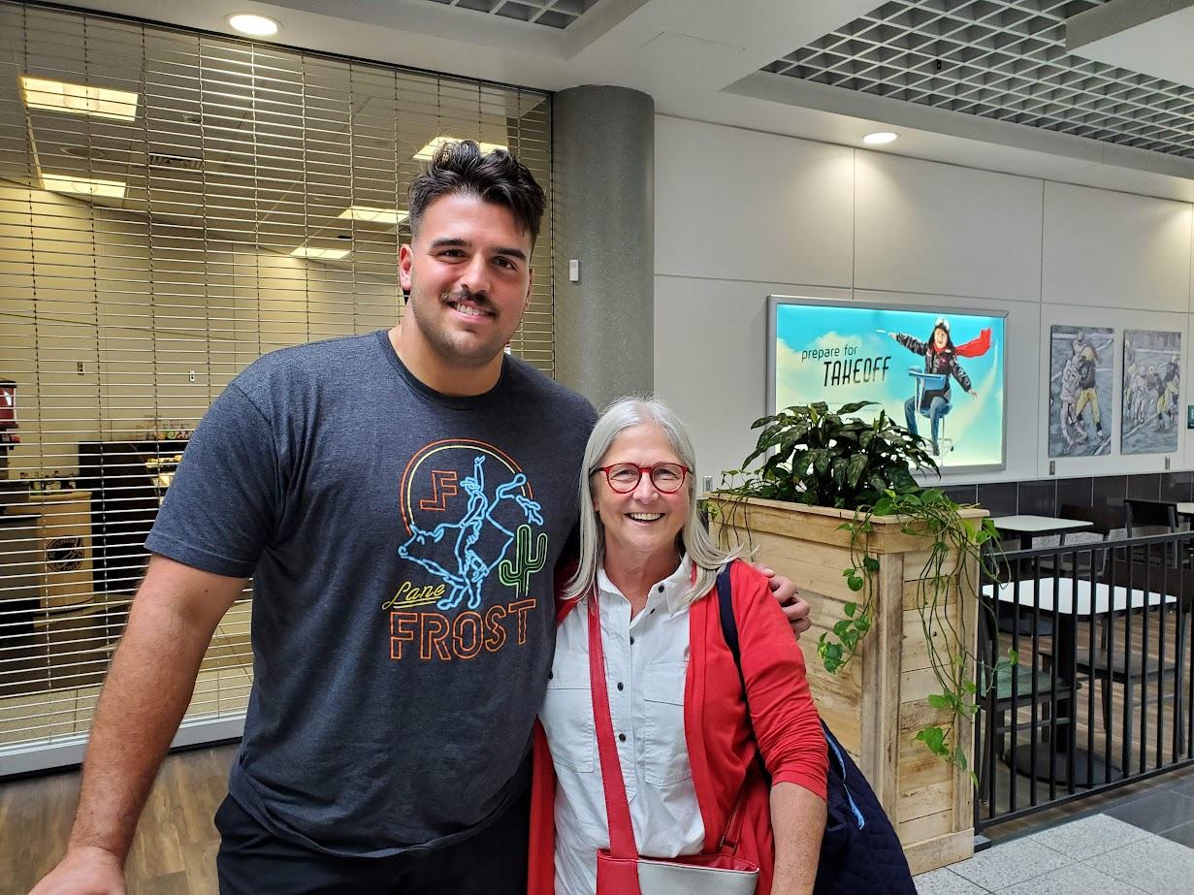
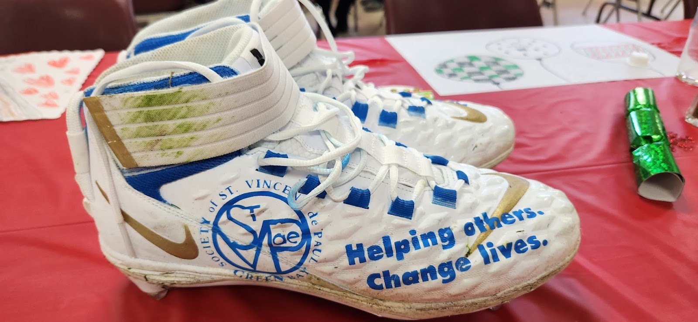
FRIENDSHIP YOU NEVER KNOW WHO WILL SAY YES TO YOUR ASK! I ASKED GREEN BAY PACKER JON RUNYAN TO HELP OUT OUR SVDP DISTRICT COUNCIL WITH OUR EVENTS AND HE SAID YES. HE SAID HE WAS LOOKING FOR A WAY TO GIVE BACK AND NOW HE KNOWS THIS IS IT! HE ALSO DID “MY CLEATS, MY CAUSE” FOR SVDP GREEN BAY, 3 YEARS IN A ROW! BE BRAVE….JUST ASK!

Slide 18
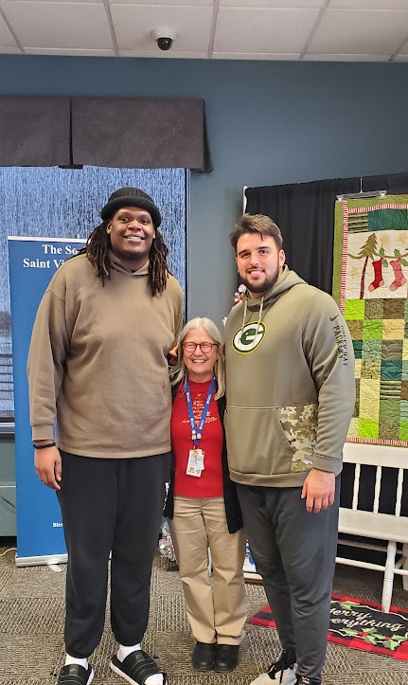
Amazing things can happen when you: You change their lives but they also change yours!
“Just Ask”

Slide 19
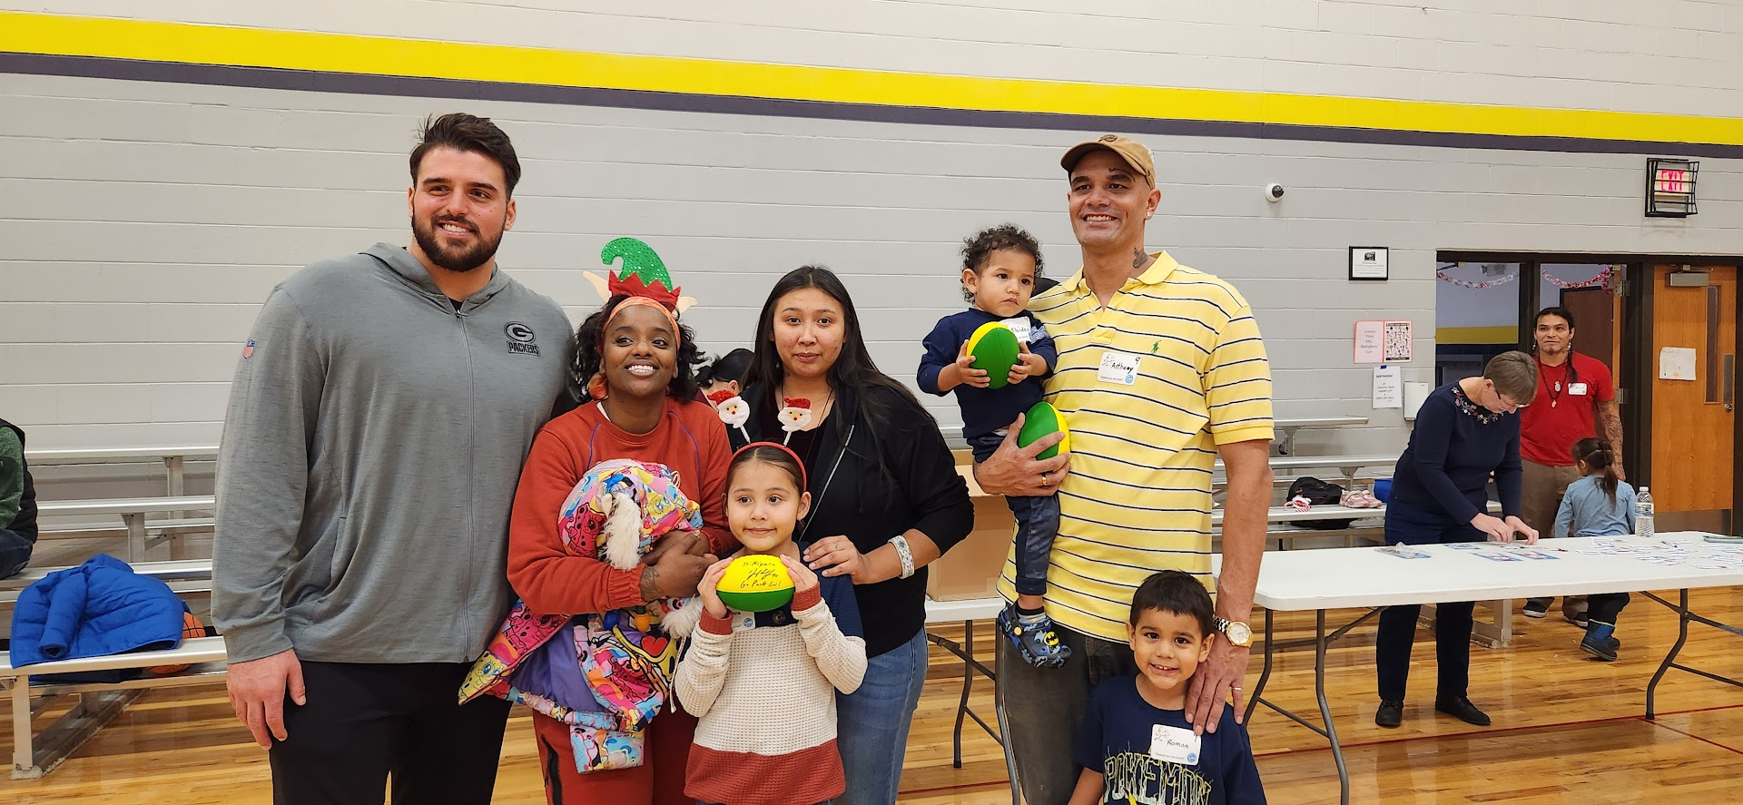
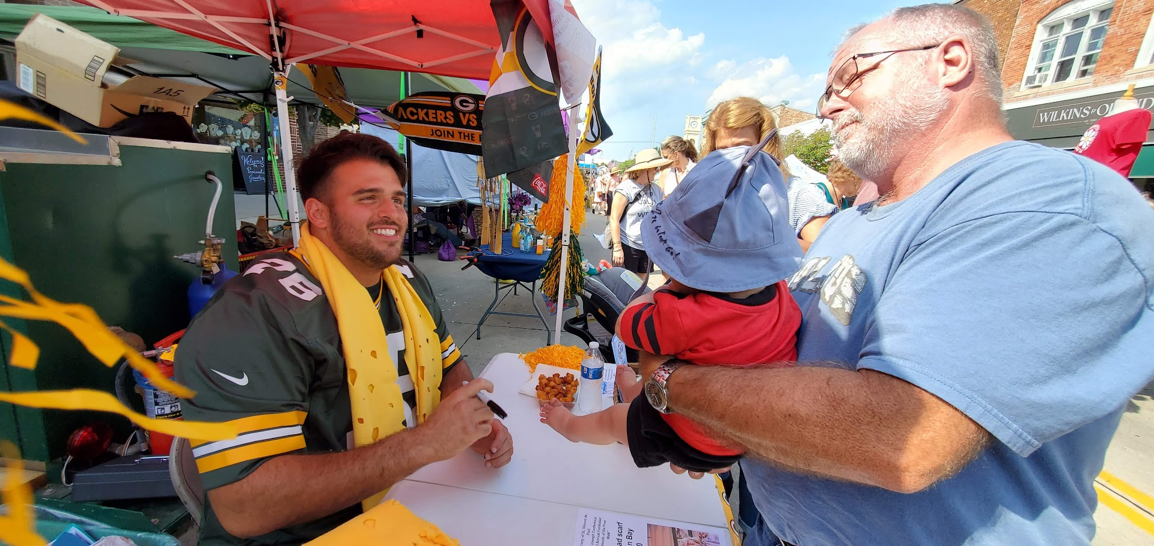
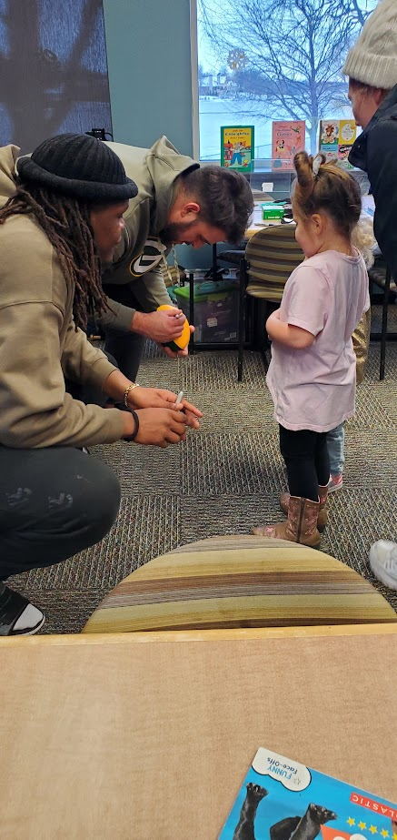
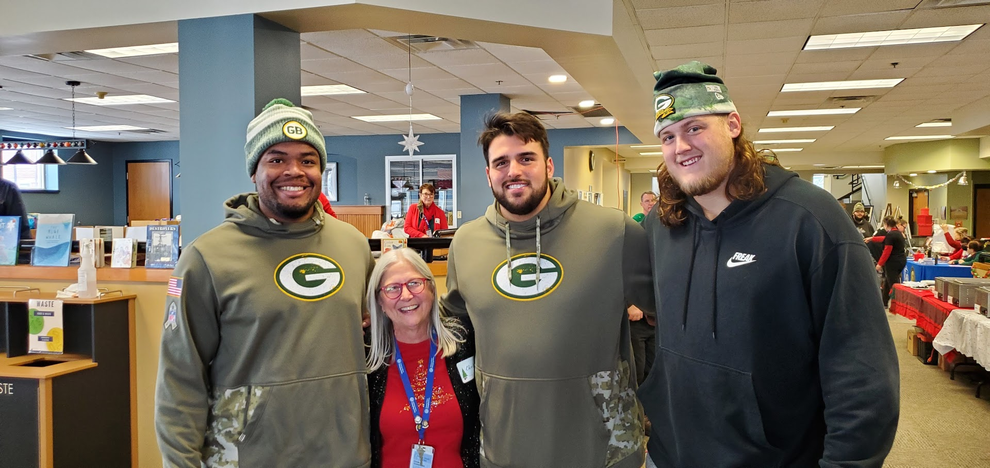
We took full advantage of his Yes. And our District Council came together to put on a great event for the homeless families in Green Bay in December, two years running. Called Believe You are Loved!! Never be afraid to beg for the Poor! Or ASK!

Slide 20
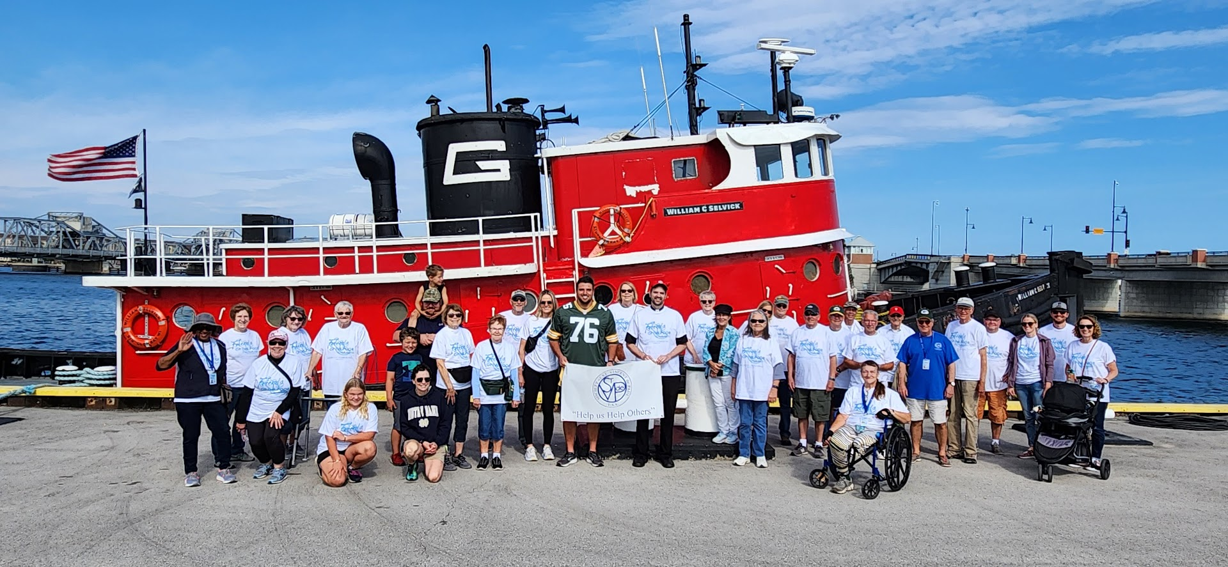
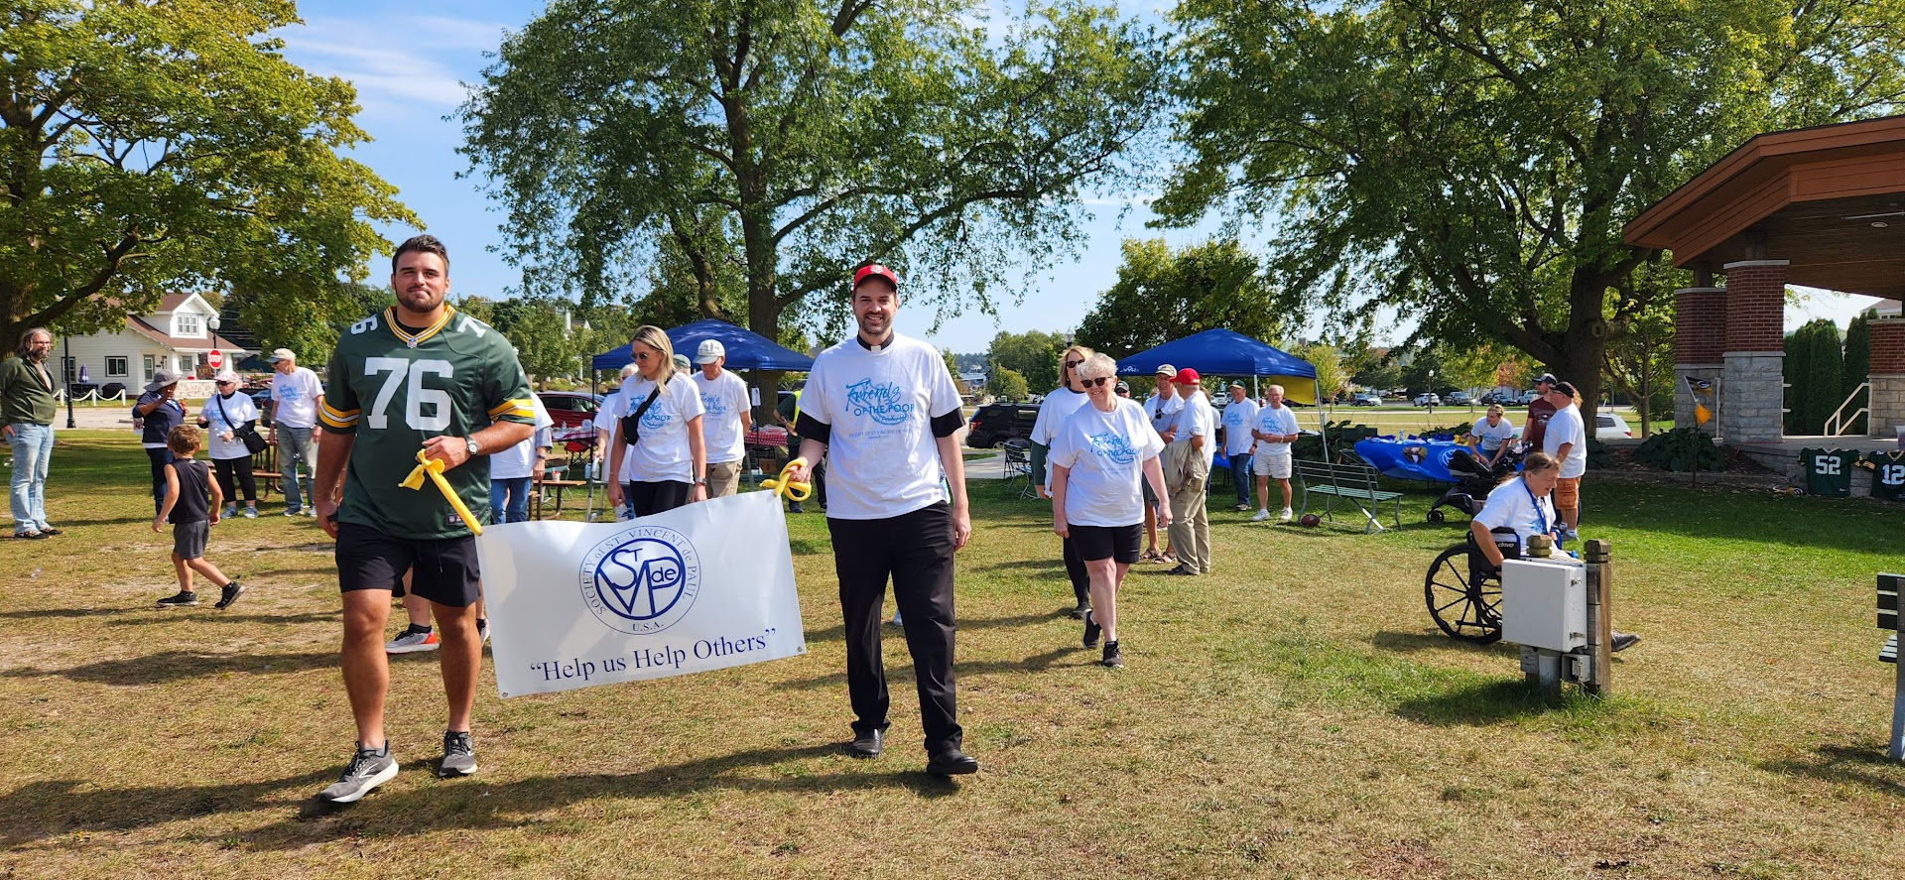
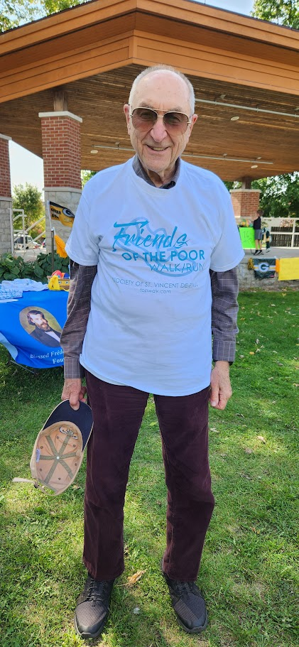
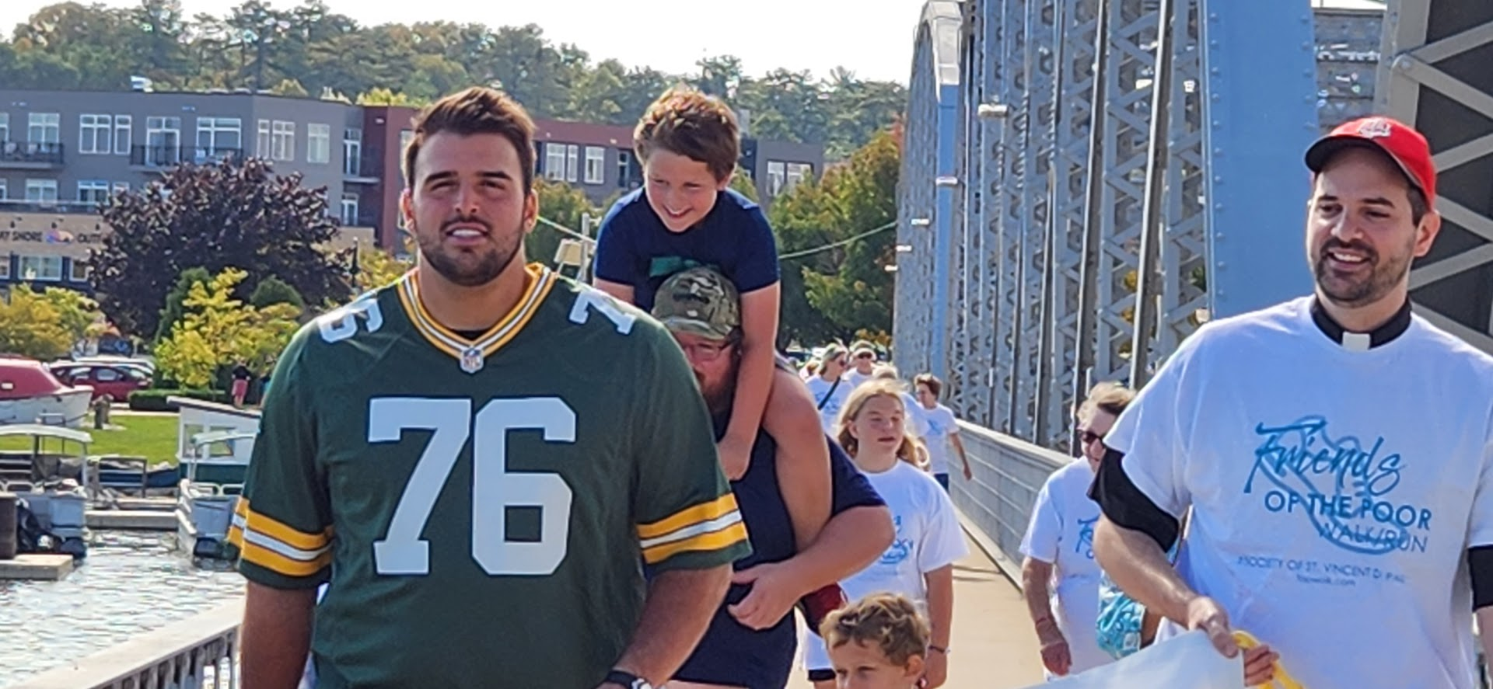
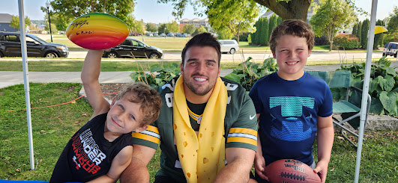
Friends of the Poor Walk 2023

Slide 21


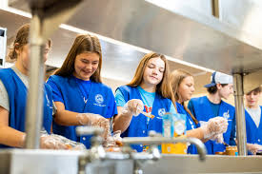
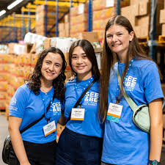
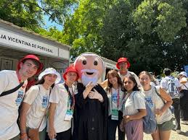
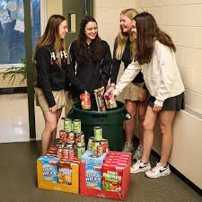

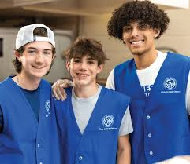
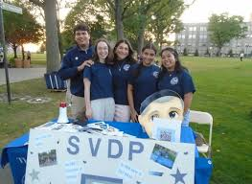
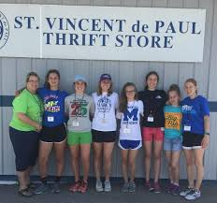
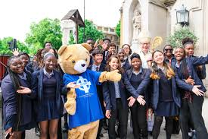
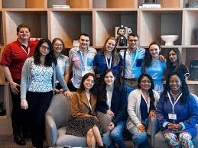
We need youth, young adults & diversity
Young adult church attendance has nearly doubled since 2020
Young people are actively seeking purpose, community, and meaning

Slide 22
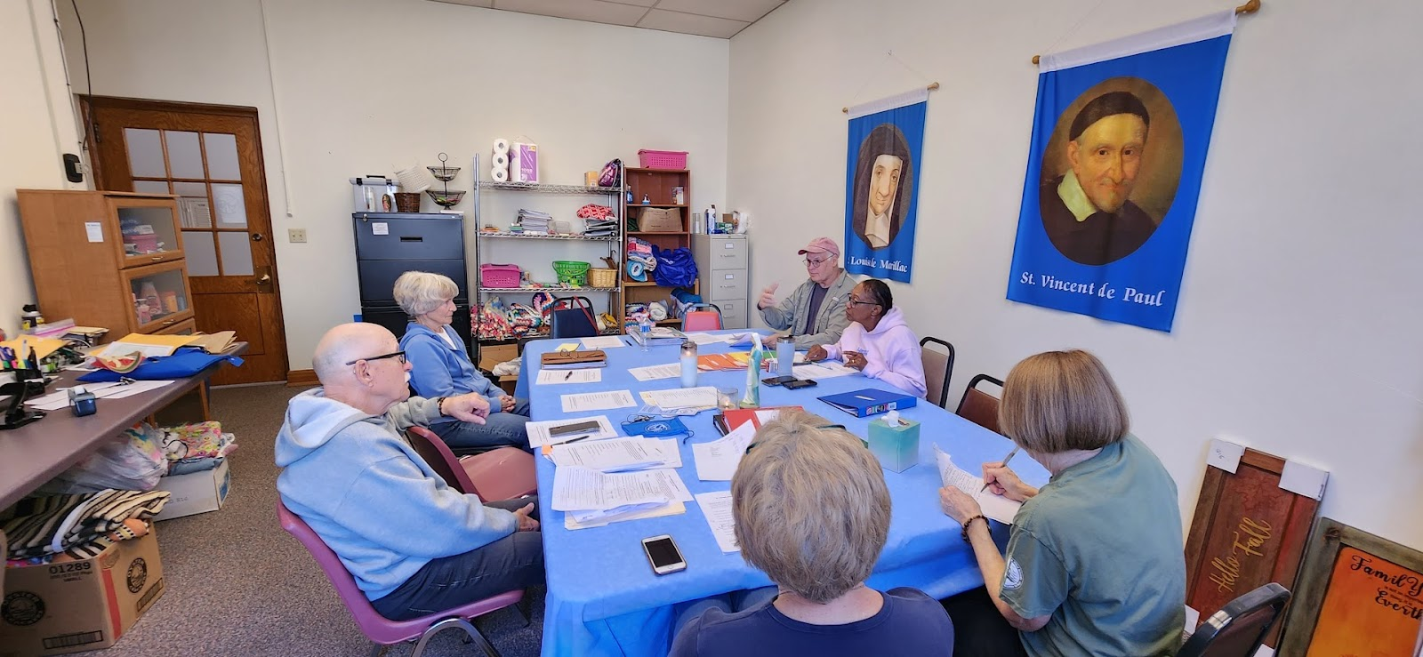
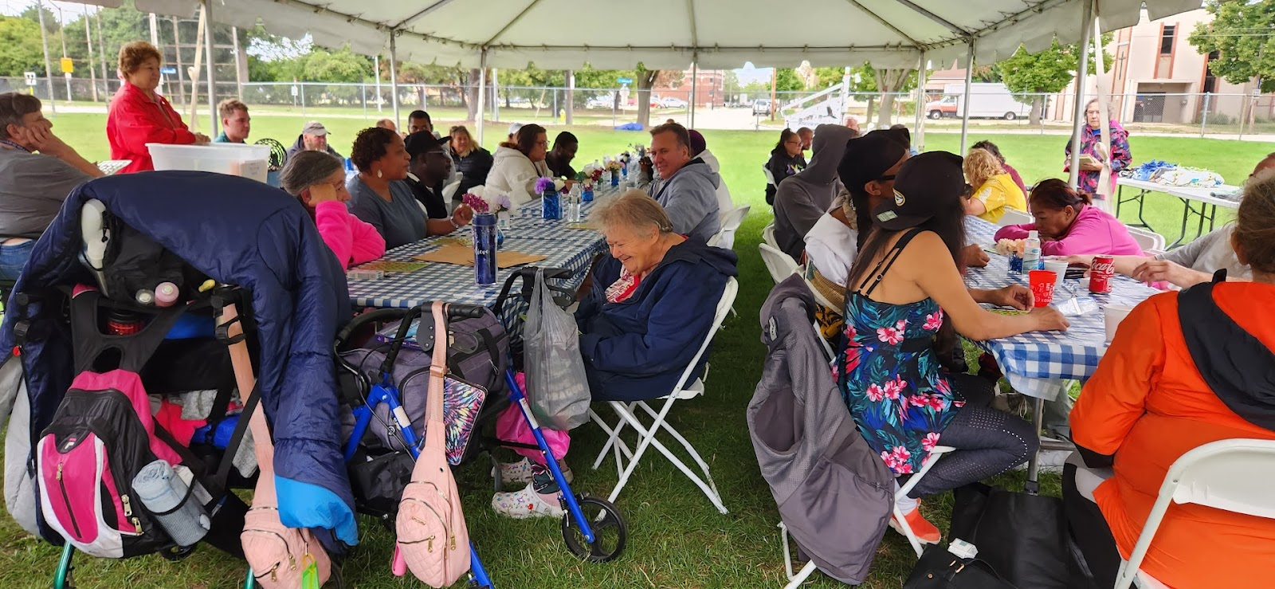
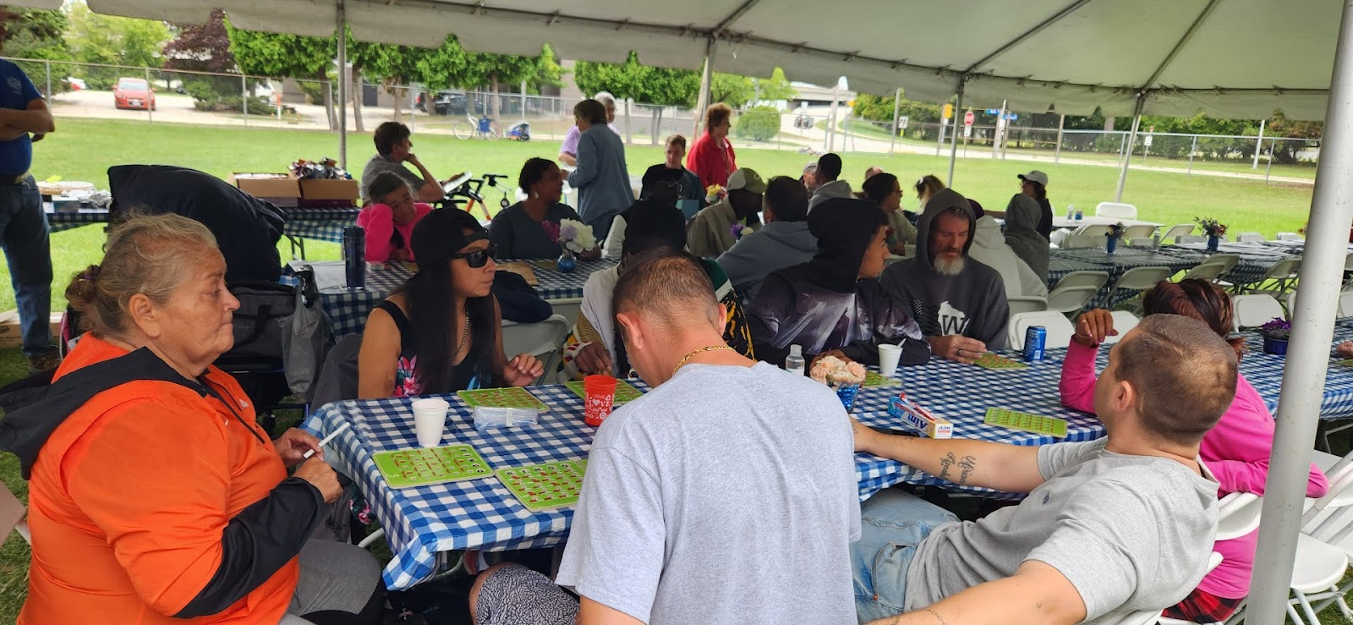
SERVICE TO THE POOR IT BEGINS WITH US GOING TO THEM. THIS CAN NOT BE STRESSED ENOUGH. IN THE RULE IT STATES:“VISITS TO THOSE IN NEED SHOULD BE MADE IN THEIR ENVIRONMENTS.” WE DID 2 EVENTS IN 2023 FOR THE HOMELESS LIVING IN A LOCAL PARK IN GREEN BAY.. THE FIRST WAS A FULL BREAKFAST, LUNCH, SUPPLIES AND GAMES. THE SECOND WAS PIZZA, PIE AND BINGO!

Slide 23
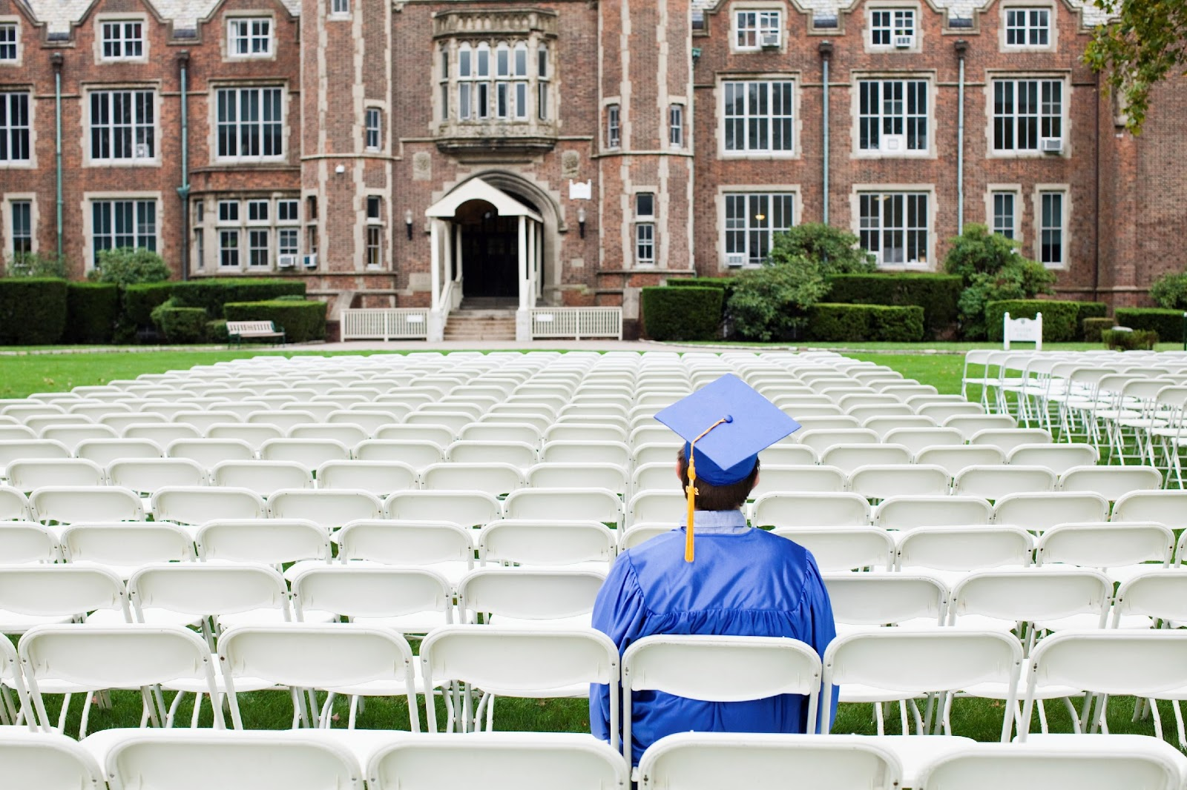

MAKE YOUR CONFERENCE AS STRONG AS POSSIBLE!
There are numerous opportunities for learning!
Ozanam Orientation
Invitation for Renewal
Printed Material
Webinars
Meetings
Serving in Hope formation program
Invitation To Serve
Culture of Welcome
Standards of Excellence
Never Quit Learning!

Slide 24

OK, you ask someone to consider joining SVDP. What now?
You did an Invitation To Serve at Church and have a follow up meeting. What’s next?
Create a Culture of Welcome in your Conference!
Use the National Council Template: Creating a Culture of Welcome
Be flexible on meeting times and activities. (pizza parties, work shifts together at food pantries, stores, shelters, family dinners together…..etc.) Be creative!
Tell them they will see the Face of Christ in the Poor.
Tell them about life changing home visits. Transformative! For both the Vincentian and our Friend in Need. Use personal examples.
Always remember the 3 tenets of SVDP: Spirituality, Friendship and Service to the Poor!!!

Slide 25

So, who do you ask?
Look around you in Church.
Ask your parish Priest or Deacon who he thinks would make a good Vincentian.
If you want to get something done ask a busy person.
Check out the Lectors, Ushers, Eucharistic Ministers, Rel. Ed. Teachers, Knights of Columbus, Confirmation Students!
You only have to find One!
But beware, it could change both your lives!

Slide 26

Give me some of that Wisdom!
Many of our older Vincentians are aging out of home visits.
Does that mean done being active Vincentians? ABSOLUTELY NOT!
Does that mean we stop doing home visits? ABSOLUTELY NOT!
Many opportunities are available to participate:
Conference Officer positions | Call back person | Assist with Annual Reports
Spiritual Advisors
Maintain Conference records | Participate in Conference or Council events
Mentor new members on Home Visits | Caller at Bingo night
Volunteer in the Food Pantry | Make quilts for our FINs,
Put together toiletry kits | Write thank you notes | Pray for us!
The list goes on!

Slide 27
Leadership Development

Slide 28
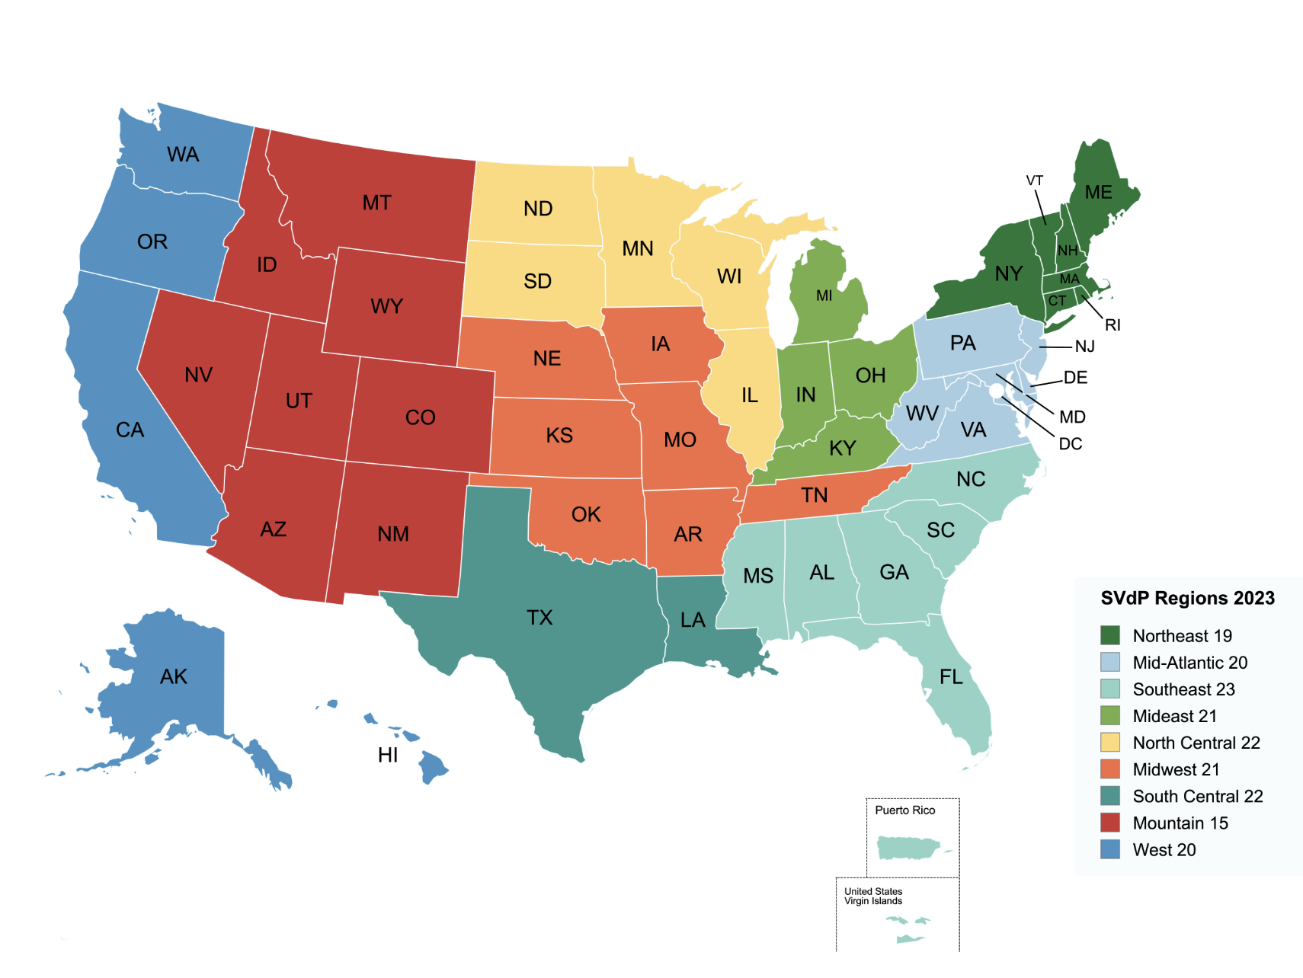
REGIONAL COORDINATORS NEEDED
Sean Myers: VP for MGLD - South Central
Alec Jewell: Committee Chair - Mid-East
Chris McCarthy: Membership Subcommittee Lead - North Central
Doug DeCosta: Leadership Subcommittee Lead - Northeast
Cathy Crisp: North Central
Julie Bennett: Mid-East
Dave Barringer: Mountain
Tom Berg: Clergy Partnership - Southeast
Mirya Roach: West
Rick Opatick: Mid-Atlantic
Tim Williams: Staff Lead - Mid-West

Slide 29
Common Questions and Issues
Throughout the Year:
Governance
Spirituality
Financial
Officer Challenges
How do I…?
?

Slide 30
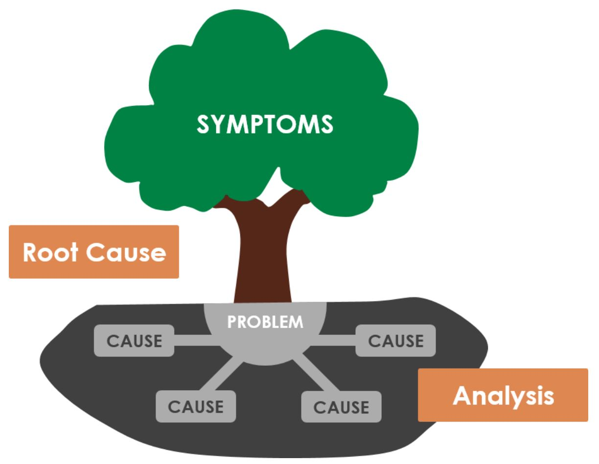
Root Causes of These Questions:
Do not know the Rule
Did not get instructions or advice from local experienced leaders
Never had an orientation or any training

Slide 31



Typical National/Council Responses:
Send an Email
It’s on the website
Attend the National Assembly
Occasional Regional and Council Training
National Mentorship Program

Slide 32
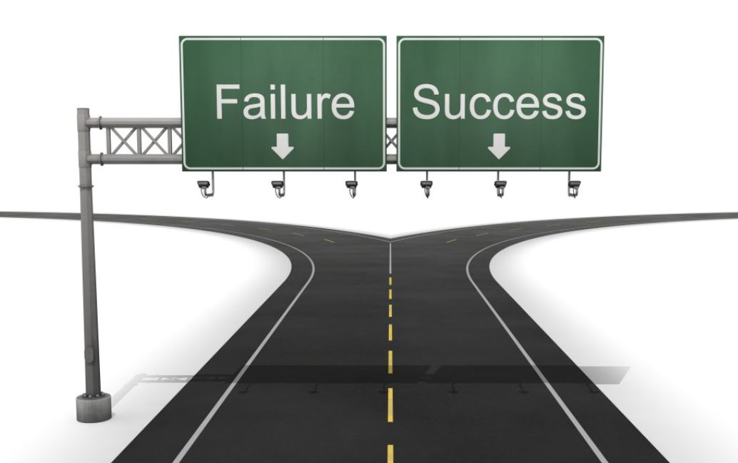
The initiatives outlined in the previous slides have achieved only
partial success or outright failed!

Slide 33

Why does this occur?
Leadership Turnover Crisis
With over 4,000 Conferences and numerous District Councils facing hundreds of annual leadership transitions, SVdP grapples with a persistent leadership deficit that hinders our mission’s momentum.

Slide 34
LET’S ADOPT A NEW APPROACH
TO ENGAGE OUR MEMBERSHIP AND LEADERSHIP MORE EFFECTIVELY!
Change is hard at first, messy in the middle and gorgeous at the end.
– Robin Sharma -

Slide 35


Slide 36
GOAL: FOSTER A THRIVING CULTURE OF MENTORSHIP ACROSS THE SOCIETY
Ignite passionate leadership through mentorship across all levels, empowering Vincentians to guide others confidently (Rule 3.10).
Build effective succession plans to ensure enduring mission impact, addressing leadership turnover (Rule 3.14).
Amplify service impact by equipping Vincentians with mentorship-driven skills for compassionate outreach (Rule 7.2).

Slide 37
SVdP MENTORSHIP: WHAT DOES SUCCESS LOOK LIKE?
Proactive Leadership Mentorship (Rule 3.10): New Vincentians eagerly seek mentorship, confident in guidance, while senior leaders instinctively mentor emerging talent, fostering seamless leadership transitions.
Enhanced Vincentian Collaboration (Rule 3.12): Mentorship builds trust and knowledge-sharing among members, increasing engagement and fellowship, aligning with SVdP’s focus on spiritual growth and community.
Sustained Service Impact (Rule 7.2): Mentorship equips Vincentians with skills and confidence, enhancing compassionate service delivery and supporting systemic change initiatives for those in need.

Slide 38
SVdP OPERATIONS: WHAT DOES SUCCESS LOOK LIKE?
Leadership Development and Continuity (Rule 3.10): Mentorship reduces turnover impact by fostering succession planning, ensuring sustained mission-driven leadership.
Vincentian Engagement (Rule 3.12): Mentorship strengthens member connections, boosting participation and retention through personalized guidance.
Service Impact (Rule 7.2): Mentorship equips Vincentians with skills for more effective, compassionate service, supporting systemic change and outreach.

Slide 39
ONE DAY ANNUAL LEADERSHIP DEVELOPMENT RETREAT
Adaptable Agenda for Impact: Tailor this flexible sample agenda by adding or adjusting sessions to meet your group’s unique needs and fuel SVdP’s mission.
Customize for Engagement: Select breakout topics (e.g., leadership, mentorship, governance) to inspire District Council Members, Presidents, Treasurers, and Officers.
Maximize Local Relevance: Incorporate community-specific goals and challenges to ensure the retreat drives meaningful mentorship and service growth.

Slide 40
ONE DAY ANNUAL LEADERSHIP DEVELOPMENT RETREAT
(Sample Agenda)
Mass or Spiritual Retreat
Welcome by Council President
Creating a Culture of Mentorship
Organization (national & council)
Servant Leadership
National Council Resources
Strategic Planning
Breakout Groups by Function
General Wrap Session
Closing Prayer

Slide 41
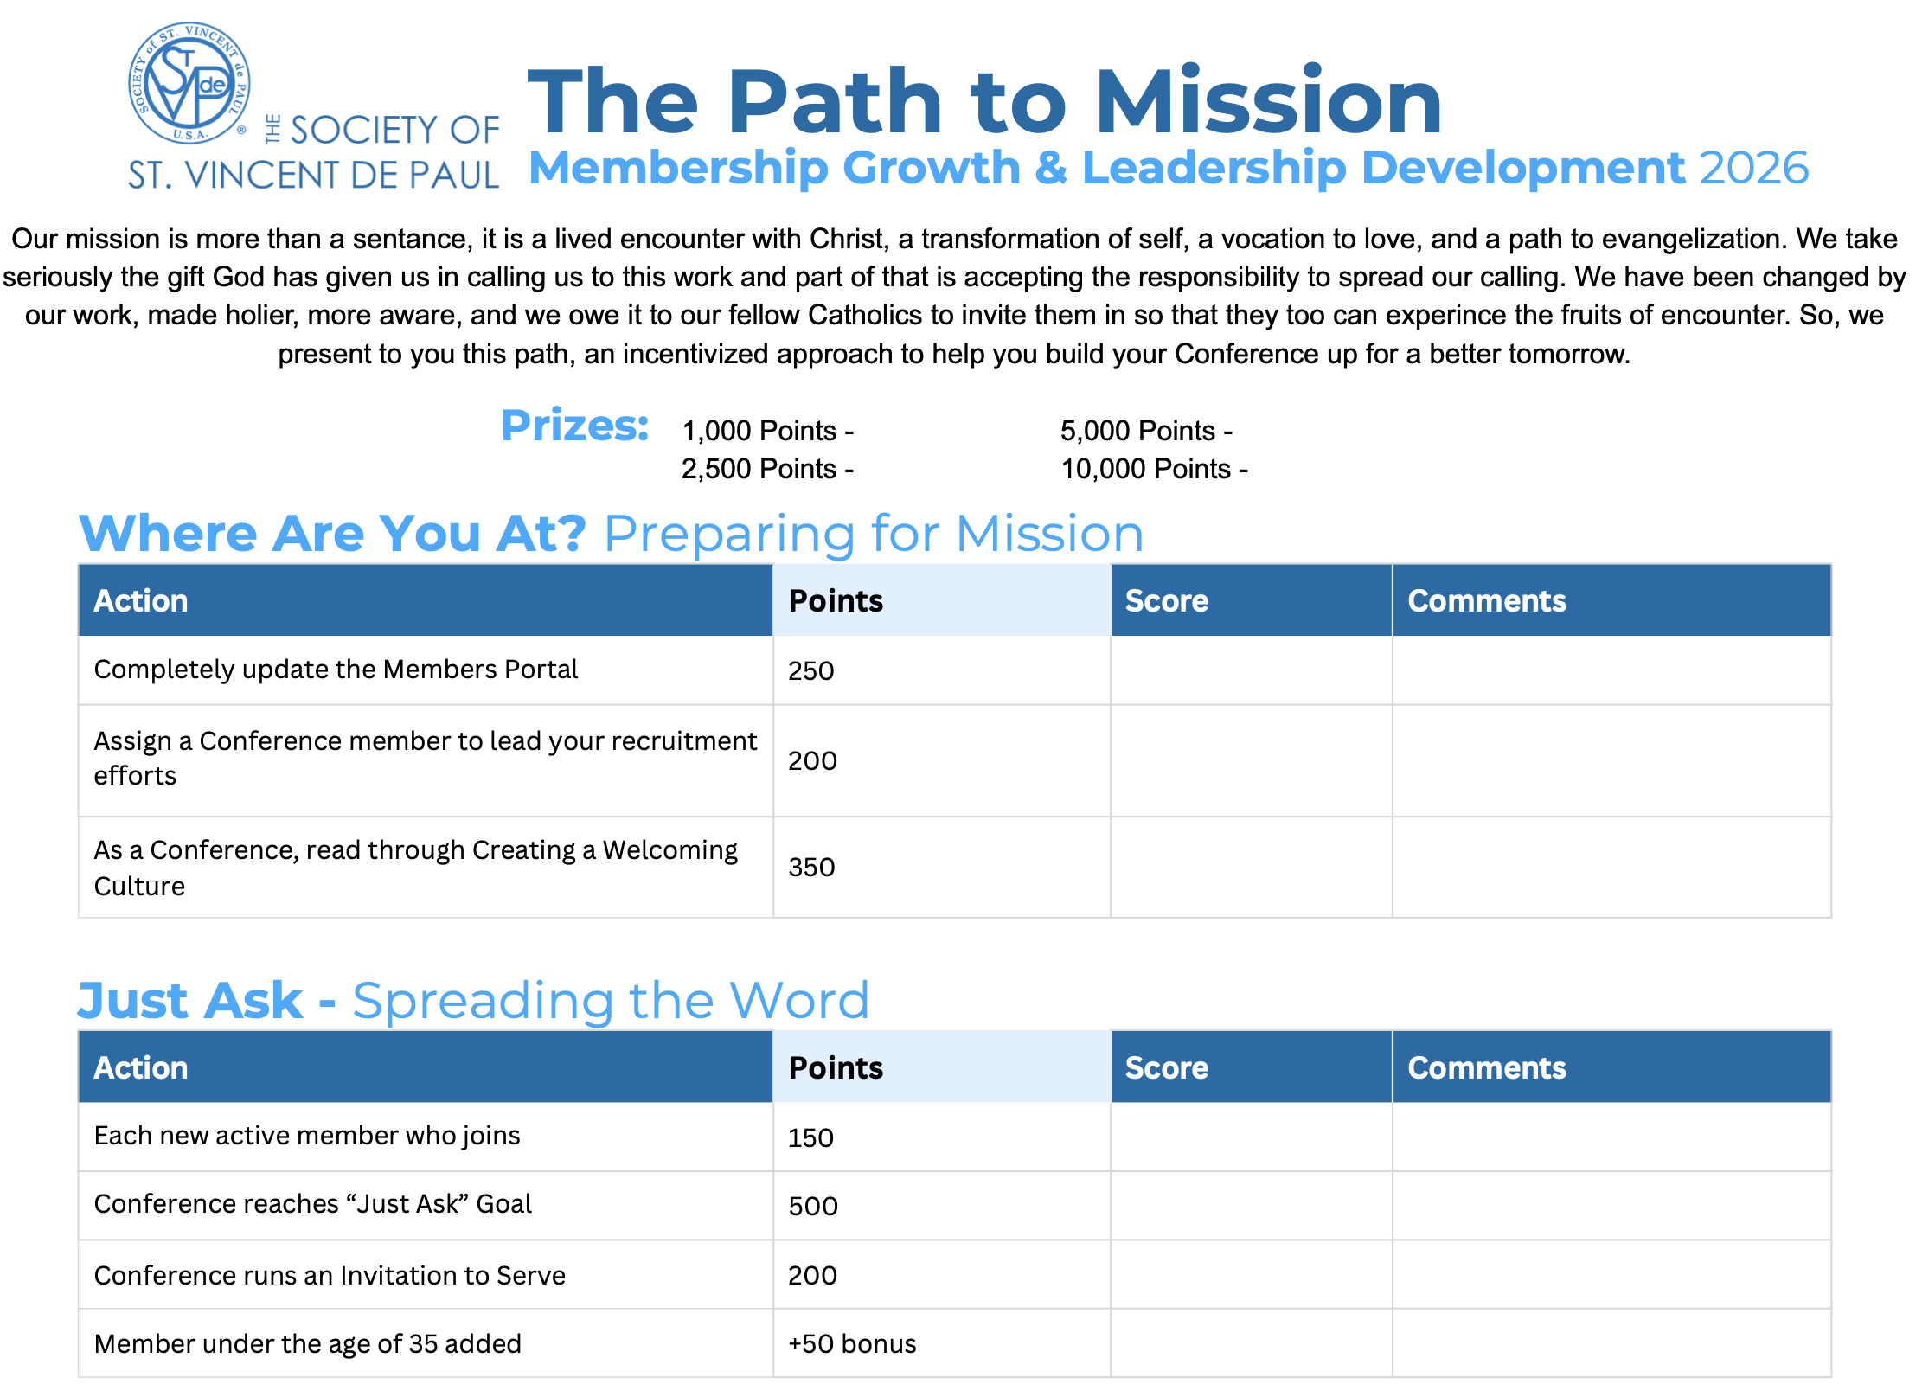

Slide 42
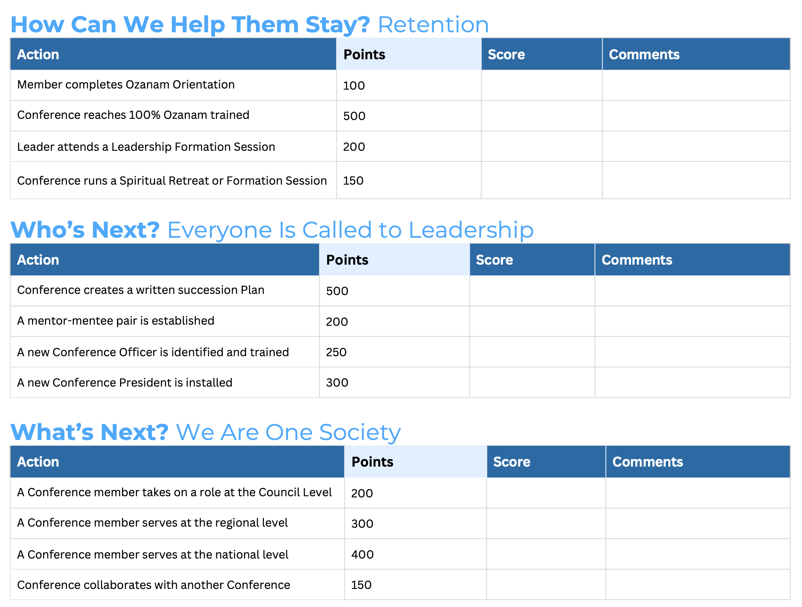

Slide 43
MAKE YOUR CONFERENCE AS STRONG AS POSSIBLE!
There are numerous opportunities for learning!
Ozanam Orientation
Invitation for Renewal
Printed Material
Webinars
Meetings
Serving in Hope formation program
Invitation To Serve
Culture of Welcome
Standards of Excellence
Never Quit Learning!

Slide 44
OK, you ask someone to consider joining SVDP. What now?
You did an Invitation To Serve at Church and have a follow up meeting. What’s next?
Create a Culture of Welcome in your Conference!
Use the National Council Template: Creating a Culture of Welcome
Be flexible on meeting times and activities. (pizza parties, work shifts together at food pantries, stores, shelters, family dinners together…..etc.) Be creative!
Tell them they will see the Face of Christ in the Poor.
Tell them about life changing home visits. Transformative! For both the Vincentian and our Friend in Need. Use personal examples.
Always remember the 3 tenets of SVDP: Spirituality, Friendship and Service to the Poor!!!

Slide 45

Questions?

