Slide 1
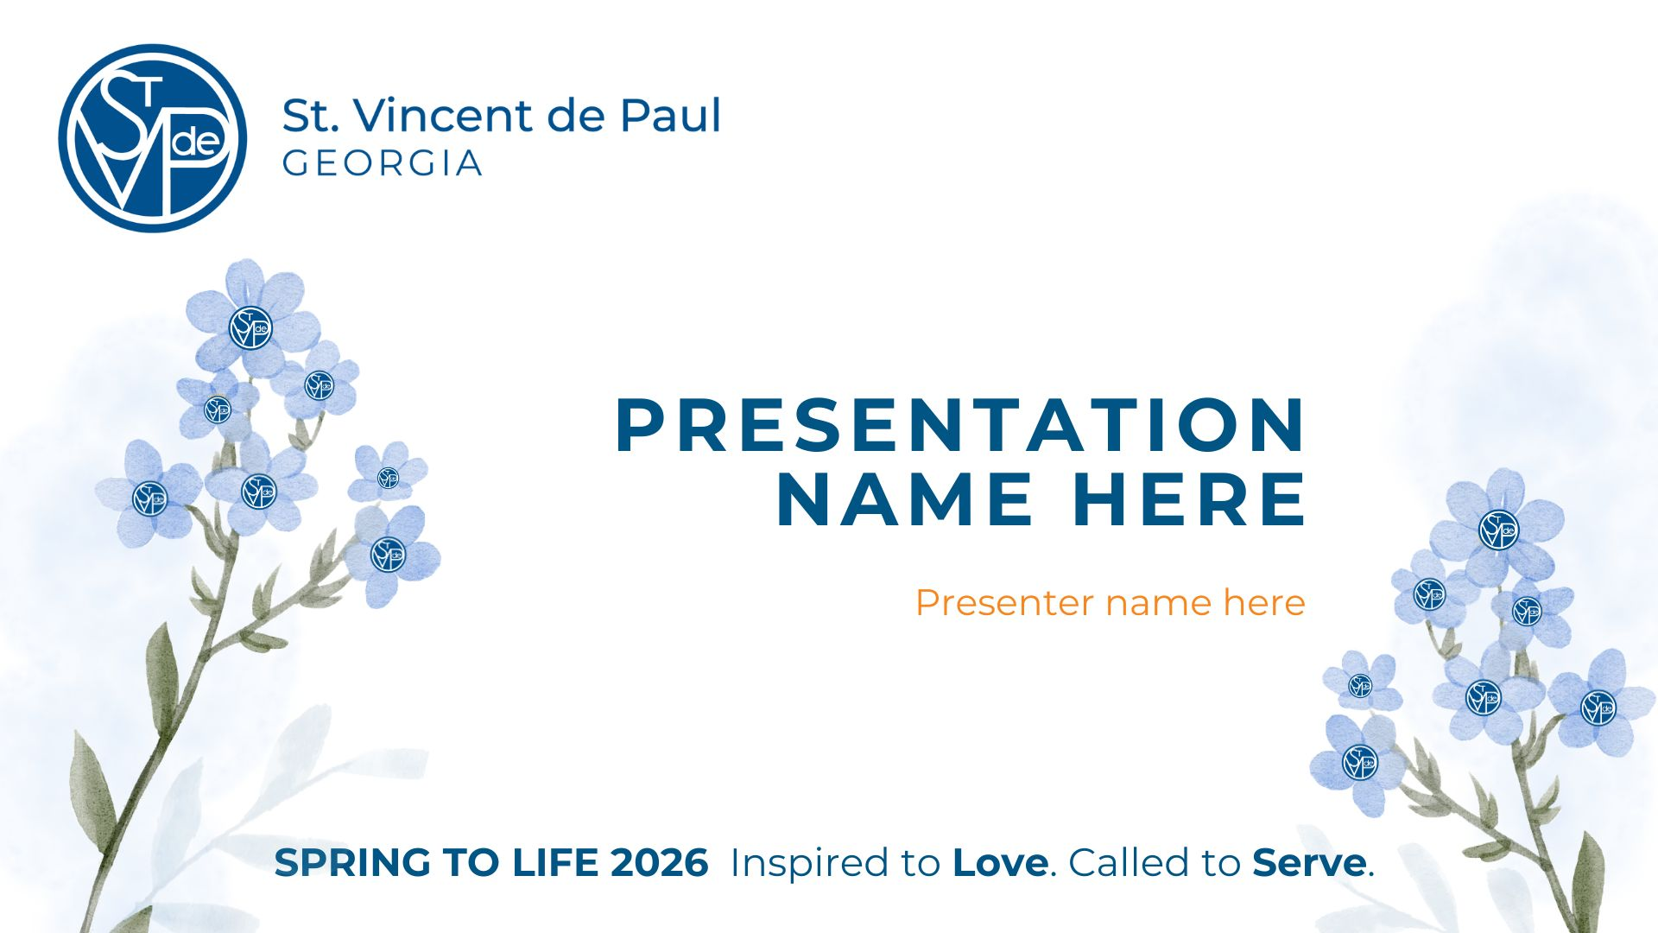
PRAYING WITH NEIGHBORS
Deacon Bill Boyd,
Georgia Council Chaplain

Slide 2
Show Me My Neighbor
Lord of All Love,
As I step out the door,
show me my neighbor.
As I read the news,
show me my neighbor.
As I pray,
show me my neighbor.
On my left, on my right
Perhaps turning to me right now,
Show me my neighbor.
Where my eyes have passed before and then turned away,
Show me my neighbor.
Where my ears have heard cries that I have ignored
Show me my neighbor.
As they share a story that is different from my story
Help me to listen as if it is my own.
Show me my neighbor.
Notes:
As we start out Home Visit section, we should begin in prayer as we would a before a Home Visit.
We have the most unique perspective because of our home visits. No other agency has our understanding of what is happening to cause need in our communities – we need to use that perspective to influence public policy and advocate – Voice of the Poor

Slide 3
And then let me love them
In their joy and in their distress
That their delight be mine
And their pain be mine too.
Let me love them
As completely and mercifully
as you love me.
In true solidarity
Singing our songs together
until a new song emerges,
Let me love them.
I look up now, Lord.
Show me my neighbor.
Amen.
Notes:
As we start out Home Visit section, we should begin in prayer as we would a before a Home Visit.
We have the most unique perspective because of our home visits. No other agency has our understanding of what is happening to cause need in our communities – we need to use that perspective to influence public policy and advocate – Voice of the Poor

Slide 4
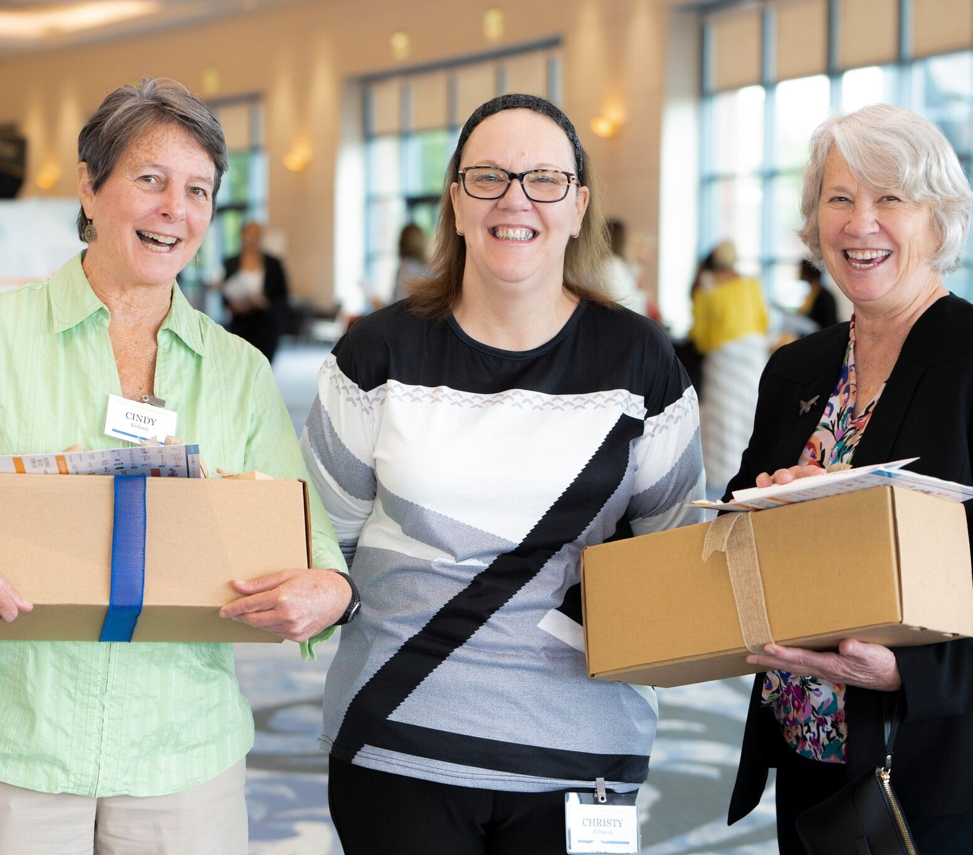
Our Vincentian Charism

Slide 5

Vincentian Spirituality
Essential Elements: Spirituality, Friendship and Service
Living our faith
Bearing witness to Christ
Grow in holiness through prayer, service, friendship, and formation

Slide 6
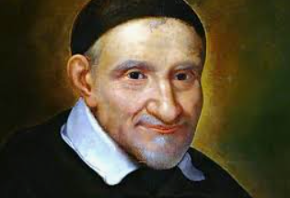
Vincentian Spirituality
St. Vincent de Paul
our Patron Saint
to love God, our Father, with the sweat of our brow and the strength of our arms
to see Christ in the poor and the poor in Christ
to share the compassionate and liberating love of Christ the Evangelizer and Servant of the Poor
to heed the inspiration of the Holy Spirit

Slide 7
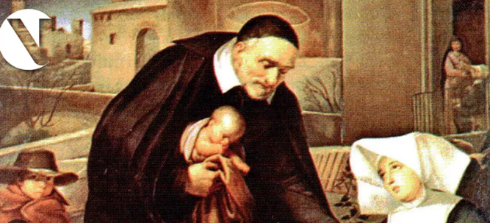
Vincentian Spirituality
Love in Union with Christ
The journey together towards holiness
Prayer in Union with Christ

Slide 8

Vincentian Spirituality
Parable of the Good Samaritan (Luke 10:25-37)
“And who is my neighbor?”
“…a Samaritan traveling…was moved with compassion…”
“Which…in your opinion, was the neighbor?”
“Go and do likewise”

Slide 9
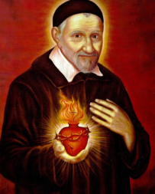
Vincentian Virtues
Simplicity
Humility
Selflessness
Gentleness
Zeal

Slide 10
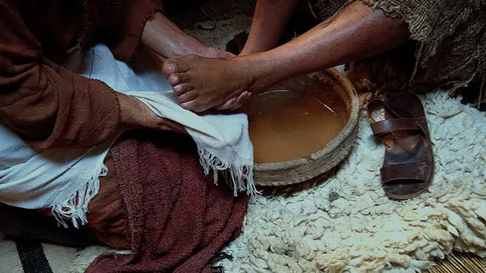
Vincentian Virtues
Practicing Simplicity and Humility
Authentic conversations and relationships
Focus on what matters
Staying present
Not being bogged down by ‘stuff’
Accepting the truth of our own frailties

Slide 11
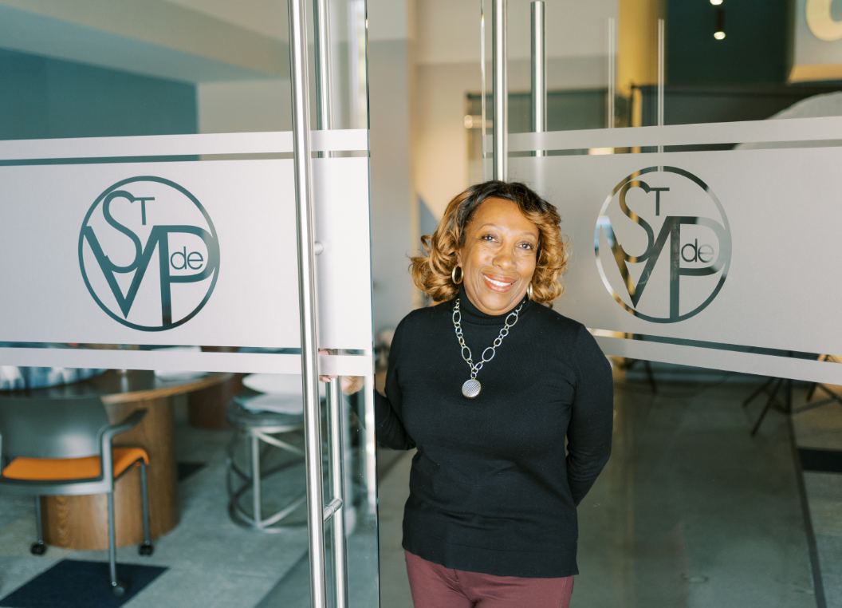
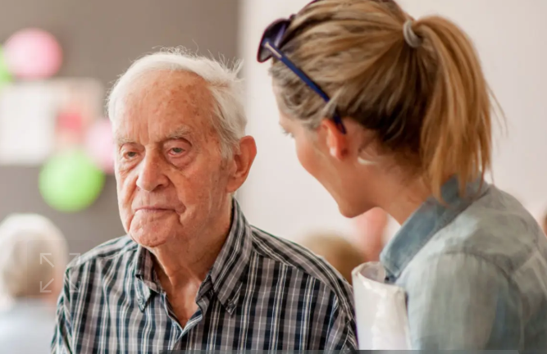
Vincentian Virtues
Practicing Gentleness and Selflessness
Letting go of our biases and prejudices
Exuding warmth and approachability
Loving from the heart in a spirit of generosity
Sharing our time, possessions and talents

Slide 12

Vincentian Virtues
Practicing Zeal!
True passion for the full flourishing and eternal happiness of every person
“I wish to encircle the world in a network of charity.”
-Frederic Ozanam

Slide 13
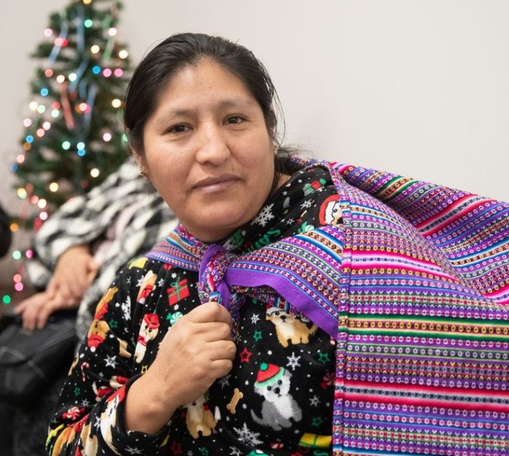
Extending our Vincentian Charism
Connecting with neighbors through prayer and spiritual encounters

Slide 14
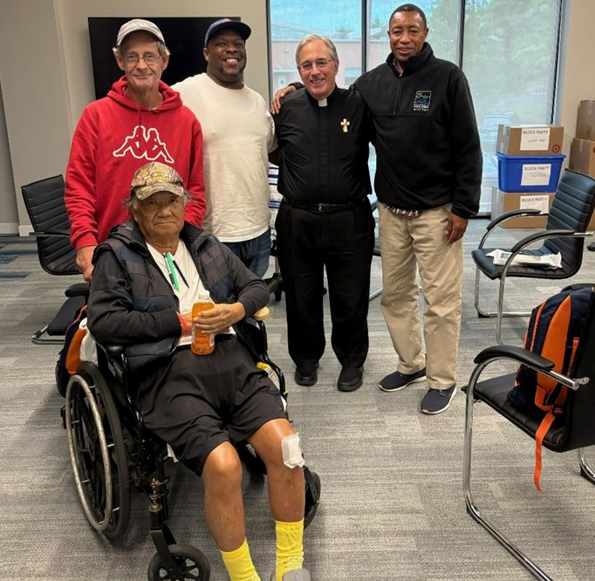
Neighbors
Retreats for Conferences

Slide 15


Slide 16


What is Walking with Neighbors?
Walking With Neighbors is a proprietary, collaborative effort between the Ignatian Spirituality Project (ISP) and St. Vincent de Paul Georgia.
Supported by ISP volunteers and staff, the initiative provides training, materials, and infrastructure for Vincentians to offer spiritual retreats for our neighbors.

Slide 17
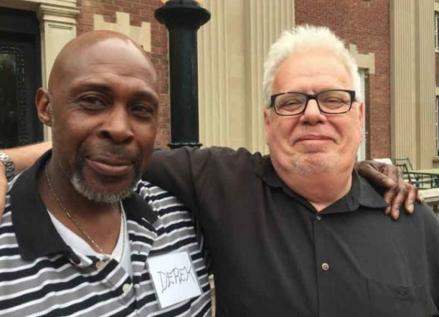
Accompanying our Neighbors on our mutual journey of healing and hope
Mission Statement
Walking with Neighbors is an invitation for the Vincentian community and their neighbors to encounter God’s love, hope and healing through spiritual companionship that transforms lives.
Foundational to the Vincentian call to Love our Neighbor, the retreat applies the Spiritual Exercises of Ignatius of Loyola and 12-Step spirituality.

Slide 18
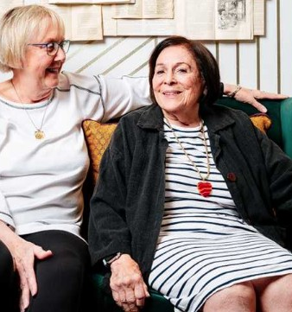
Companions play a critical role
Through Vincentian personal encounter and accompaniment, we walk with our neighbors during challenging times that involve pain, hardship, and transition

Slide 19
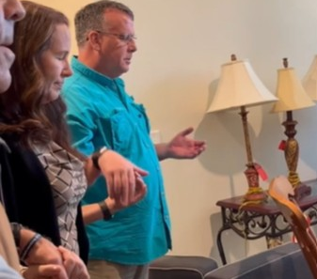
Retreat Format and Overview

Slide 20
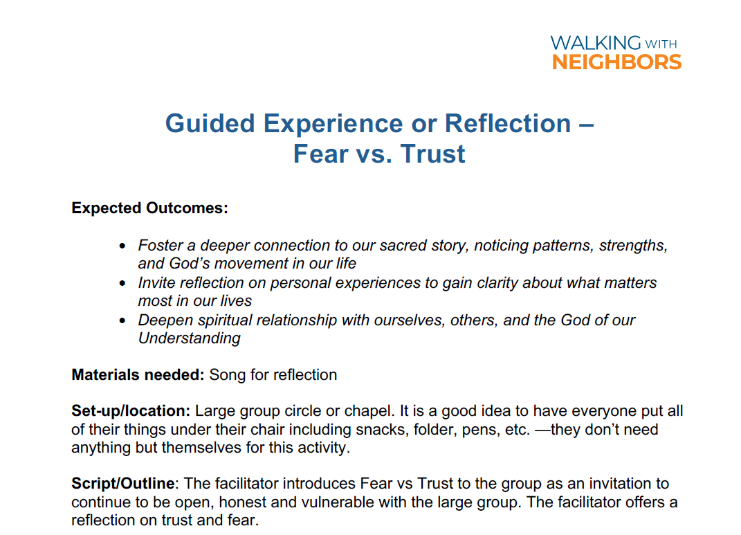

Slide 21
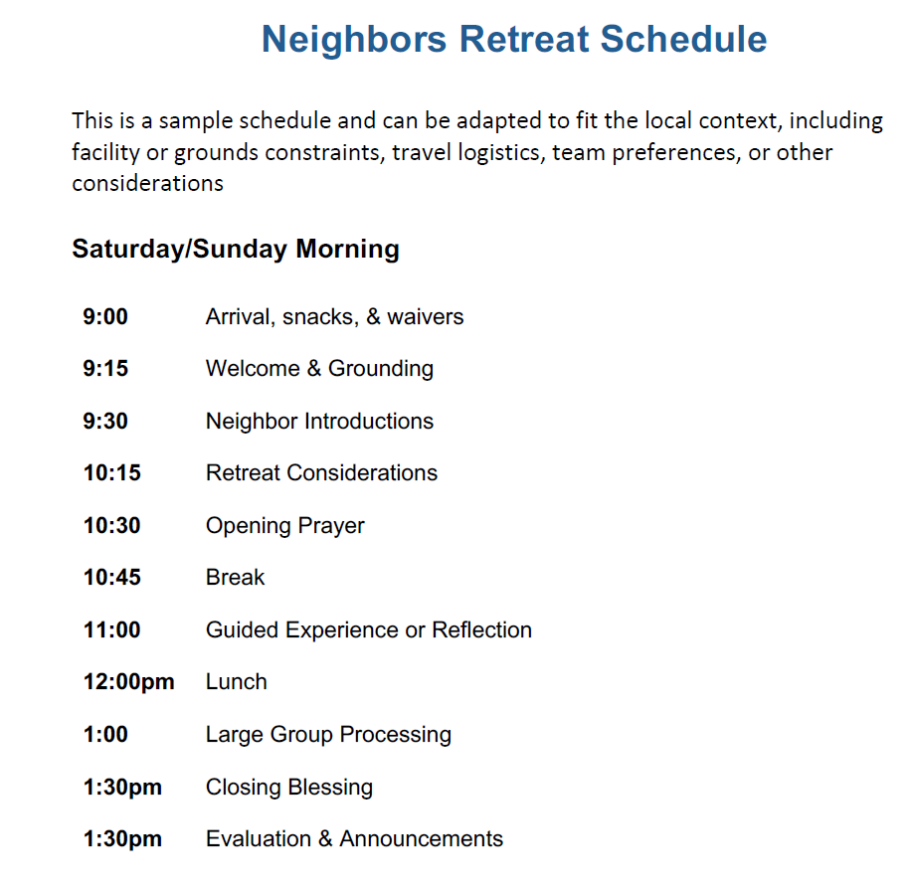

Slide 22

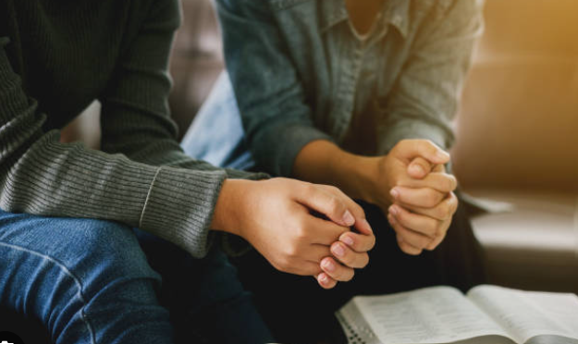
Partner Introductions

Slide 23
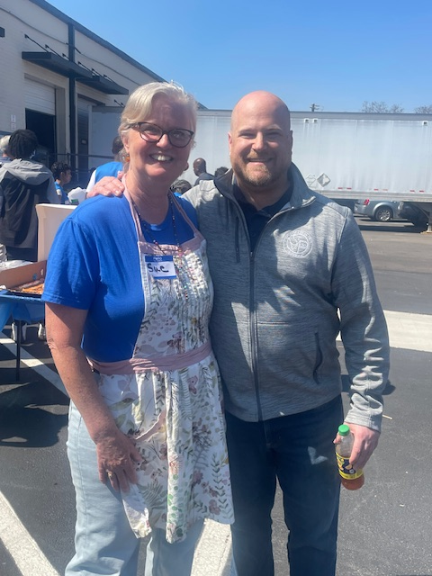
Hospitality and Encounter

Slide 24
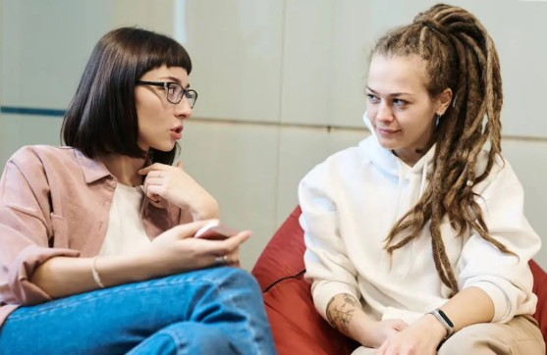
Compassionate Listening

Slide 25
Other Retreat Topics
Fear vs Trust
Spiritual Journey
Image of God

Slide 26
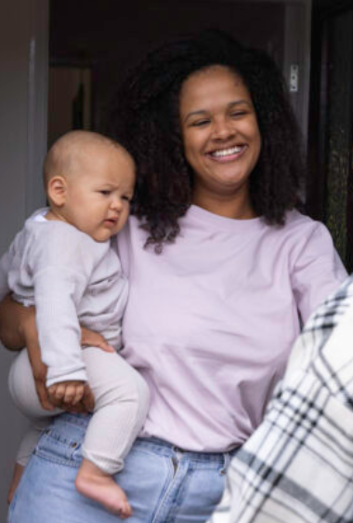
Contemplate...
Has a neighbor you served become a friend?
What has that meant in your life?
For your neighbor?

Slide 27
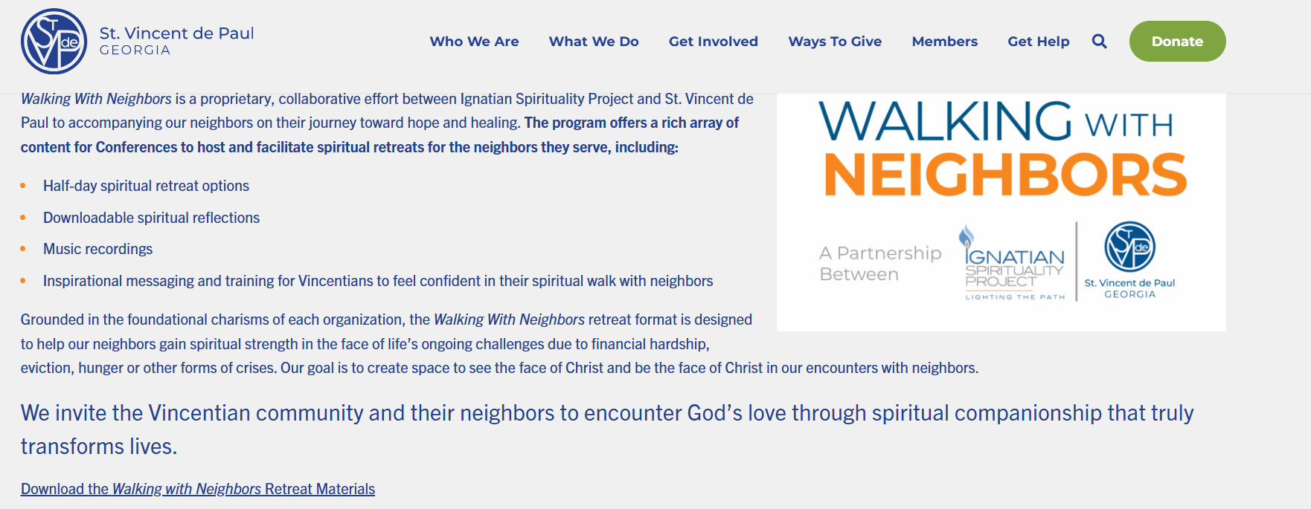
https://svdpgeorgia.org/wwn/
svdpgeorgia.org/wwn

Slide 28
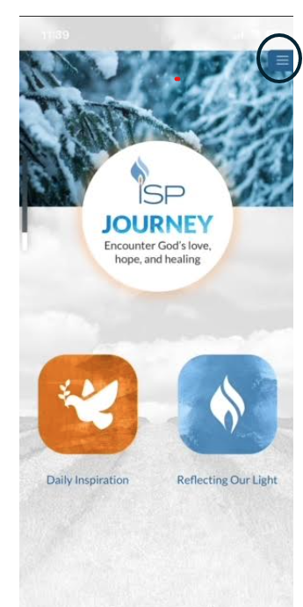
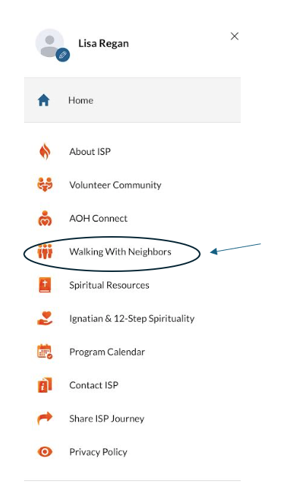
Download the ISP App for more resources

Slide 29
Questions?
Deacon Bill Boyd, SVdP Georgia Chaplain
bboyd@svdpgeorgia.org
Lisa Regan, Associate Executive Director
lregan@svdpgeorgia.org
Website Materials
svdpgeorgia.org/wwn

Slide 30
Thank you!

