Slide 1

OUR VINCENTIAN ROOTS & CATHOLIC SOCIAL TEACHING
Kat Doyle, Archdiocese of Atlanta
Notes:
Good Morning and thanks for joining me. Welcome to Our Vincentian Roots and CST
Let’
Start with a brief historical overview of how Frederic Ozanam was part of the beginning of modern Catholic Social Teaching.
Define in more detail Catholic Social Teaching, including the 7 major themes of CST and how they might be applied to the work of SVdP.

Slide 2

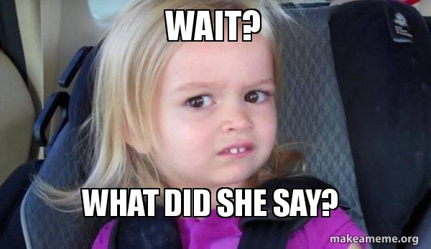
CATHOLIC SOCIAL TEACHING
The collective name given to the Catholic Church’s formal pronouncements on matters of social structures and social justice since 1891.
It is grounded in the critical social questions of the day and draws on contemporary economics, and social and political sciences.
Notes:
CST is the collective name given by popes and bishops to the Catholic Church’s formal pronouncements on matters of social structures and social justice since 1891.
This formal body of teaching is made up of papal documents, scripture teaching and Catholic tradition. It is grounded in the critical social questions of the day and draws on contemporary economics, and social and political sciences.
[CLICK]
Wait, what?

Slide 3

THERE IS NO OFFICIAL CATHOLIC
“The Church’s deepest nature is expressed in her three-fold responsibility: of proclaiming the word of God, celebrating the sacraments, and exercising the ministry of charity. These duties presuppose each other and are inseparable.”
Deus Caritas Est (25)
Notes:
Let’s back up
The Catholic Church does not have an official mission statement. If it did, these words from Pope Benedict XVI’s encyclical Deus Caritas Est~God is Love would be a good starting point
[CLICK]
“The Church’s deepest nature is expressed in her three-fold responsibility: of proclaiming the word of God, celebrating the sacraments, and exercising the ministry of charity. These duties presuppose each other and are inseparable.”
In other words, proclaim the good news, celebrate the sacraments and care for the poor. We can’t pick and choose among these commands they are non-negotiable and we must include all three as we live out our lives.

Slide 4
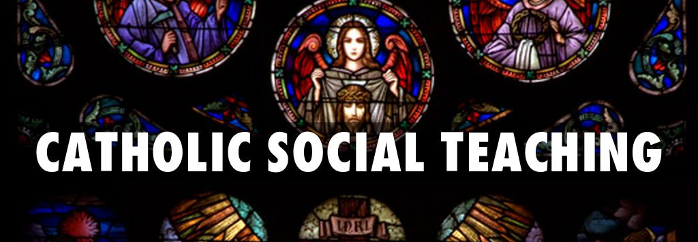
THE POOR and…
Notes:
The same is true of Catholic social teaching… it’s a central and essential element of our faith, a part of who we are as Catholics.
Its roots are in the Hebrew prophets who announced God's special love for the poor and called God's people to a covenant of love and justice.
It is a teaching founded on the life and words of Jesus Christ, who came "to bring glad tidings to the poor . . . and who identified himself with "the least of these,"
And it’s built on a commitment to the poor articulated by the Society of St. Vincent de Paul

Slide 5

“…envisioned the establishment of a network of charity and social justice encircling the world.”
Rule of the International Confederation of the Society of St. Vincent de Paul, 2.4 p.8
Blessed Frederic Ozanam
Notes:
But did you know that Blessed Frederic Ozanam, your founder, a French Catholic father, literary scholar, lawyer, journalist and equal rights advocate,
[CLICK]
the man who said that he envisioned the establishment of a network of charity and social justice encircling the world, played an important part in establishing modern Catholic Social Teaching?
The work of Ozanam and his companions helped lay the foundations for the social teaching of the contemporary Catholic Church, and has inspired generations of Catholics in their struggles for social justice.
Today he would be delighted at the opportunities the Society of St Vincent de Paul has to improve the lives of the disadvantaged, not just with immediate material help, but drawing on its experience and expertise to speak to public opinion on better ways of doing things, and suggesting ways to improve social policies and service delivery. The Society has an important role to play in the development of social policy, as a voice and advocate on behalf of the disadvantaged.

Slide 6

PARIS 1831: Catholicism…
Hopelessly conservative and mired in medieval nostalgia
Openly reviled and denounced as anachronistic in almost every venue imaginable
Seen as a detrimental influence on society and the individual
Modern French society needed to liberate itself from this stifling and oppressive ecclesial yoke
Notes:
Let’s go back and review a little history in order to see how CST actually rose from some of the work of Ozanam.
[CLICK]
When Ozanam first arrived in Paris in 1831 at the age of 18, the Catholic Church was viewed by a majority of his professors and peers at the University of Paris as hopelessly conservative and mired in medieval nostalgia. Universities like Paris and the Sorbonne were seedbeds for liberal democratic philosophies and progressive political organization.
[CLICK]
Catholicism, therefore, was openly reviled and denounced as anachronistic in almost every venue imaginable.
[CLICK]
Lectures in Paris, in a variety of disciplines, normally included some mention of the ways in which the Church had been a detrimental influence on society and the individual,
[CLICK]
and how modern French society needed to liberate itself from this stifling and oppressive ecclesial yoke.

Slide 7
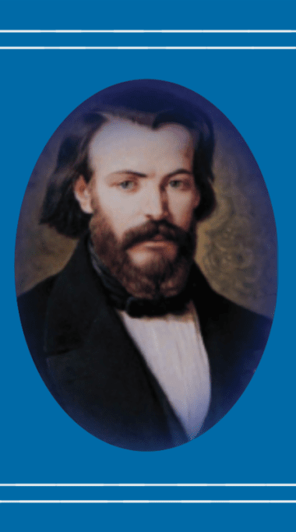
Ozanam:
Defender of the Catholic Church
NOT as an institution permanently entangled in deteriorating medieval structures
RATHER, a Church that reached out to the people, seeking bonds of solidarity and embracing the rule of ‘all by all’
Notes:
Soon after arriving in Paris, Ozanam distinguished himself both in the classroom and in extracurricular debates as a formidable intellectual force, who combined encyclopedic knowledge with incisive logic and unparalleled reasoning skills. He quickly assumed a leadership role among a minority of Catholic students who wanted to defend their faith in this hostile and oppositional climate. Ozanam had a burning passion for intellectual debate, and this hunger drove him to engage faculty and fellow students in lively discussions concerning a very wide ranging sample of topics. He would gather a group of scholars for regular ongoing debates.
[CLICK]
He quickly distinguished himself as an articulate defender of the Church,
not as an institution permanently entangled in deteriorating medieval structures, but rather,
a Church that reached out to the people, seeking bonds of solidarity and embracing the rule of all by all.

Slide 8
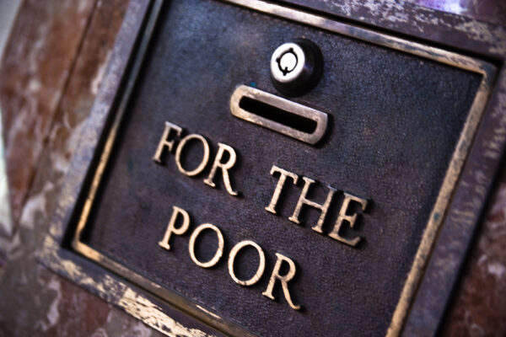

CATHOLICISM…
“Christianity has done wonders in the past, but what is it doing now in Paris for the poor?
Show us what practical benefit the working man reaps from your religion, and we too will believe in it.”
Notes:
It quickly became tradition for the debates to ultimately settle on the relative merits of the Catholic faith in relation to whatever historical topic was being discussed. Ozanam and his Catholic buddies would defend Catholicism, while other groups would represent the more mainstream intellectual position that the Church was generally a corrupt, oppressive and retrogressive force in history.
[CLICK]
One day, in the middle of such a debate, Ozanam was challenged by a fellow student to provide evidence that the Church was a benevolent force, to which he replied by reciting a litany of events in Church history that highlighted ways in which the Church had unequivocally made the world a better place.
[CLICK]
But Ozanam’s opponent was not satisfied and argued that the Church might have been a good force at one time, but he questioned how it could be construed as a positive force NOW. Ozanam answered by pointing to the many good and charitable works being done in the name of the Church by the clergy and the various religious orders.
[CLICK]
Finally, the student said, “Ozanam, Christianity has done wonders in the past, but what is it doing now in Paris for the poor? Show us what practical benefit the working man reaps from your religion and we too will believe in it.”

Slide 9

SILENCE …
Notes:
CRICKETS!
According to his biographers, this articulate man of elegant words was silenced by the challenge he encountered.

Slide 10
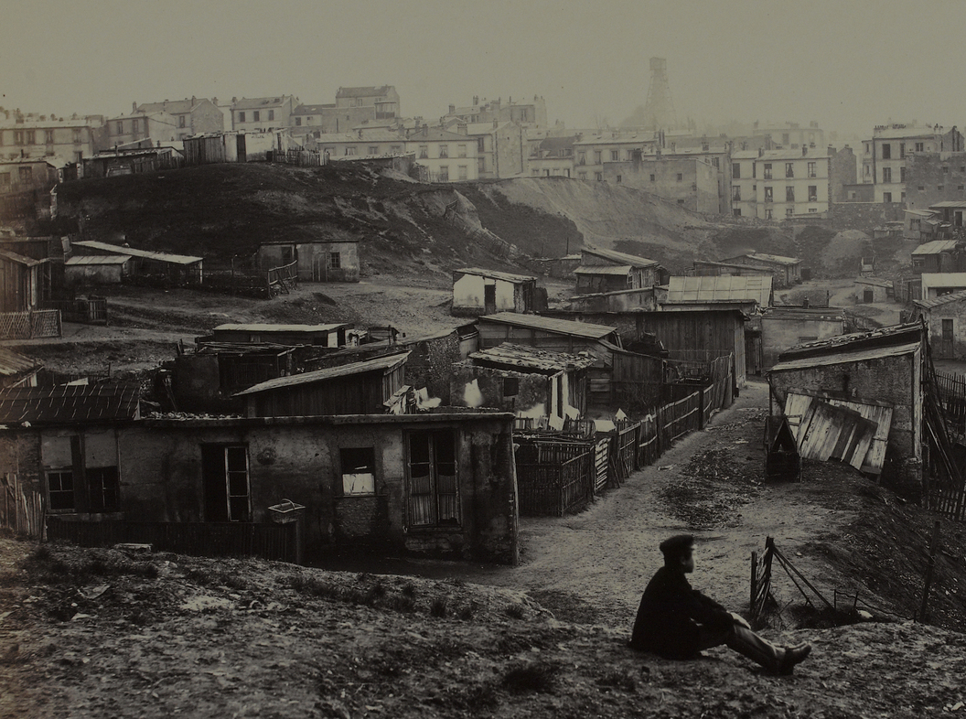
THE CHALLENGE…
To his own insulated and comfortable existence and
The Church’s own aristocratically coddled position in French society
AN OPTION FOR THE POOR
“We must do what is agreeable to God. Therefore, we must do what our Lord Jesus Christ did when preaching the gospel. Let us go to the poor!”
Notes:
When Ozanam was challenged by his peers to demonstrate how Catholicism was changing the lives of contemporary Frenchmen, he instinctively understood this as a challenge to both
[CLICK]
-his own insulated and comfortable existence,
-as well as the Church’s own aristocratically coddled position in French society.
He interpreted the challenge as
[CLICK]
one that called him out to the dirty, garbage-strewn ghettos of Paris where he and his friends would encounter the very real human byproducts of industrial capitalism.
He could have chosen to interpret this challenge differently. He could have taken the challenge as a call to be more pious, more liturgically oriented, or more involved in the political machinery of the Church and its relationship to the State of Louis-Phillipe. All of these would have been valid, even, in some ways, more likely responses to such a challenge.
[click]
However, Ozanam chose an option for the poor instead, which resulted in an organization whose practices were decidedly different from other Catholic charitable outreaches of his day.
On April 23, 1833, Frédéric’s 20th birthday, he and five other students gathered in the newspaper office of Emmanuel Bailly and with Ozanam’s words,
[click]
“We must do what is agreeable to God. Therefore, we must do what our Lord Jesus Christ did when preaching the gospel. Let us go to the poor!”, the Society of St. Vincent de Paul was born.

Slide 11
INTERESTINGLY BOTH ~ AND
Something that is BOTH fundamentally conservative, insofar as it was a charitable outreach to the poor,
AND, at the same time, it was also something that was radically progressive and disruptive to the status quo.
Notes:
Interestingly, The foundation of the Society of St. Vincent de Paul can be characterized as something that is
CLICK
-both fundamentally conservative, insofar as it was a charitable outreach to the poor,
-and, at the same time, it was also something that was radically progressive and disruptive to the status quo due to the fact that it organized lay people in a way that supplemented and supplanted those who occupied positions traditionally reserved for an elite religious class.

Slide 12
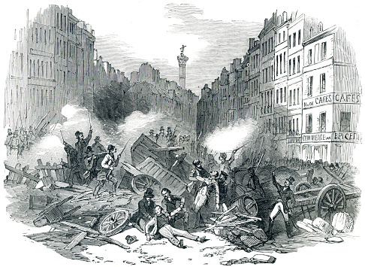
NOW…IMAGINE THIS: PARIS, 1848…
The Catholic Church should become more engaged with social concerns!
From Pioneer and Prophet: Frédéric Ozanam’s Influence on Modern Catholic Social Theory - We are Vincentians
Notes:
So the Society is formed and the small founding group has been out with the poor in the ghettos of Paris for 15 years.
Now Imagine this….
Paris 1848.
Frederic Ozanam is a Professor at the University of Paris.
France is in crisis.
Government is bankrupt.
Workers are mired in poverty.
Victor Hugo, an acquaintance of Ozanam during his student days, is writing Les Misérables.
Karl Marx has published his Communist Manifesto in London and returned to Paris to support the socialist struggle.
The Archbishop of Paris is shot dead in the middle of the barricades between the revolutionaries and government forces.
France is divided.
Many are challenging the entrenched privilege of the aristocracy and talking about “socialism”— by which they mean a fair and just society.
Catholic leaders are slow to change and tend to support the old systems of government, the Ancient Régime.
Catholic Social Teaching had not yet been formulated.
So, Ozanam drawing on his knowledge of economics and history—remember he had been a professor of commercial law and then a professor of European literature— and driven by his experience of finding Christ among the impoverished citizens of Paris, inspired what would become known in France as ‘social Catholicism’.
[CLICK]
He urged a conservative Catholic Church to become more engaged with social concerns.
Long before Pope Leo XIII in 1891 issued his great social encyclical, Rerum Novarum, the beginning of our formal body of teaching known as CST, Ozanam wrote passionately about what ‘Christian democracy’ entailed: justice in wage contracts; a more just distribution of wealth; humane working hours; legislation to protect children and women in the workplace; progressive taxation; extension of co-operative marketing and ownership; the right to form trade unions; income support for the sick and aged; adequate regulation of finance and the economy etc.
He strove to draw French Catholics of his time beyond partisan political disputes to fresh visions of a renewed nation, more firmly incorporating the principles of human rights, equity, solidarity and social justice.

Slide 13
But… what is the role of the church in tackling the difficult issues of our time?
Notes:
And here we are in 2026
Studying the work of Ozanam and his companions who helped lay the foundations for the social teaching of the contemporary Church and has inspired generations of Catholics in their struggles for social justice.
It is intriguing how relevant Ozanam’s concerns are to debates about public policy today.
But just what Is the roll of the Church in tackling the difficult issues of our time?

Slide 14
CATHOLIC SOCIAL TEACHING
“The best kept secret in the Roman Catholic Church in the United States!”
Notes:
To answer that question, we need to understand the role of CST.
The Catholic church is deeply blessed with more than 135 years' worth of outstanding social justice & peace documents authored by popes, 2nd Vatican Council, world synods of bishops and national conferences of bishops.
Out of these Catholic social teaching documents, the church has developed a set of principles designed to help guide us in applying the liberating message of the Gospel to the social, economic and political problems facing modern humanity.
[CLICK]
But…it seems to be Our best-kept secret… that we actually have a formal body of teaching, complete with it’s own compendium.
It seems to have been overlooked—or have never been known—by a majority of the Roman Catholic community in the United States.
All too few Catholics know about the Church’s social teaching.
How many of you have heard of CST? Heard it preached in a homily? Taught at adult ed offerings?

Slide 15

CATHOLIC SOCIAL TEACHING
Notes:
The foundation of CST is pretty well recognized by us Catholics…love God AND love your neighbor.

Slide 16
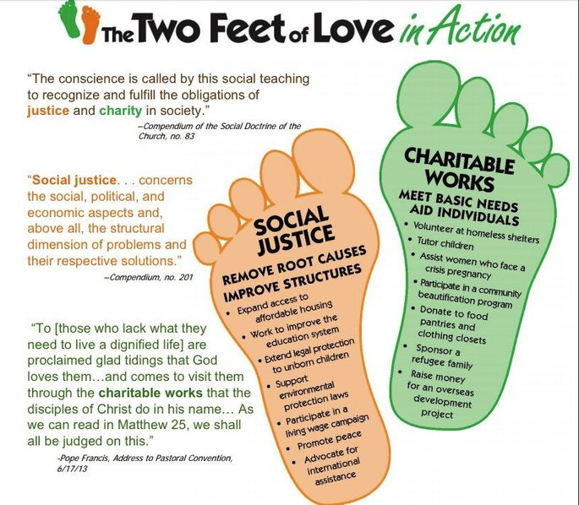

Notes:
But what seems simple is often hard to live, so let’s take a quick look at what CST actually calls us to do.
The 2 Feet of Love… there are 2 different, but complimentary ways we walk the path of love…
It takes two feet to walk a steady path and to allow us to take action.
This slide gives you a relatively quick and understandable way in which we use the 2 feet of love-Charity and Justice-to address social issues.
This is important because it can be used to help us figure out how to live the themes of CST
So now let’s look a little closer at the themes of CST and talk about how they draw on Ozanam’s work and on the work SVdP does today.

Slide 17

CARE FOR GOD’S CREATION
We show our respect for the Creator by our stewardship of creation. We are called to protect people and the planet, living our faith in relationship with all of God’s creation.
Care for the earth is not just an “Earth Day” slogan, it is a requirement of our faith. This environmental challenge has fundamental moral and ethical dimensions that cannot be ignored.
Notes:
We start with CARE FOR GOD’S CREATION
Because in the beginning, God created everything and we are called to show our respect for the Creator by our stewardship of all of His creation.
We are called to protect people and the planet, living our faith in relationship with all of God’s creation.
Care for the earth is not just an Earth Day slogan, it is a requirement of our faith.
This environmental challenge has fundamental moral and ethical dimensions that cannot be ignored.

Slide 18
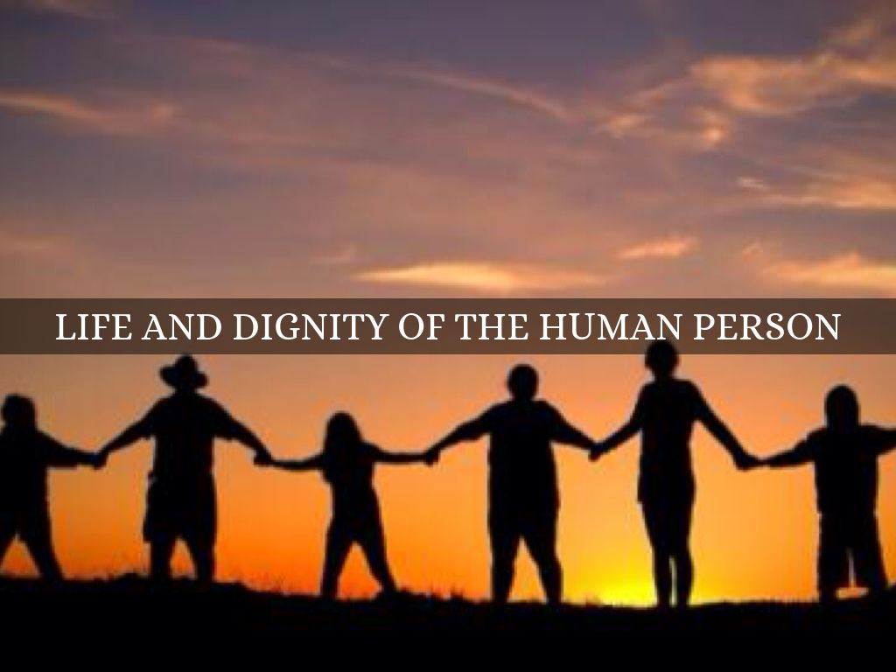
LIFE & DIGNITY OF THE HUMAN PERSON
The Catholic Church proclaims that human life is sacred and that the dignity of the human person is the foundation of a moral vision for society. This belief is the foundation of all the principles of our social teaching. We believe that every person is precious, that people are more important than things, and that the measure of every institution is whether it threatens or enhances the life and dignity of the human person.
Notes:
Next up is LIFE & DIGNITY OF THE HUMAN PERSON
This belief is the foundation of all the principles of our social teaching. The Catholic Church proclaims that human life is sacred and that the dignity of the human person is the foundation of a moral vision for society. In our society, human life is under direct attack from abortion and euthanasia. Human life is threatened by cloning, embryonic stem cell research, and the use of the death penalty. The intentional targeting of civilians in war or terrorist attacks is always wrong. Catholic teaching calls on us to work to avoid war. Nations must protect the right to life by finding effective ways to prevent conflicts and resolve them by peaceful means. We believe that every person is precious, that people are more important than things, and that the measure of every institution is whether it threatens or enhances the life and dignity of the human person.

Slide 19
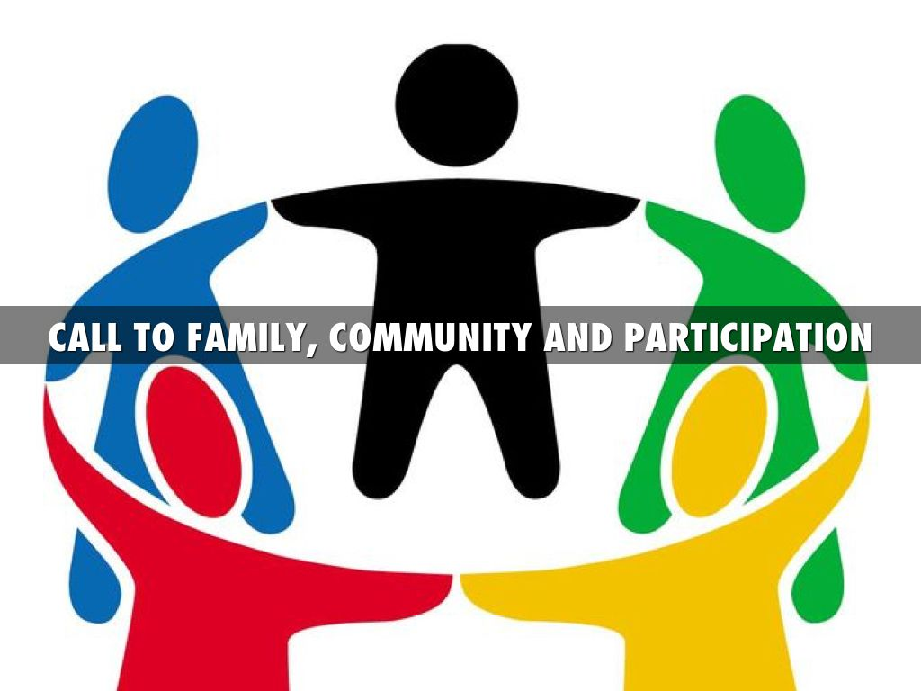
CALL TO FAMILY, COMMUNITY & PARTICIPATION
The person is not only sacred but also social. Marriage and family are the central social institutions that must be supported and strengthened, not undermined. We believe people have a right and a duty to participate in society, seeking together the common good and well-being of all, especially the poor and vulnerable.

Slide 20

RIGHTS & RESPONSIBILITIES
The Catholic tradition teaches that every person has a fundamental right to life and a right to those things required for human decency.
Corresponding to these rights are duties and responsibilities—to one another, to our families, and to the larger society.
Notes:
Every person has RIGHTS & RESPONSIBILITIES
The Catholic tradition teaches that human dignity can be protected and a healthy community can be achieved only if human rights are protected and responsibilities are met. Therefore, every person has a fundamental right to life and a right to those things required for human decency. Corresponding to these rights are duties and responsibilities—to one another, to our families, to the larger society, and to the common good of all.

Slide 21
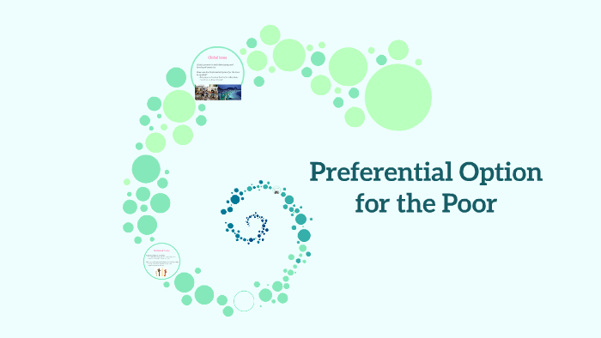
OPTION FOR THE POOR & VULNERABLE
A basic moral test is how our most vulnerable members are faring. In a society marred by deepening divisions between rich and poor, our tradition recalls the story of the Last Judgment (Mt 25:31-46) and instructs us to put the needs of the poor and vulnerable first.

Slide 22
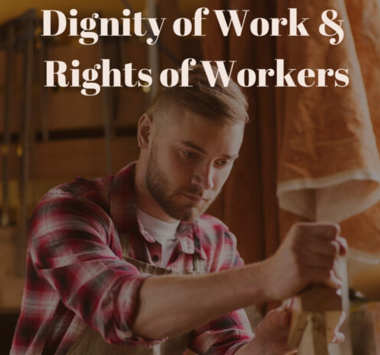
THE DIGNITY OF WORK & THE RIGHTS OF WORKERS
The economy must serve people, not the other way around. Work is more than a way to make a living; it is a form of continuing participation in God’s creation. If the dignity of work is to be protected, then the basic rights of workers must be respected—the right to productive work, to decent and fair wages, to the organization and joining of unions, to private property, and to economic initiative.
Notes:
Then we have THE DIGNITY OF WORK AND THE RIGHTS OF WORKERS
The economy must serve people, not the other way around. Work is more than a way to make a living; it is a form of continuing participation in God’s creation. If the dignity of work is to be protected, then the basic rights of workers must be respected—the right to productive work, to decent and fair wages, to the organization and joining of unions, to private property, and to economic initiative.
Additionally, workers owe a fair day’s work for a fair day’s wages.

Slide 23


SOLIDARITY & SUBSIDIARITY
Solidarity…We are one human family. We are our brothers’ and sisters’ keepers. Loving our neighbor has global dimensions in a shrinking world.
Subsidiarity…nothing should be done at a higher level that can be done well or better at a lower level.
Notes:
And finally, SOLIDARITY AND SUBSIDIARITY…perhaps the most confusing of the bunch.
Let’s start with Solidarity.
We are one human family whatever our national, racial, ethnic, economic, and ideological differences.
We are our brothers’ and sisters’ keepers, wherever they may be. Loving our neighbor has global dimensions in a shrinking world.
Solidarity is NOT a feeling of vague compassion or shallow distress at the misfortunes of so many people, both near and far.
On the contrary, it is a firm and persevering determination to commit oneself to the common good, striving for a more just society that respects the rights of all people.
For example, we are in solidarity with the unborn when we work to reduce the number of abortions. We are in solidarity with people who are homeless or hungry when we meet their immediate needs and work to overcome the underlying causes.
[CLICK]
So most people have heard the word solidarity, even if they understand it in different ways. But most have not heard of Subsidiarity or know anything about what it means.
[CLICK]
Subsidiarity means nothing should be done at a higher level that can be done well or better at a lower level.
Solidarity and subsidiarity are actually complementary principles, Solidarity sees from a global perspective, we are all connected, and Subsidiarity see from a local perspective, action should first occur at the lowest level possible.
Subsidiarity, however, is not just about local control. The principle of subsidiarity is also about the duty of the higher order to provide assistance to the lower order when appropriate
Subsidiarity is ultimately about building stronger communities in which government is a necessary—but not the only—form of social organization.
Catholics believe that a well-ordered society is one in which institutions large and small, sacred and secular, and public and private come together to work for the common good.

Slide 24
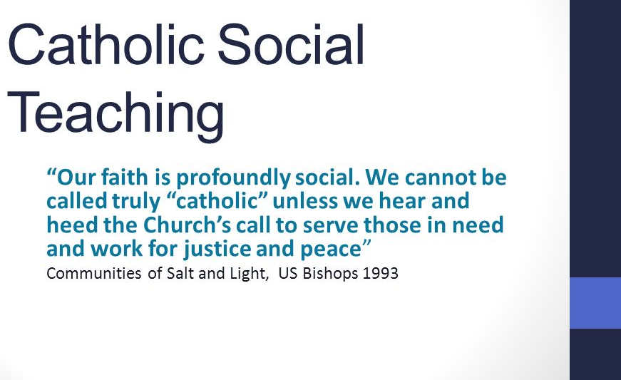
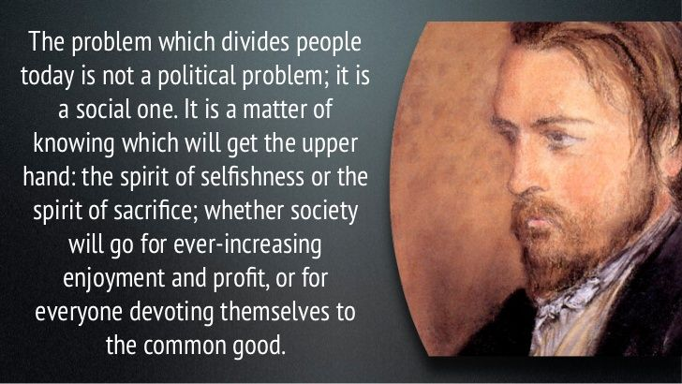
MAKING THE CONNECTION…
Notes:
Hopefully you’ve begun to make the connection between CST and why it’s so important to the work of SVdP. It’s been a part of the Society since its inception, even before it was formally recognized as a body of teaching in the Catholic Church.
Our faith is profoundly social and Blessed Frederic Ozanam said that the problem which divides people is a social one.
CST presents the Catholic Christian response to basic modern social problems.
It is a body of social teachings containing principles for actions and guidelines for practice that help us respond to our social responsibility in view of urgent social needs.
It is the source of wisdom and insights to help us acquire a truly Christian faith-vision of social justice and peace.

Slide 25
THANK YOU for ATTENDING!
Kat Doyle
Director, Justice & Peace Ministries
Office of Life, Dignity & Justice
Catholic Archdiocese of Atlanta
kdoyle@archatl.com
404.920.7897

