Slide 1

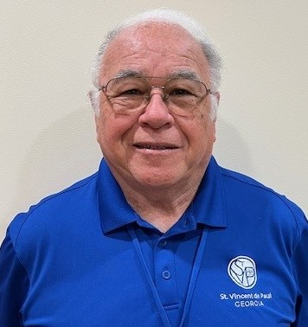
A “Coach Approach” Towards Servant Leadership
Mark Meredith
Holy Family Conference

Slide 2
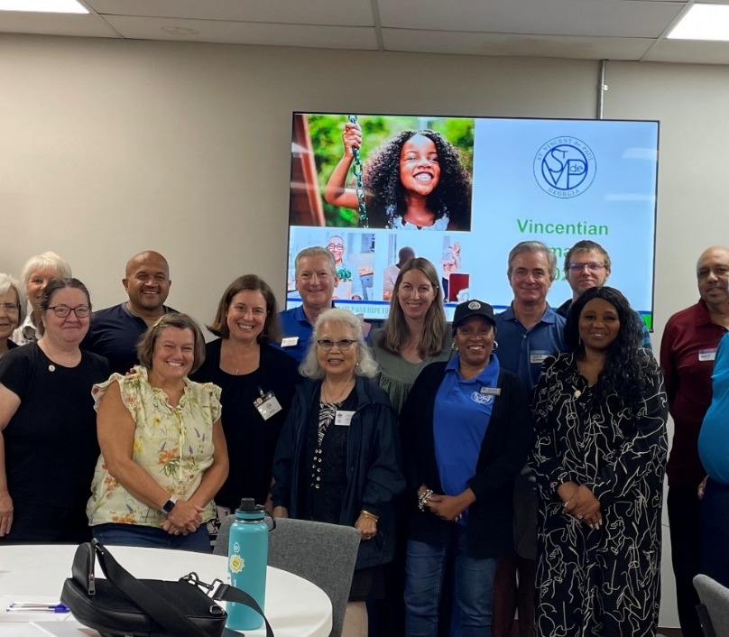
Session Objectives
Use a “coach approach to assist you in Servant Leader role:
  To enhance communication skills
    Asking “Powerful Questions”
    Listening Skills
  Works with:
    Vincentians
    NsiN
  Reduces the need for you to always be the “Answer Person!”
Practice using the G.R.O.W. model to build coaching skill and confidence

Slide 3

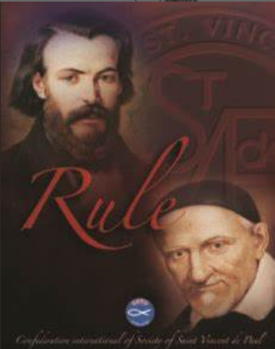
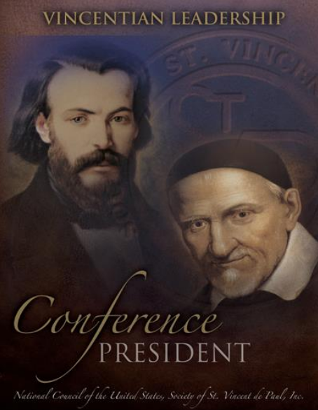
Servant Leadership Defined
Warren Buffet
Former CEO
Berkshire Hathaway
“What Can I do for YOU”
“Servant leadership is done in imitation of Jesus who said, “For the Son of Man came not to be served but to serve and give his life as a ransom for many.” Mk 10:45
The Rule, Part III, Statute 11
“Servant leaders are not expected to do all the work but are called to delegate, encourage, inspire the members to work together to accomplish the mission”
Conference President Handbook

Slide 4
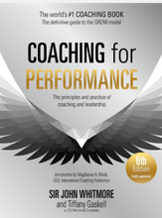
Coaching Defined
Not:
Yelling
Telling
Selling
"Unlocking People's Potential to Maximize their Performance"
When to Coach:
A joint problem-solving opportunity that takes a little time (5-7 minutes)
Noticing the same question is being repeatedly asked
A dependency has developed where you have become the “Answer Person”, time to break the dependency
For developmental purposes – to build leadership skills in others
When not to Coach:
When you don’t have the time to invest in dialog (e.g., emergency)
When the person is new to the job/task (don’t know what to do)
For tasks, decisions needing a simple answer (yes, no)
Create awareness by asking open
(can’t be answered by yes/no) POWERFUL questions

Slide 5
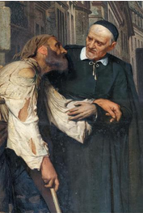

Ask Open (Powerful) Questions
(can’t be answered by yes/no)
Ask one another
“What is it that you see?
What do the expressions tell you?
Who is helping who?
When did they first meet?
What did the “Neighbor in Need” say?
How did SVdP respond?
What happens next?
4

Slide 6
Key Questioning Tips
Questions should come from a place of curiosity and intuition.
Simple, seven words or less. Use “open” questions (Powerful)
Ask one question at a time
Allow time for the person to answer your question, everyone has a different processing time.
What do the expressions tell you?
Who is helping who?
When did they first meet?
What did the “NiN” say?
How did SVdP respond?
What happens next?

Slide 7


Focus on Open/Powerful Questions when Coaching
Leading Questions:
  Intent - subliminally offer an answer, suggestion, opinion and/or idea
  Impact - can feel like manipulation
Closed Questions:
  Answered by a yes or no
  Intent - confirm, verify, qualify
  Impact - narrows down information, can curtail conversation
Open Questions:
Typically begin with who, what, when how (refrain from asking why?)
  Intent – collect information
  Impact – expands dialog
Powerful Questions:
Open-ended, short, simple curious
  Intent – evoke clarity, discovery, insight and/or commitment
  Impact – promote action, deepen learning

Slide 8
Powerful Questions:
What did you feel?
What’s your “Plan B?”
What’s the question I should be asking you?
How did it affect you?
What was the impact?
What did you learn?
How has it changed you?
What would you have done?
Where are you feeling it?
What’s the cost of doing nothing?
What’s the benefit of doing something?
What do you want?

Slide 9
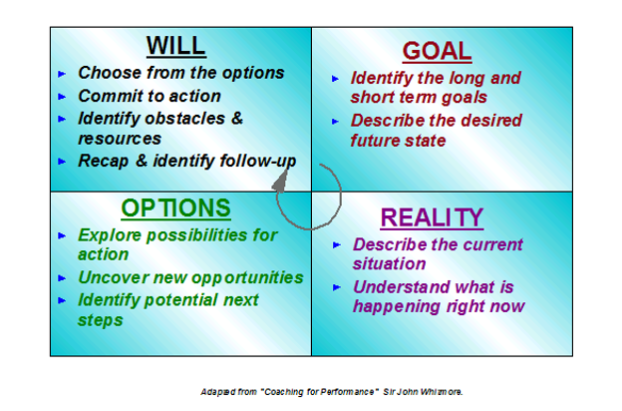
Start with Goal and move clockwise through the quadrants; revisit quadrants as needed
Ask one (open) question at a time, refrain from answering, providing options
Allow time for the person to answer your questions
Choose from options
Commit to action
Identify obstacles
and resources
Recap and identify
follow-up
2/23 will contact parish staff to schedule on 3/13
Text you to show accountability
Will have friend make cookies
and provide green basket
Have our pastor realize the benefits of giving more support to our SVdP conference
Identify long and short
term goals
Describe the desired
future state
EXAMPLE
Explore possibilities
for action
Uncover new oppor-
tunities
Identify potential
next steps
Use parish staff to schedule 1 on 1 and bring cookies in green basket for St. Patrick's Day
Show interesting stats demon- stating impact within our county
    e.g., Treasurers Report
Pastor micro-manages
  e.g., holding up approval of using parish room for our SVdP meetings
Doesn’t’ want to meet with SVdP
Describe the current
situation
Understand what is
happening right now

Slide 10
Practice using G.R.O.W.
Pair up
  Each person think of an SVdP situation/issue that you would be willing to be coached on… 30 seconds in silence
Round 1: 10 minutes total
Decide who will be the coach and coachee
  Coachee: briefly describe the situation – make it real: 1 minute (Coach just listens, does not say anything)
  Coach: Practice using G.R.O.W. 7 minutes
Ask only Open questions – no Closed Questions
If Coach asks a Closed Question, hold up your hand and answer only with yes or no - have Coach reframe question into an Open Question
Try asking a Powerful Question (short, 7 words or less, creates insight, deepens learning)
Coachee gives Coach Feedback: 2 minutes – Open Questions used? What happened when Closed Questions were used?
  How did “Powerful Questions” land?
Round 2: 10 minutes total
  Switch roles
  Same as Round 1

Slide 11
Call to Action:
Practice
  Keep and refer to today’s handout
  Use G.R.O.W. with fellow Vincentians, Neighbors in Need
  Ask Open, Powerful Questions as a Servant Leader when coaching
  2. Teach this topic in a Conference Meeting
  Read Performance Coaching: Sir John Whitmore
    ISBN# 978089842383
  3. Visit Performance Consultants website
    https://www.performanceconsultants.com
  THANK YOU!🙏
Mark Meredith
Holy Family Conference
mark@mpmeredith.com
770-877-1772

