Slide 1

BEYOND THE PEW Engaging Council, District and Parish in the Hunt for Donors and Partners
Louise Scott, SVdP Georgia Board 1st Vice Chair
and
Rene Bazel, Senior Manager of Institutional Giving/Interim Director

Slide 2
Agenda
Session Goals and Objectives
Review Steps of Fundraising
How to Leverage Support Through Council Development Team and Other Resources
Better Understand How to Maximize Community Collaborations
Utilizing Resources for Local Support Within Your Conference Area
Share What Works/Open Discussion

Slide 3
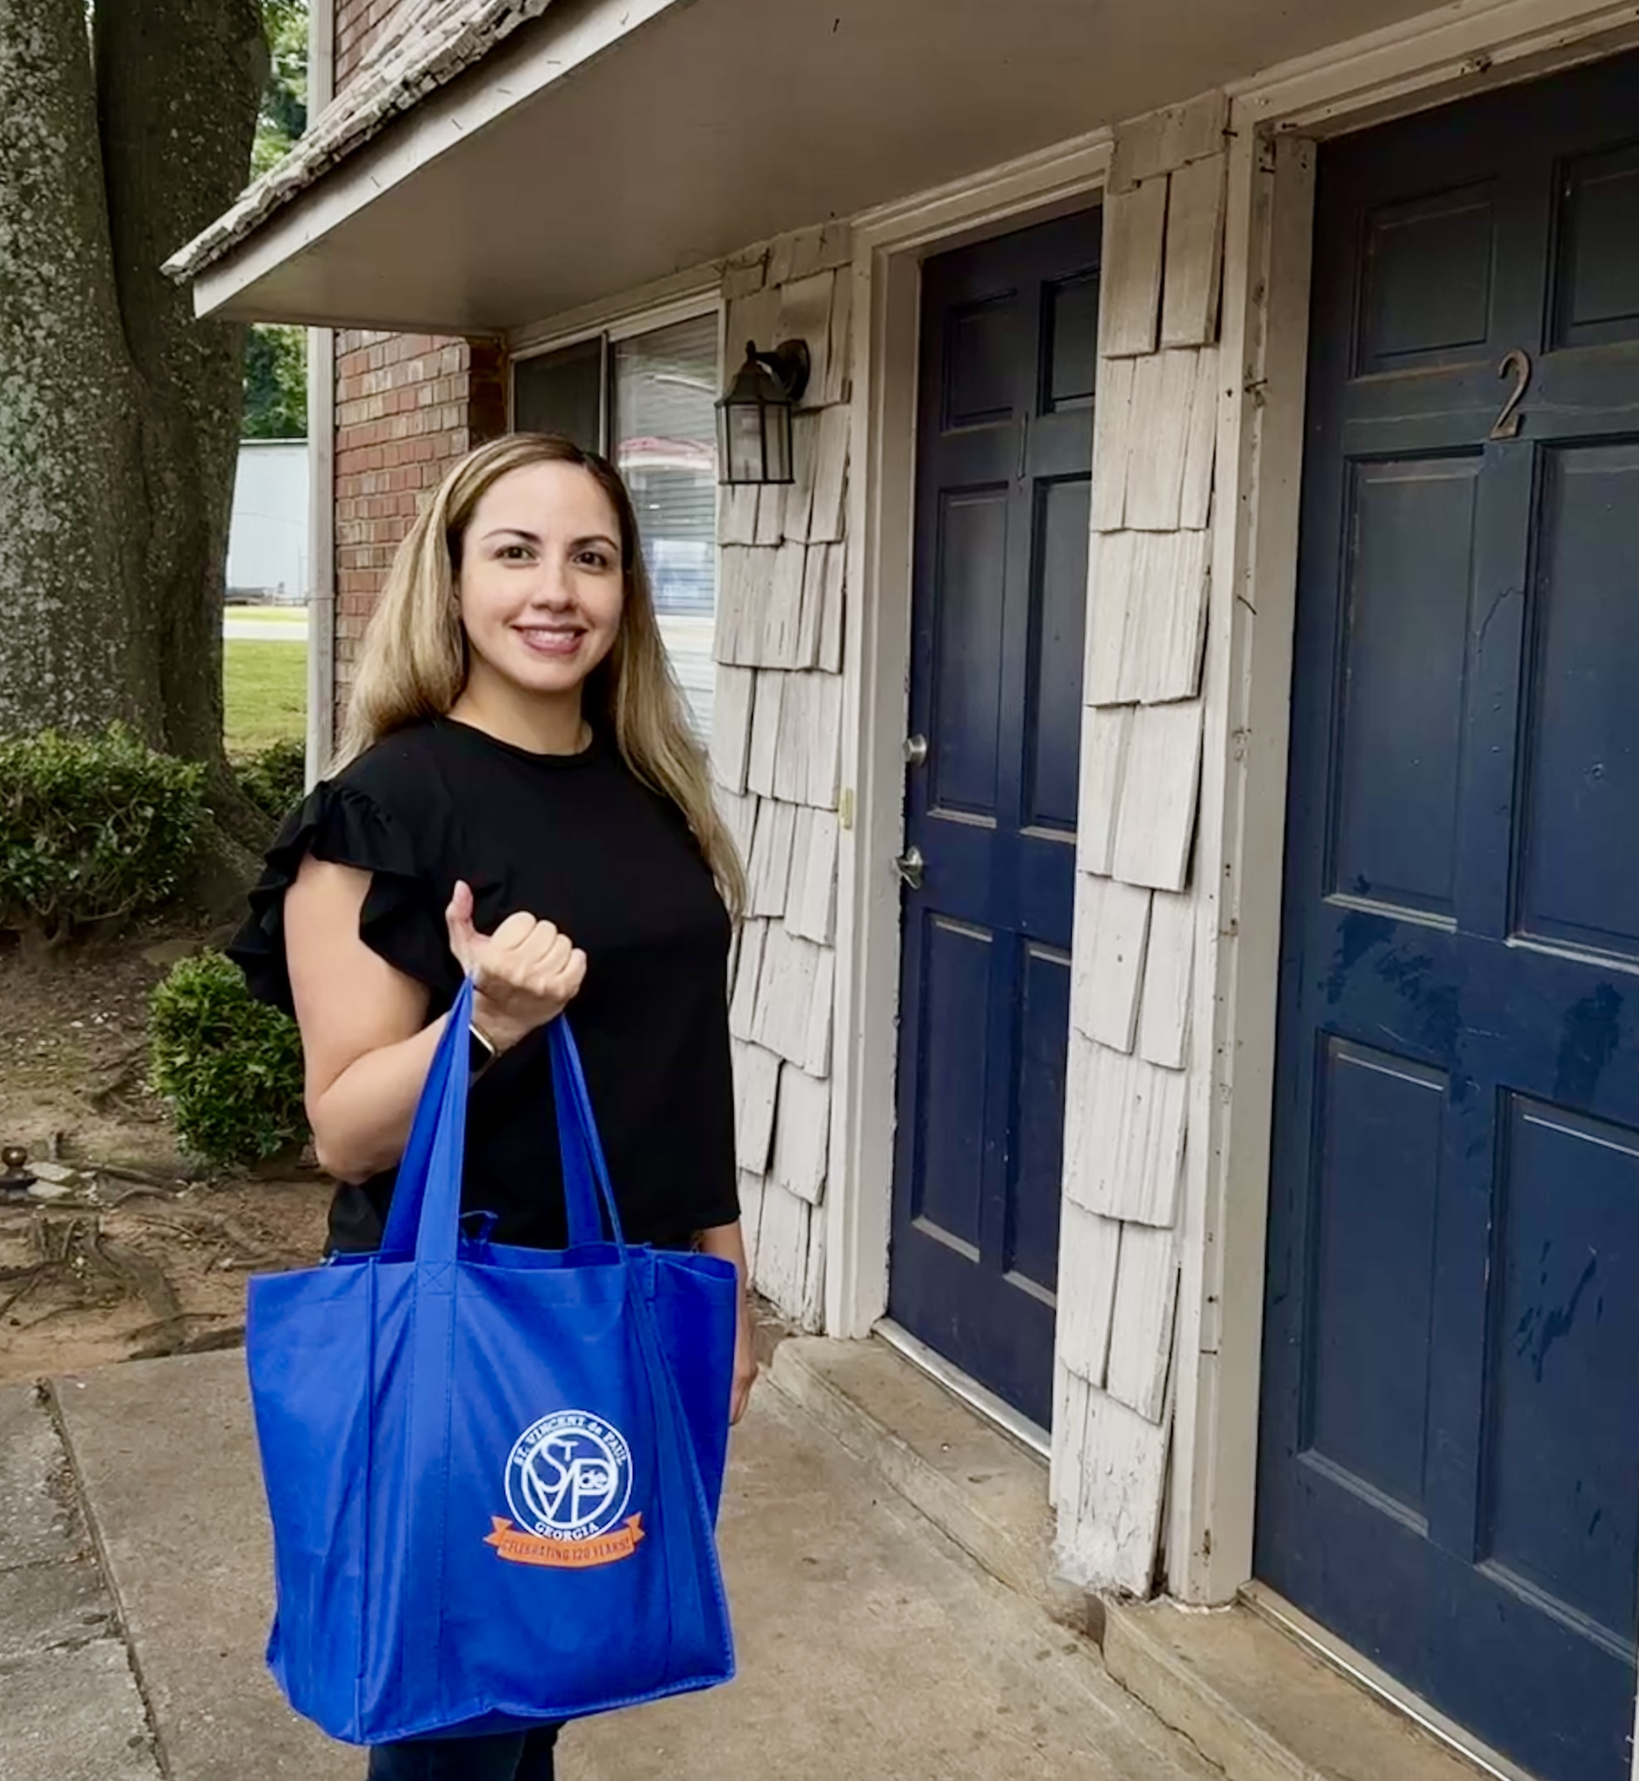
Our Mission
Rooted in Love. Focused on Impact.
Our Mission:
To Serve our Neighbors with Love and Respect: Delivering Help, Hope, and Pathways to Self-Sufficiency
Our mission explains why we exist and who we are at our core—
a community rooted in love, respect, and action.
We speak of neighbors because relationships matter, and our care is always personal.
“Help, hope, and pathways” reflects both our compassionate response in times of crisis and our commitment to long-term sustainability.

Slide 4
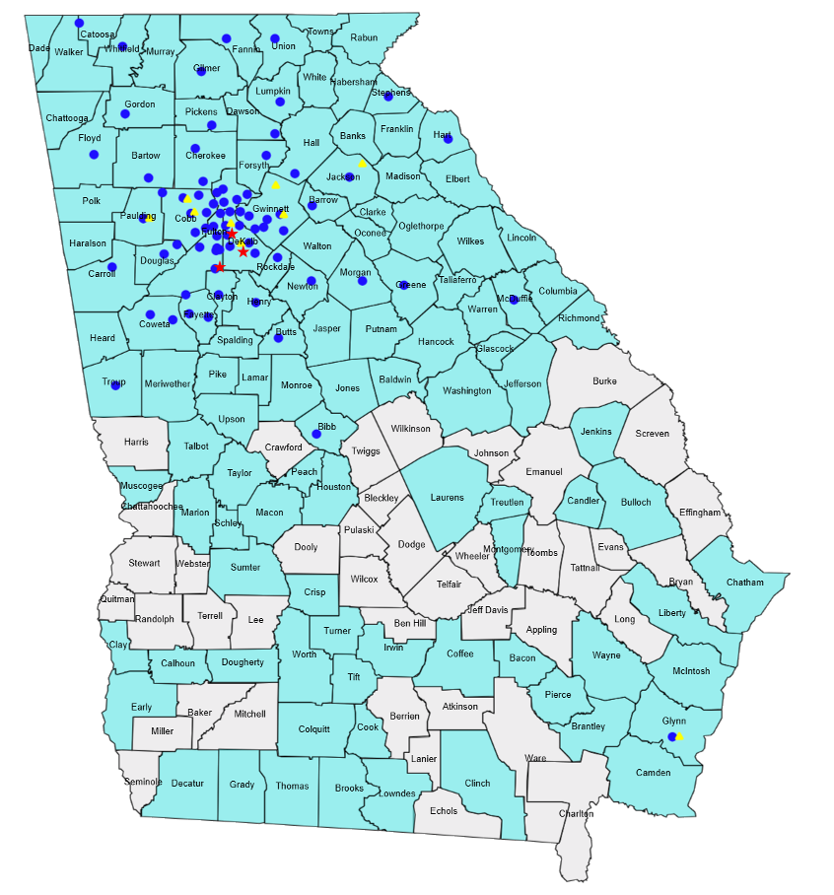
SVdP Georgia Conference Data
In the Archdiocese of Atlanta, St. Vincent de Paul has a strong presence, with Conferences in 72 of 93 traditional parishes.
In the Diocese of Savannah, we have 2 Conferences serving 5 of 50 traditional parishes (8% coverage).
District / Area | # Conferences
D1 – Cobb & NW Georgia | 11
D2 – North Fulton | 7, 1 Youth
D3 - Gwinnett | 9
D4 - Intown | 9
D5 - Southwest | 10, 1 Youth
D6 - DeKalb | 5
D7 – East Georgia | 6
D8 – East Mountain | 8
D9 – West Mountain | 9
Council Wide | 74, 2 Youth
77% of parishes in the Archdiocese of Atlanta have active Vincentians—triple the national average! Our neighbors are supported by one of the most engaged volunteer networks in the country.

Slide 5

“And God is able to bless you abundantly, so that in all things at all times, having all that you need, you will abound in every good work.”
2 Corinthians 9:8

Slide 6
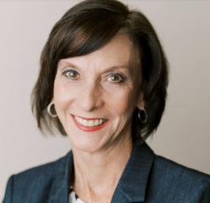
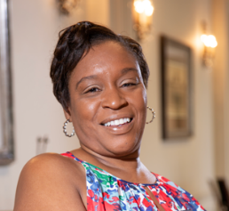
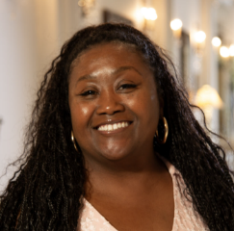
Council Development Team
Lisa Regan - Associate Executive Director
Lregan@svdpgeorgia.org
770.576.4080
What We Do
Secure support for SVdP Mission
Amplify SVdP public profile of mission, programs and services
Stewards of data, systems and expertise
  Steward of Development CRM
  Collect and analyze data
  Critique results for process and practice improvement
  Conduct peer performance reviews, adopt and share best/standard practice
  Provide direct support in funding endeavors for al Conference locations
Rene Bazel - Senior Manager of Institutional Giving/Interim Director
rbazel@svdpgorgia.org
678.892.6175
Debra Roberts - Senior Manager of Development
droberts@svdpgeorgia.org
404.834.2014
Development Support Team
Brian Dooling - Director of Diocesan Relations
Malissa Lawton - Development Operations
Dave Mangels - Development Coordinator
Jay Bazel - Development Assistant

Slide 7






Development Role of the Council
This team of Professionals are working for YOU and is ready to help for the good of our Neighbors in need!
Relationships, Partnerships, Major Gifts and Events:
Corporate Impact Luncheon
WISH Georgia
Tee Off for Hope
Volunteer Appreciation Reception
Morning of Hope
Annual Block Party
Holiday Open House

Slide 8
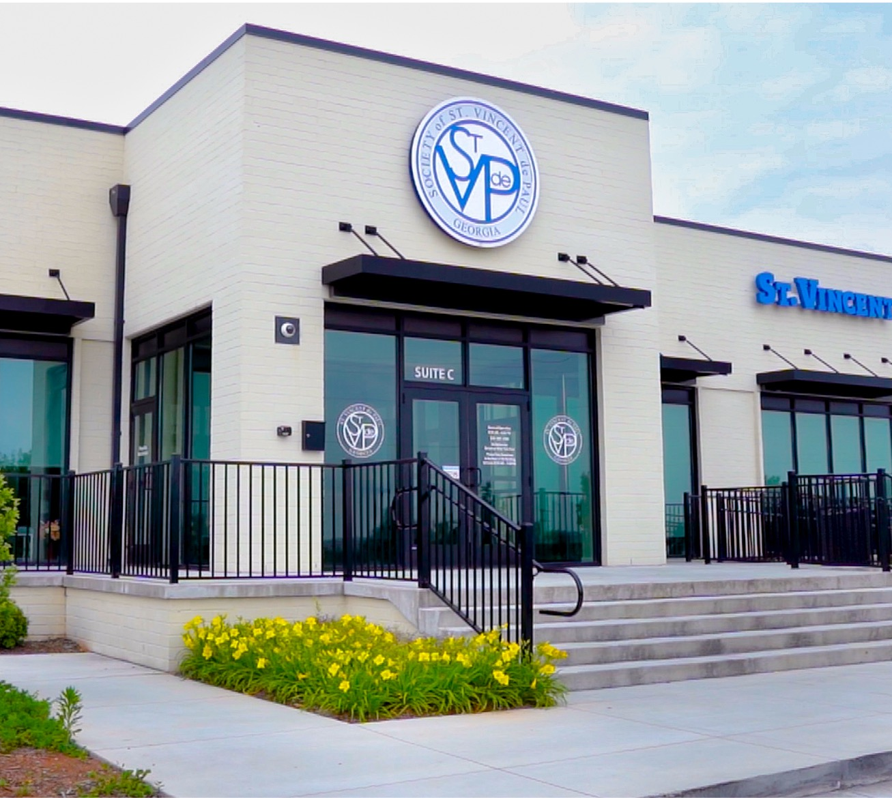
Conference Support from SVdP Council
One Of The State’s Oldest And Most Trusted Social Services Organization
 | FY2025 | FY2026 YTD
Grant Support Received | $113,000 | $108,000
Obtained Funding | $81,000 | $18,000/$50,000 Pending
Percentage Total | 72% Success Rate | 63% Success Rate YTD
Council Contact for Grant Support: Rene Bazel

Slide 9





Steps To Fundraising
Set Goals – Know Your Audience
Identification
people, corporations, foundations, civic/government, associations, etc.
Qualification
demographics, history, capacity, interest, etc.
Cultivation
Share what you know and what you do; reflect prospect/donor interest
Solicitation
Inviting donations, gifts, sponsorships, LOIs, grant applications, giving societies, etc.
Stewardship/Recognition
Thanking and showing donors
the difference they made

Slide 10





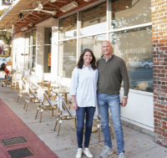
Let’s Get Local - Potential “Untapped” Resources
Rotary Clubs
Typical Grants up to $10,000
Sustainable and Measurable Outcomes, to include Family Stabilization - i.e., homeless prevention, emergency assistance, underserved communities
Kiwanis Clubs
Typical Grants up to $10,000
Focus on children, families in crisis, hunger and education
Community Foundations
Typical Grants up to $25,000
Focus on basic needs, rural poverty, improving quality of life
Local Food Banks
Focus on providing food at a significant reduction in price
Bulk purchases, which provides cost savings
Electric Membership Corporations (EMCs)
41 EMCs statewide
EMC Members participate in “Operation Round Up” to provide grant support. Grant funding varies, based on location
Local Business
Identify local business that may want to support initiatives within the community
Focus on your local Conference endeavors
10

Slide 11
Let’s Get Local - Potential “Untapped” Resources
Rotary Clubs
https://my.rotary.org/en/domui/club-search
Kiwanis Clubs
https://www.georgiakiwanis.com/
Community Foundations
Search your Local Community Foundation
Local Food Banks
https://www.feedingamerica.org/
EMCs
https://georgiaemc.com/
Local Business
Utilize local business sectors to identify whom you should contact
11

Slide 12

Georgia has a robust network of Community Foundations focused on improving local, regional, and statewide philanthropy.
Community Foundations Across Georgia Examples
Community Foundation for Greater Atlanta: Serves the 22-county metro Atlanta area.
Community Foundation of the Chattahoochee Valley: Based in Columbus, serving the surrounding area.
Community Foundation of Central Georgia: Serving Macon and surrounding counties.
North Georgia Community Foundation: Focuses on the North Georgia region.
Community Foundation of Northeast Georgia: Serving the Northeast Georgia region.
Community Foundation for the CSRA: Serving the Central Savannah River Area (Augusta region).
Community Foundation of South Georgia: Serving Southern Georgia.
Communities of Coastal Georgia Foundation: Serving Camden, Glynn, and McIntosh counties.
Community Foundation of West Georgia: Serving West Georgia.
Athens Area Community Foundation: Serving the Athens area.
Community Foundation of Northwest Georgia: Serving the Northwest region.

Slide 13
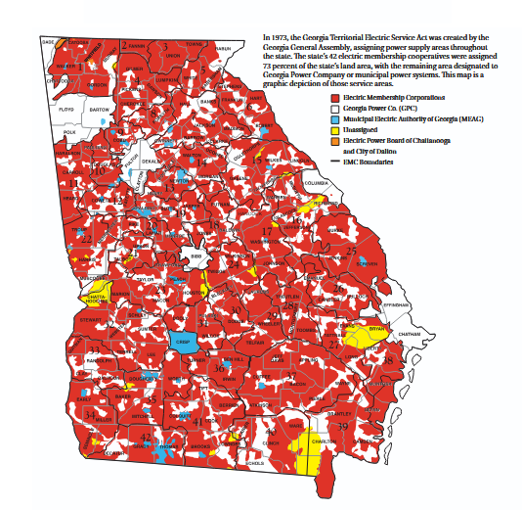
Case In Example
  Funds Expensed via EMC In Local Sawnee Area

Slide 14
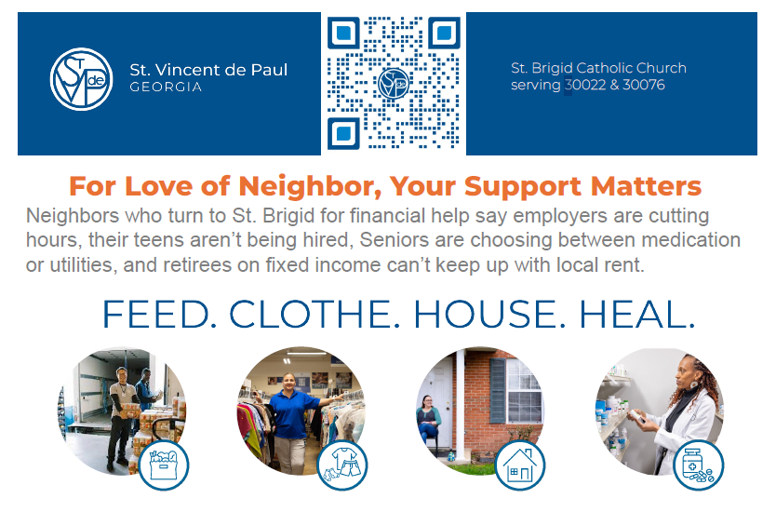
Fundraising at Your Parish
Understand the Impact of YOUR Local Community
Know Your Local Parish and Conference Impact for Neighbors
Help Your Pastor Achieve the Parish Mission
Build relationships with:
  Local Community Entities
  Other Ministries
  Knights of Columbus
  Women’s Guild
  Men’s Club
  Youth Groups
Ask to be the beneficiary of events

Slide 15
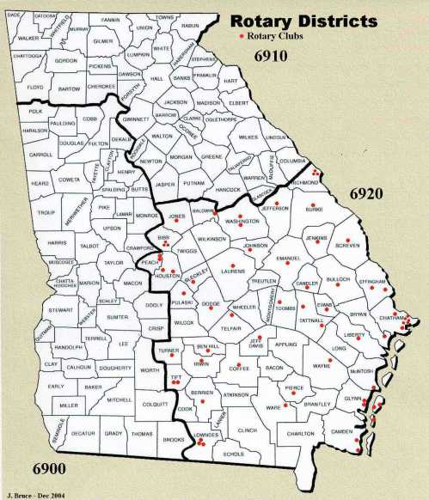
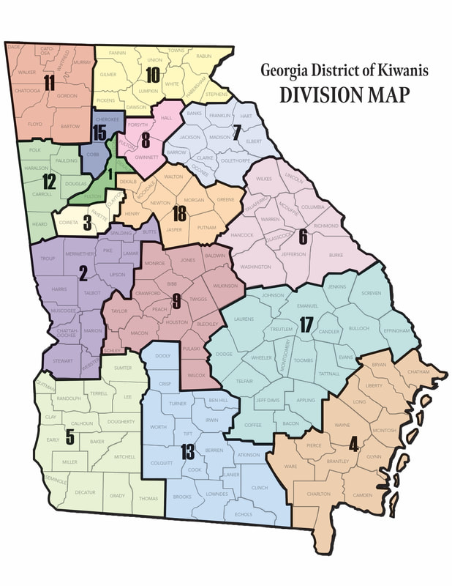

Fundraising In Your Parish
  Civic and Service Organizations

Slide 16
Key Considerations for SVdP Georgia Development Department and Conference Collaborations
We all use ONE EIN Number
There is more than enough to go around
Our efforts will differ; our aim will be the same
Share stories of Neighbor encounters with your donors

Slide 17

Questions, Answers and
Open Discussion

