Slide 1

Feed. Clothe. House. Heal.
Inspired to Lead. Called to Serve.
Conference Presidents' Leadership Retreat
February 21, 2026

Slide 2
Icebreaker

Slide 3
Agenda
Opening Prayer & Spiritual Reflection
Objectives & Inspiration for the day
Topic One
Bezos Day 1 Families Fund
Lunch
Topic Two
Topic Three
Dessert Bar & Group Review
Re-Commissioning & Closing Prayer

Slide 4


Slide 5
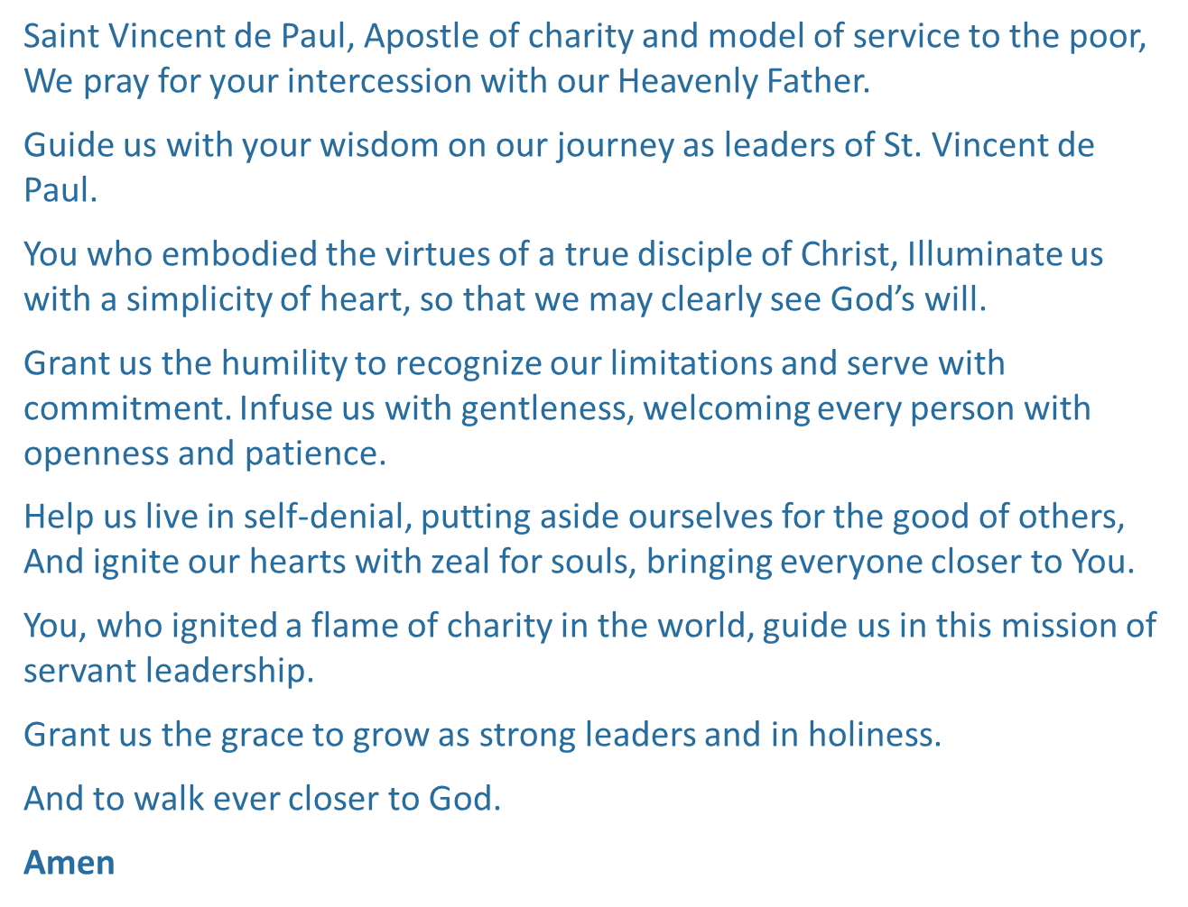


Slide 6
What is Servant Leadership And Am I Called?

Slide 7

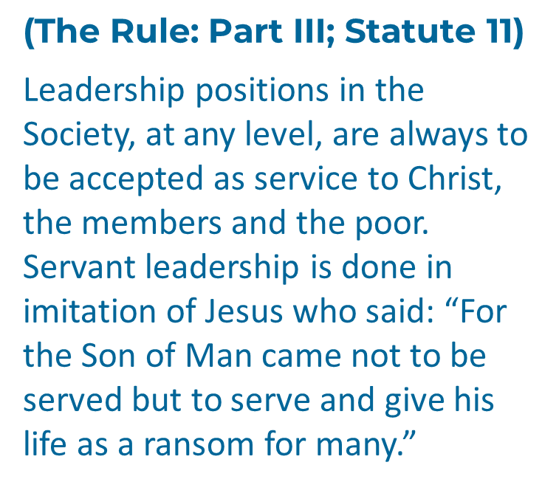
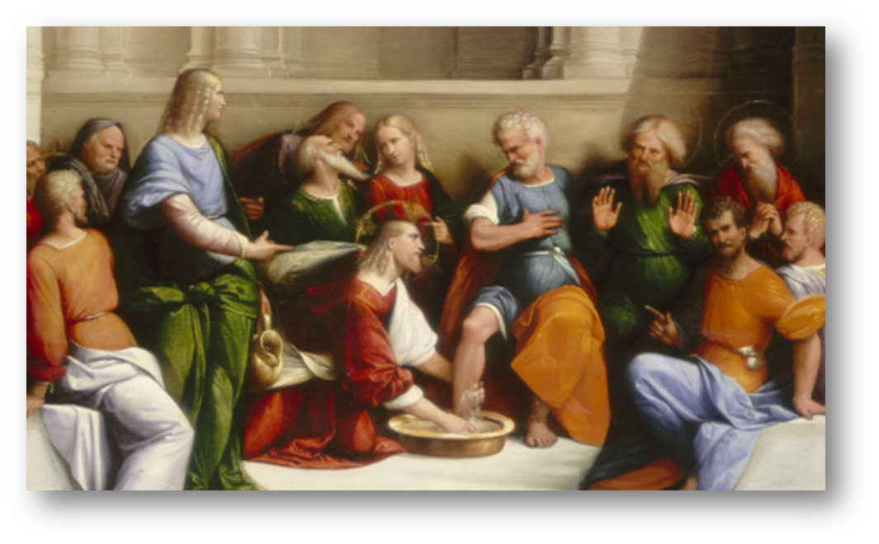

Slide 8

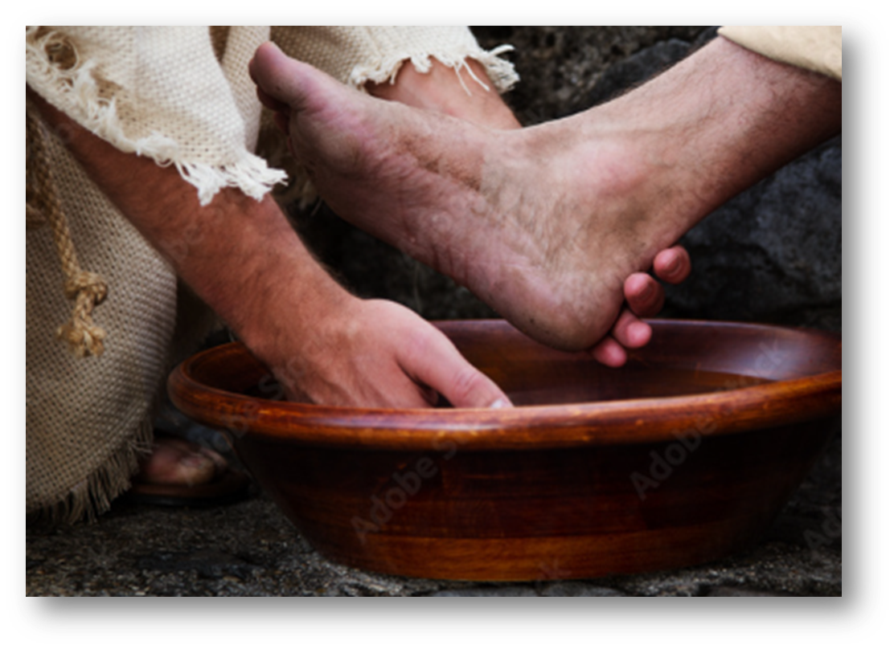
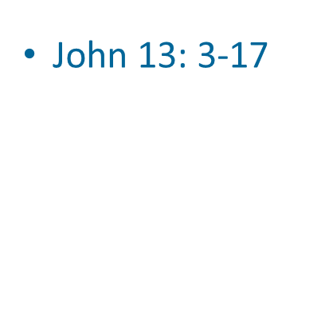

Slide 9
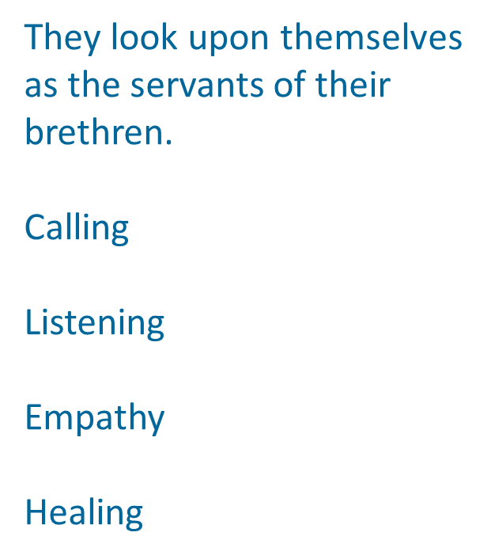

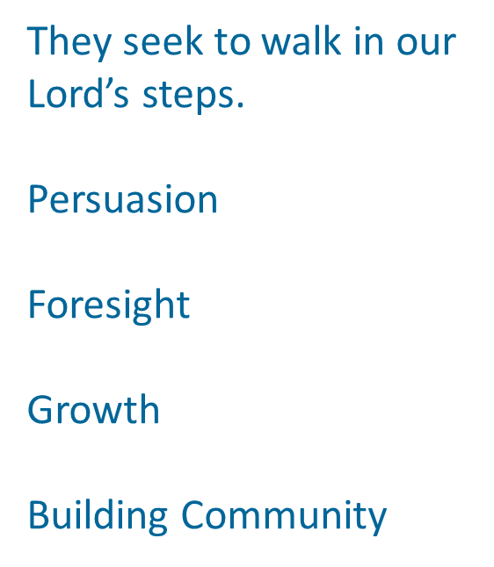

Slide 10
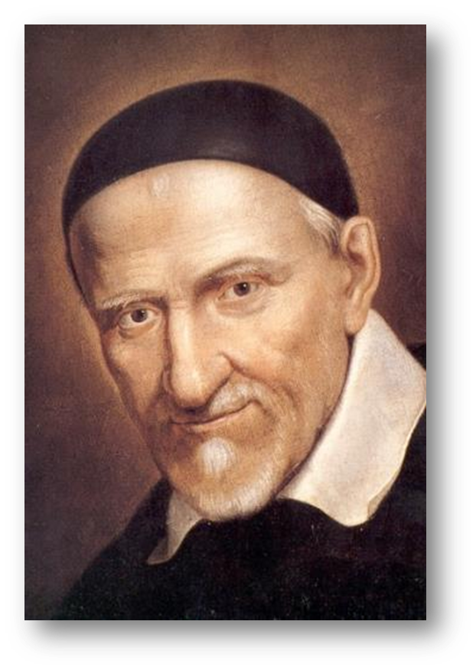
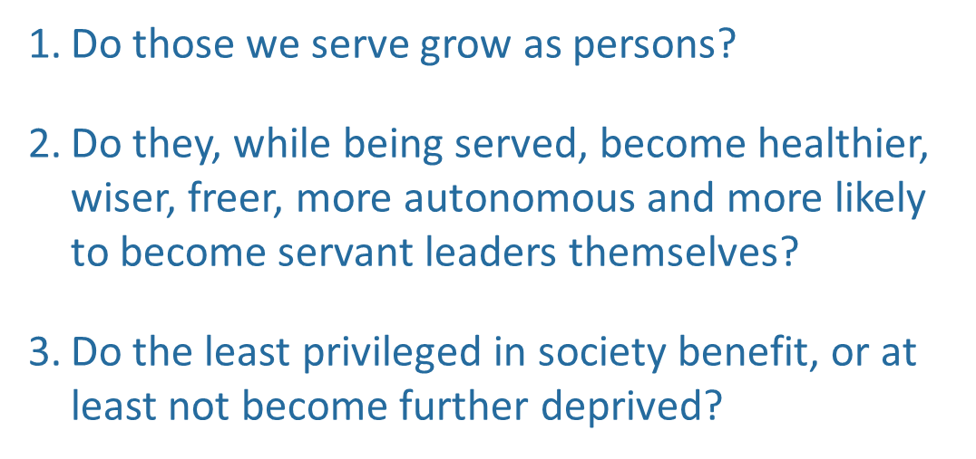

Slide 11

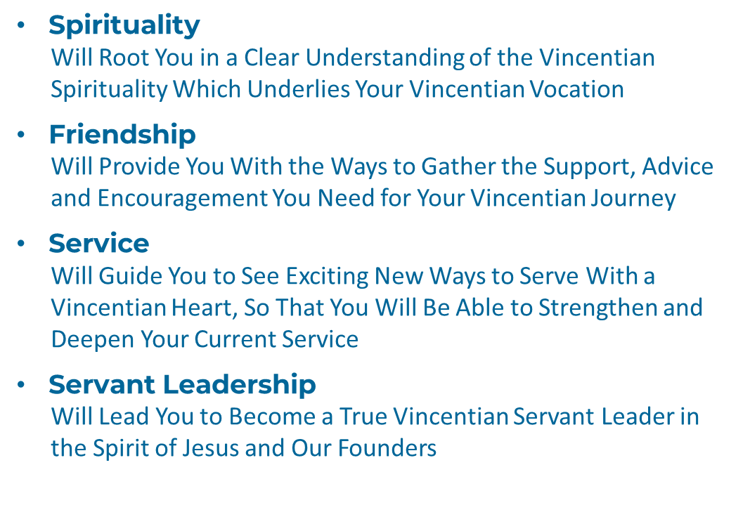

Slide 12

https://www.youtube.com/watch?v=kdmgpMfnjdU

Slide 13
Setting the Stage

Slide 14

Our Meeting Theme
Inspired to Lead. Called to Serve.

Slide 15
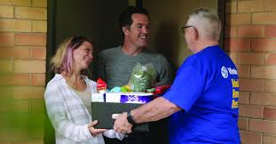


Our Meeting Goals
Motivated.
Connected.
Supported.

Slide 16

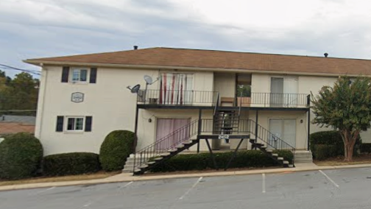
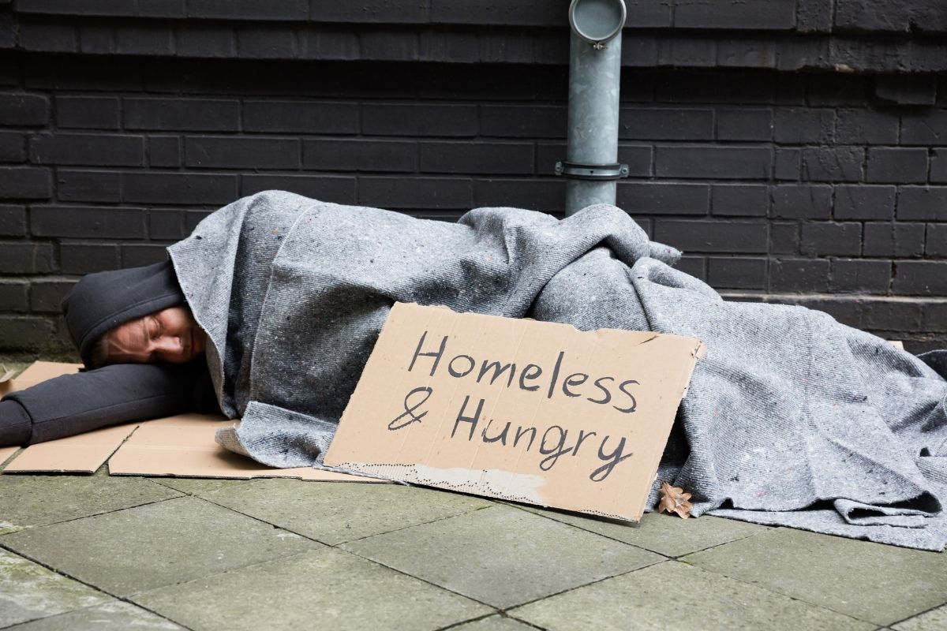

Our Meeting Topics
Recruiting & Succession Planning
Housing and Homelessness
Managing Intake Volume
and
Bezos Funding

Slide 17
Strategic Plan Pillars 2025-2030
Supporting Conferences
Supporting Vincentians
Supporting Neighbors
Supporting Communities
Internal
Building Neighborhoods of Support and Friendship
External

Slide 18
Strategic Objectives
Supporting Conferences
Strengthen Conference Operations and Support Systems
Supporting Vincentians
Supporting Neighbors
Supporting Communities
Invest in Our Physical Neighborhoods
Expand Holistic Resources to Foster Systemic Change
Emphasize Personal Encounters
Expand Our Conference Network
Address Underserved Communities
Expand Targeted Housing Programs & Develop Services for Unsheltered
Provide Greater Opportunities for Training and Skills Development
Enhance Resources and Support for Caseworkers and Neighbor Advocates
Re-Center Our Work on Our Vincentian Charism and Essential Elements
Cultivate a Vincentian Staff
Advocate for Our Neighbors
Focus Resources on Membership Recruitment
Encourage Collaboration to Share Resources and Best Practices
Supplement Conference Funding Efforts
Building Neighborhoods of Support and Friendship

Slide 19
Topic One: Recruiting, On-Boarding & Succession Planning

Slide 20
Recruiting:
Role-Filling vs. Soul-Filling

Slide 21


Role-Filling vs. Soul-Filling
What I need
What my fellow parishioners need
Caseworkers. Intake. Home Visitors. CMS Admin. Pantry. More Caseworkers.
Community. Friends. Up-lift. Fulfillment. Spiritual Growth. Faith. Connection. Fellowship.
Notes:
MIKE: Challenge how they think about recruiting

Slide 22

Role Filling vs. Soul-Filling
“SVdP is following so closely with the life of Jesus Christ… you are growing in a way that makes (volunteering) a spiritual development of your own life.”
-Pat Fischer, Vincentian

Slide 23
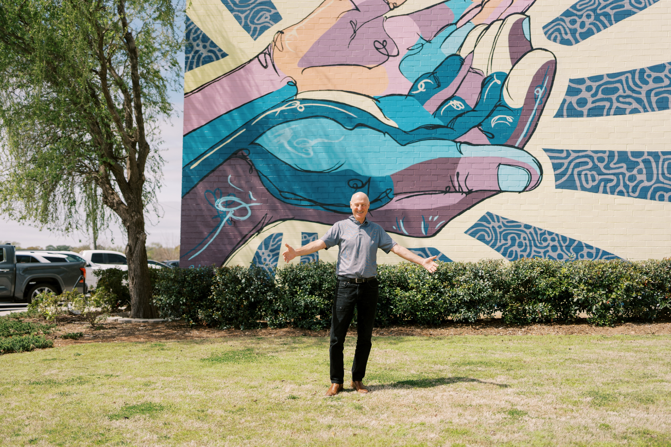
Recruiting through Ambassadorship
Share the good news of your conference’s work!
At church
In your Neighborhood
With friends
At the dinner table with your children and family
With you Pastor after Sunday Mass

Slide 24
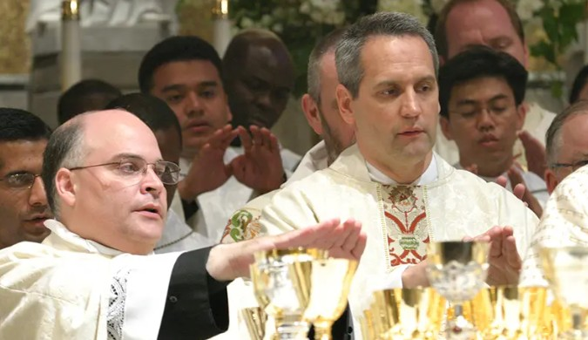
Engage your Pastor
Know your pastor’s goals for the parish; demonstrate how SVdP can contribute to parish life
Share the work of your conference; provide stories and statistics
Thank your pastor for his endorsement of St. Vincent de Paul

Slide 25

Just Ask!
The Power of a Personal Invitation
Share your personal testimony with friends, parishioners and acquaintances
Welcome people to join a conference meeting or participate in an SVdP activity.
Challenge your Vincentian members to do the same!

Slide 26


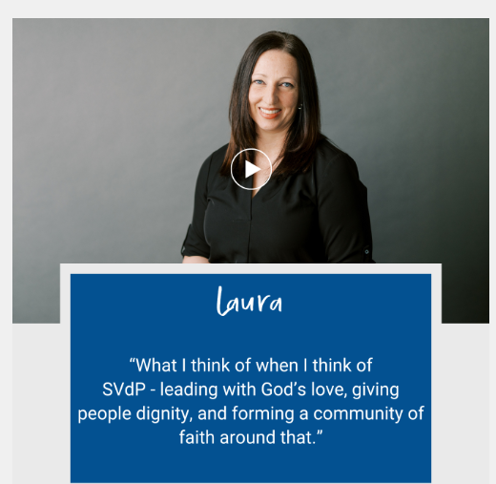

Council-based Annual Recruiting Campaign
April 23----------------------------September 27
(Anniversary of the Society) (Feast of St. Vincent de Paul)

Slide 27


Recruiting Campaign: the Prep
Meet with your pastor; invite him to the Council Support Center
Schedule a recruiting/ministry weekend
Promote the weekend 3 weeks ahead: bulletin announcements; social media; parish newsletter
Ask members to participate in the recruiting event & serve as mentors to new recruits
Schedule an ‘info meeting’ for interested parishioners and promote that date at the recruiting weekend

Slide 28

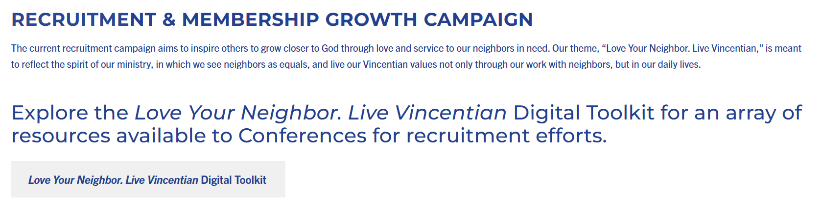

Recruiting Campaign: Resources
https://svdpgeorgia.org/members/recruitment-marketing/recruitment-growth/

Slide 29

Recruiting and Onboarding
You’ve got a room full of interested parishioners: now what?
Have your plan in place for new recruits to plug in quickly:
Home Visit Secondary
Pantry Support
Observe Intake processes
What else?
Assign Vincentian mentors to new recruits for continuity and support

Slide 30
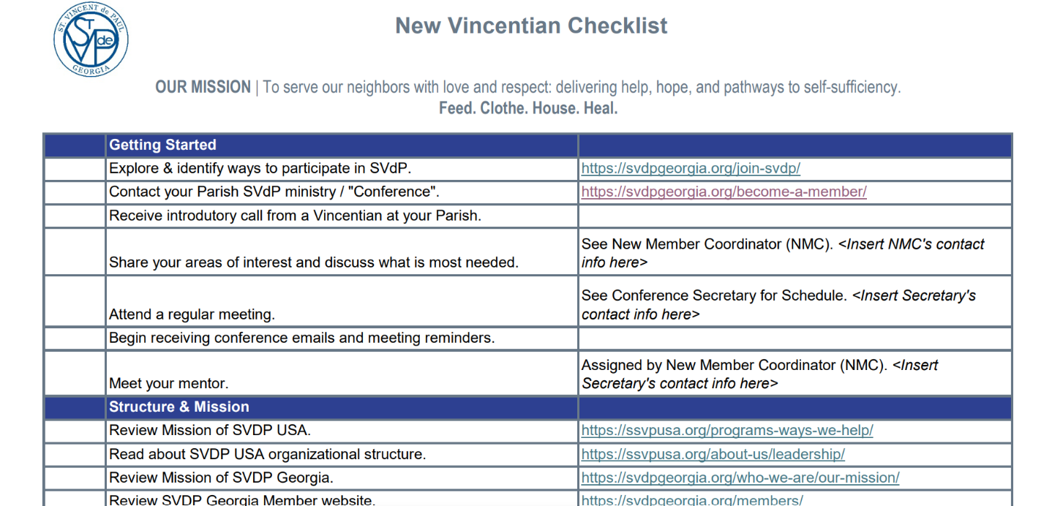
Recruiting and Onboarding

Slide 31
Succession Planning

Slide 32

Succession through Servant Leadership
Succession planning starts from the moment a new officer is in place!
Get to know your active Vincentians
What are their gifts and talents? Motivations and Desires?
What gifts to they bring to the table?
A Vice President role can fulfill a variety of functions. Engage as many VP’s as you have needs to fill!

Slide 33

Table Talk Exercise One
Group Sharing

Slide 34
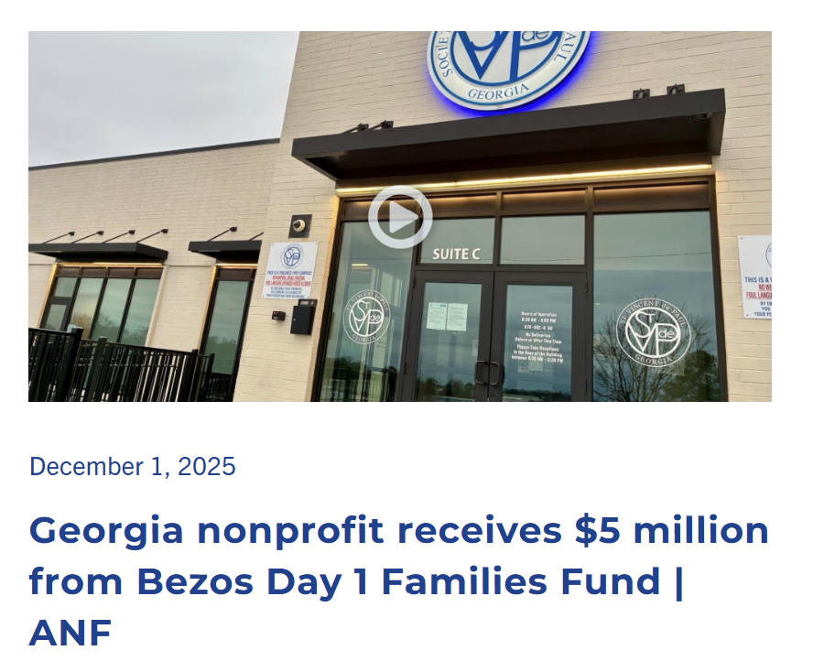

Bezos Day 1 Families Fund
Notes:
Thank you Darlene!

Slide 35

Day 1 Families Fund Grant
$5 Million Award to support homeless families over 5 years
Purpose: “To pursue solutions to family homelessness with a strong focus on providing housing as well as social services, skills training, and job support to assist families in transitioning to and remaining in permanent housing.”
Homeless families includes families currently experiencing homelessness (living outdoors, in cars, in shelter, or someplace unsafe or that they have to leave), or who are in the process of exiting homelessness and stabilizing in permanent housing.
Eligible activities include:
Outreach
Shelter
Housing
Services
Gift is intended to have an impact over 5 years.

Slide 36
Requested Budget
Category | 5-Year Budget | Annual Budget | Description
Outreach Services | $1,322,500 | $264,500 | Casework, casework support, essential and emergency needs, referral services
Emergency Support & Rapid Rehousing | $1,883,250 | $376,650 | Emergency housing (motels), rental assistance, other financial support (utilities, transportation, food)
Housing Stability Services | $870,000 | $174,000 | Master leased apartments and related expenses, child care, transportation, household items
Support Services | $940,000 | $188,000 | Wrap-around services, LEAP, IAP, education programs, statewide social worker, administrative costs
 | $5,015,750 | $1,003,150

Slide 37
Year 1 Allocations
Category | 2026 Budget | Description
Direct Aid | $250,000 $150,000 $75,000 $130,000 | Conferences: Reimbursable Matching Grant for Emergency Services for homeless families, including motel stays Conferences: Rehousing support for homeless families referred by Conferences Council: Motel and move-in assistance in White Space (areas of the state not covered by a Conference) Hybrid: Supplemental funding for rapid rehousing programs (e.g. MARI, STABLE)
Casework Support | $155,000 | Casework Support: Family Stability Specialist 100% allocated to support Conferences Council Caseworker to focus on supporting unhoused families
Stability Services Program Staff | $140,000 | Full-time Landlord Navigator (LEAP) Part-time Workforce Coordinator (IAP) Part-time HANDS Peer Educator
Unallocated | $100,000 | Available to expand above efforts and support administrative expenses
 | $1,000,000

Slide 38
Year 1 Allocations
Category | 2026 Budget | Description
Direct Aid | $250,000 $150,000 $75,000 $130,000 | Conferences: Matching Grant for Emergency Services for homeless families, including motel stays Conferences: Georgia Family Rehousing Initiative referrals to Council Council: Motel and move-in assistance in White Space (areas of the state not covered by a Conference) Hybrid: Supplemental funding for rapid rehousing programs (e.g. MARI, STABLE)
Casework Support | $155,000 | Casework Support: Family Stability Specialist 100% allocated to support Conferences Council Caseworker to focus on supporting unhoused families
Stability Services Program Staff | $140,000 | Full-time Landlord Navigator (LEAP) Part-time Workforce Coordinator (IAP) Part-time HANDS Peer Educator
Unallocated | $100,000 | Available to expand above efforts and support administrative expenses
 | $1,000,000

Slide 39
Year 1 Allocations
Category | 2026 Budget | Description
Direct Aid | $250,000 $150,000 $75,000 $130,000 | Conferences: Matching Grant for Emergency Services for homeless families, including motel stays Conferences: Georgia Family Rehousing Initiative referrals to Council Council: Motel and move-in assistance in White Space (areas of the state not covered by a Conference) Hybrid: Supplemental funding for rapid rehousing programs (e.g. MARI, STABLE)
Casework Support | $155,000 | Casework Support: Family Stability Specialist 100% allocated to support Conferences Council Caseworker to focus on supporting unhoused families
Stability Services Program Staff | $140,000 | Full-time Landlord Navigator (LEAP) Part-time Workforce Coordinator (IAP) Part-time HANDS Peer Educator
Unallocated | $100,000 | Available to expand above efforts and support administrative expenses
 | $1,000,000

Slide 40
Year 1 Allocations
Category | 2026 Budget | Description
Direct Aid | $250,000 $150,000 $75,000 $130,000 | Conferences: Matching Grant for Emergency Services for homeless families, including motel stays Conferences: Georgia Family Rehousing Initiative referrals to Council Council: Motel and move-in assistance in White Space (areas of the state not covered by a Conference) Hybrid: Supplemental funding for rapid rehousing programs (e.g. MARI, STABLE)
Casework Support | $155,000 | Casework Support: Family Stability Specialist 100% allocated to support Conferences Council Caseworker to focus on supporting unhoused families
Stability Services Program Staff | $140,000 | Full-time Landlord Navigator (LEAP) Part-time Workforce Coordinator (IAP) Part-time HANDS Peer Educator
Unallocated | $100,000 | Available to expand above efforts and support administrative expenses
 | $1,000,000

Slide 41
Year 1 Allocations
Category | 2026 Budget | Description
Direct Aid | $250,000 $150,000 $75,000 $130,000 | Conferences: Matching Grant for Emergency Services for homeless families, including motel stays Conferences: Georgia Family Rehousing Initiative referrals to Council Council: Motel and move-in assistance in White Space (areas of the state not covered by a Conference) Hybrid: Supplemental funding for rapid rehousing programs (e.g. MARI, STABLE)
Casework Support | $155,000 | Casework Support: Family Stability Specialist 100% allocated to support Conferences Council Caseworker to focus on supporting unhoused families
Stability Services Program Staff | $140,000 | Full-time Landlord Navigator (LEAP) Part-time Workforce Coordinator (IAP) Part-time HANDS Peer Educator
Unallocated | $100,000 | Available to expand above efforts and support administrative expenses
 | $1,000,000

Slide 42
Year 1 Allocations
Unallocated
Program Staff
Direct Aid
Casework Staff

Slide 43

Year 1 Allocations

Slide 44
Switch Tables &
Grab Lunch

Slide 45
Topic Two: Eviction Prevention, Homelessness & Conference Guidelines

Slide 46
Goals
Assure your Conference activities and guidelines are mission-aligned!
Where does your Conference fit in the housing and homelessness response system?
What are the needs of your community?
What are the capabilities of your Conference and parish community?
Do your guidelines help or hinder your mission?

Slide 47

What Causes Homelessness?
Notes:
Ask the audience…..

Slide 48
What Causes Homelessness?
Structural Causes “Where”
High rent
Low vacancy rates
Individual Vulnerabilities “Who”
Severe cost-burden
Prior homelessness, eviction, frequent moves
Destabilizing Event “When”
Loss of job, relationship
Declining health
Supply and demand imbalance
Inelastic supply
Child welfare, Courts, DV
HS dropout, no GED
Exiting prison, foster care, hospital
And no savings
People of color
Source: Homelessness is a housing problem, Colburn and Aldern
Notes:
We can’t solve all of these issues, but we can impact those affected by them

Slide 49
Where should our focus be?
Preventing Homelessness
Direct Financial Aid
Eviction Prevention
Stability Services
Diversion
Responding to Homelessness
Shelter (Motels)
Outreach
Essential Services
Stability Services
Notes:
Broad mix of conferences with varying resources
Each conf should be intentional choices of how to serve

Slide 50

Prevention and Diversion
Rent and Utility Assistance
Legal Support –Evictions
Diversion-AKA Housing Problem Solving
General Assistance: Childcare, Transportation, Food, Workforce Development
Homelessness Emergency Response System
Street Outreach
Emergency Shelter: Congregate, Non-congregate, Motel
Motel to Home
Transitional Housing
Rapid Rehousing
Stable Housing
Permanent Supportive Housing
Affordable Housing
Market Housing
Homelessness System Interventions
Notes:
Where decide to focus their effort will decide where in the system they will impact
Natl emphasized HP but free to respond to local needs

Slide 51
Why Focus on Preventing Evictions?
One of life's most traumatic events
The financial scars are deep and involve multiple generations
The health and wellbeing of families including children are compromised
Evictions hurt everyone!
Tenants (outstanding rent and late fees, court costs, moving costs, replacement of personal items)
Landlords ($5-10K)
Communities (cost of courts, law enforcement, emergency shelter, uncompensated health care, unpaid utilities, school transfers)
Evictions decrease housing stability and often lead to homelessness within 2 years
Loss of Public Housing Authority (PHA) voucher and shut out of Section 8
Landlords screen for eviction filings – used to deny applications
Notes:
Natl focus

Slide 52

The Crises Created by Evictions
Eviction filing
Eviction
Lose Possessions
Miss work
Find substandard housing
Double up or couch surf
School absenteeism increases
Extended Stay Motel
ER Visits and Hospitalizations
Mental Health and Behavior Problems
Job loss
Move into car
Emergency Shelter-now “officially” homeless
Notes:
Share with your donor base-this is the impact of intervention

Slide 53
The Eviction Process – Intervention Points
Case Management / Financial Assistance
Rental Assistance / Eviction Counseling
Legal assistance
Eviction Counseling*
Notice to Quit
Eviction Filing
Court Hearing
Judge's Decision
Notice to Vacate
Late Notice
Notes:
When provide financial assistance early enough, can have big impact and prevent negative effects of eviction

Slide 54
Why is Eviction Prevention a "good fit" for a SVdP conference?
It is within the capacity of every Conference
It is consistent with our mission, vision, and values and prevents needless trauma and suffering
Our local nature supports fast check processing and delivery
It makes $ense!

Slide 55

A Systems Look at Homelessness
Inflow
Newly homeless
(4x)
Homelessness Emergency Response System
Outflow
Stable Housing
Source: “Solving Homelessness from a Complex Systems Perspective: Insights for Prevention Responses” Fowler, Hovmand, Marcal, and Das 2019
Notes:
Resp syst only has capacity to house about 15% of those in shelters

Slide 56
Types of Homelessness
Transitional
Hidden
Episodic
Chronic
Notes:
Transist: most common: evictions, divorce, job loss,
Hidden: families doubled up, cars, motels they pay for themselves
Episodic: in and out of homelessness: younger, chronically unemployed, substance abuse, mental health, couch surf, shelters and streets "runaways and throwaways"
Chronic: homeless with at least one disability for >1 yr or more than 4 x in 1 yr

Slide 57
The Homelessness Response System
HUD
CoC
Lead Agency
Coordinated Entry
Notes:
Lead Agency: Strategy, HMIS, PIT
Coord Entry: access, fairness,prioritzation (VSPDAT), referrals to comm and np partners

Slide 58
How the System Works
ViSPDAT SCORE | Prevention | Diversion | Street Outreach | Emerg. Shelter | M2H | Transit. Housing | Rapid Re- Housing | Perm. Supp. Housing | Afford.Housing
0 | X |  |  |  |  |  |  |  | X
1 | X | X |  | X |  |  |  |  | X
2 | X | X |  | X | X |  |  |  | X
3 | X | X | X | X | X |  |  |  | X
4 |  |  | X | X | X | X | X |  | X
5 |  |  | X | X | X | X | X |  | X
6 |  |  | X | X | X | X | X
7 |  |  | X | X |  | X | X | X
8 |  |  | X |  |  |  |  | X
9 |  |  | X |  |  |  |  | X
Transitional
Types of Homelessness
Hidden
Episodic
Chronic

Slide 59
The Vincentian Rationale for Serving Homeless – The Rule
1.3 Any form of personal help
1.8 Reverence for the Poor
7.2 Affirming the dignity of each human being
7.7 Vincentians oppose discrimination
7.9 The Society should work not only with individuals in need but also with families and communities

Slide 60
The Vincentian Rationale for Serving Homeless – The Manual
Charity and Justice
The poor have the right to shelter: Vincentians welcome strangers and the homeless and provide temporary shelter. We build and administer housing, providing furnishings and household items.
Poverty Services e.g. Housing Rehabilitation
Self-help programs such as food and repair co-ops, credit unions, home services for the aged and infirm, housing rehabilitation, legal services, and adult education. These can alleviate the need for recurrent handouts, which can undermine human dignity.
Services to Promote Social Justice
Promotion of social justice requires advocacy, and the establishment and operation of programs, benefits, and services that address the root causes of want and encourage respect for human life and dignity.

Slide 61
Be Intentional – not accidental – in responding to housing instability and homelessness
Community Needs
Gaps in Community Resources
Conference Resources

Slide 62

Target those most at risk
Previous experiences with homelessness and/or eviction
Frequent moves
High amount of past due rent or high housing cost burden
Experiencing violence
Child welfare involvement
Carceral involvement
Lack of GED or HS diploma

Slide 63

Re-examine Conference Guidelines and Procedures
Are they helping or getting in the way?
Conference guidelines exist to provide wisdom and fair play
Many guidelines were created years (decades!) ago and no longer address today’s needs
Examples to reconsider:
Funding deposits
Limits on # of times served/year
Dollar limits
Requiring eviction filing
Decision process
All guidelines are arbitrary!
Notes:
As a servant leader ---we suggest that their conf know that conf guidelines belong to the conference, they can change them

Slide 64
What Causes Homelessness?
Structural Causes “Where”
High rent
Low vacancy rates
Individual Vulnerabilities “Who”
Severe cost-burden
Prior homelessness, eviction, frequent moves
Destabilizing Event “What”
Loss of job, relationship
Declining health
Supply and demand imbalance
Inelastic supply
Child welfare, Courts, DV
HS dropout, no GED
Exiting prison, foster care, hospital
And no savings
IAP
IAP
Peer Support
M2H
Walking with Neighbors
LEAP
MMI
Food
Rx
OneApp
STABLE
Marillac Moms
Money Matters
Life Skills
HANDS
VITA
Loan Refinance
Source: Homelessness is a housing problem, Colburn and Aldern
Notes:
Binder has flyers on all these programs
Council programs are trying to address these causes of H

Slide 65
Table Talk Exercise Two
Group Sharing

Slide 66
Switch Tables

Slide 67
Topic Three: Managing Intake Volume through Mission-Centric Strategies

Slide 68
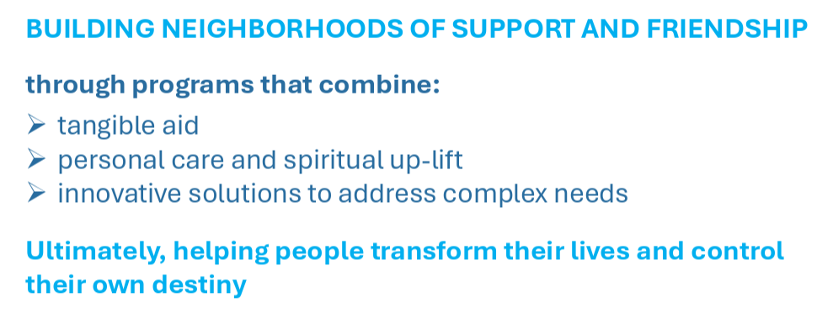
Service Opportunity: Accepting Calls When We Can't Help
Acknowledge their need.
Listen gently.
Offer encouragement.
Share resources that
may help.
Notes:
MIKE MIES

Slide 69
Intake by the Numbers Statewide Assistance Line: 678-892-6163
26,017
per month
=
85
per Conference
per week
70%
receive
25-50 per week
Notes:
WE get it. Volume high; $$ need high, and urgency / less time to act
We know we get far more calls than assigned cases.
.
DATA WE GET. Conf AS REPORTED
26,000 calls per month statewide (avg. Oct. 1 – Dec 31.)
~5,000 accepted cases across 3 months of Oct-Dec.
If calls were evenly distributed (or if Conferences took every case), that would mean 85 NIN served by every Conference every week.
Most Conferences receive 25-50 requests per week (or 70% of Conferences surveyed)
COH = 200+ in 3 days.
CSC = 149 per day
Many Conferences are facing increased demand, increased size of requests, increased urgency / less time to act.
We can’t serve every case, but we can acknowledge the Neighbor.
Some Conferences do this by texting a list of resources (IHM); some call every neighbor back. Some tell callers that only those who leave messages on a specific day of the week will receive a phone call back.
There are a variety of ways that Conferences respond to volume. The point today is this: Consider how new tools from the Council could help AND explore methods by other Conferences that could help your own.

Slide 70
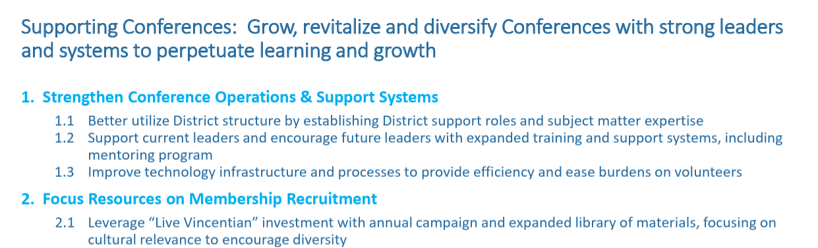
Supporting Conferences
Notes:
We’ve created tools and can offer perspective from across the state about what works & doesn’t work.
TECH to EASE BURDENS on VOLUNTEERS
TECH to help neighbors reach the right place.
WE acknowledge that it’s a shift in habits. We’re Vincentians too and we here to offer perspective from across the state..
MANAGE VOLUME BUT REMAIN MISSION-CENTRIC.
Make a personal connection.
Compassion empathy.
Acknowledgement even if it’s a call back to say we couldn't help; I'll pray for you.

Slide 71





How Callers Connect to You: 678-892-6163
1. Neighbor in Need dials the Statewide Assistance Line
2. “Thank you for calling St. Vincent de Paul of Georgia.”
3. Choose Language
English Spanish
4. Enter ZIP
Optional (Split ZIP)
“Press 1 if you live…” “Press 2 if you live…”
5. Routing Options, based on Conference Preference:
Forward to External # And allow voicemail, or
Refer to Online Form
Refer to Email
Leave voicemail End call.
Succinct
Native Language
Conference defines what happens next
Notes:
New benefits are:
-blue dot

Slide 72
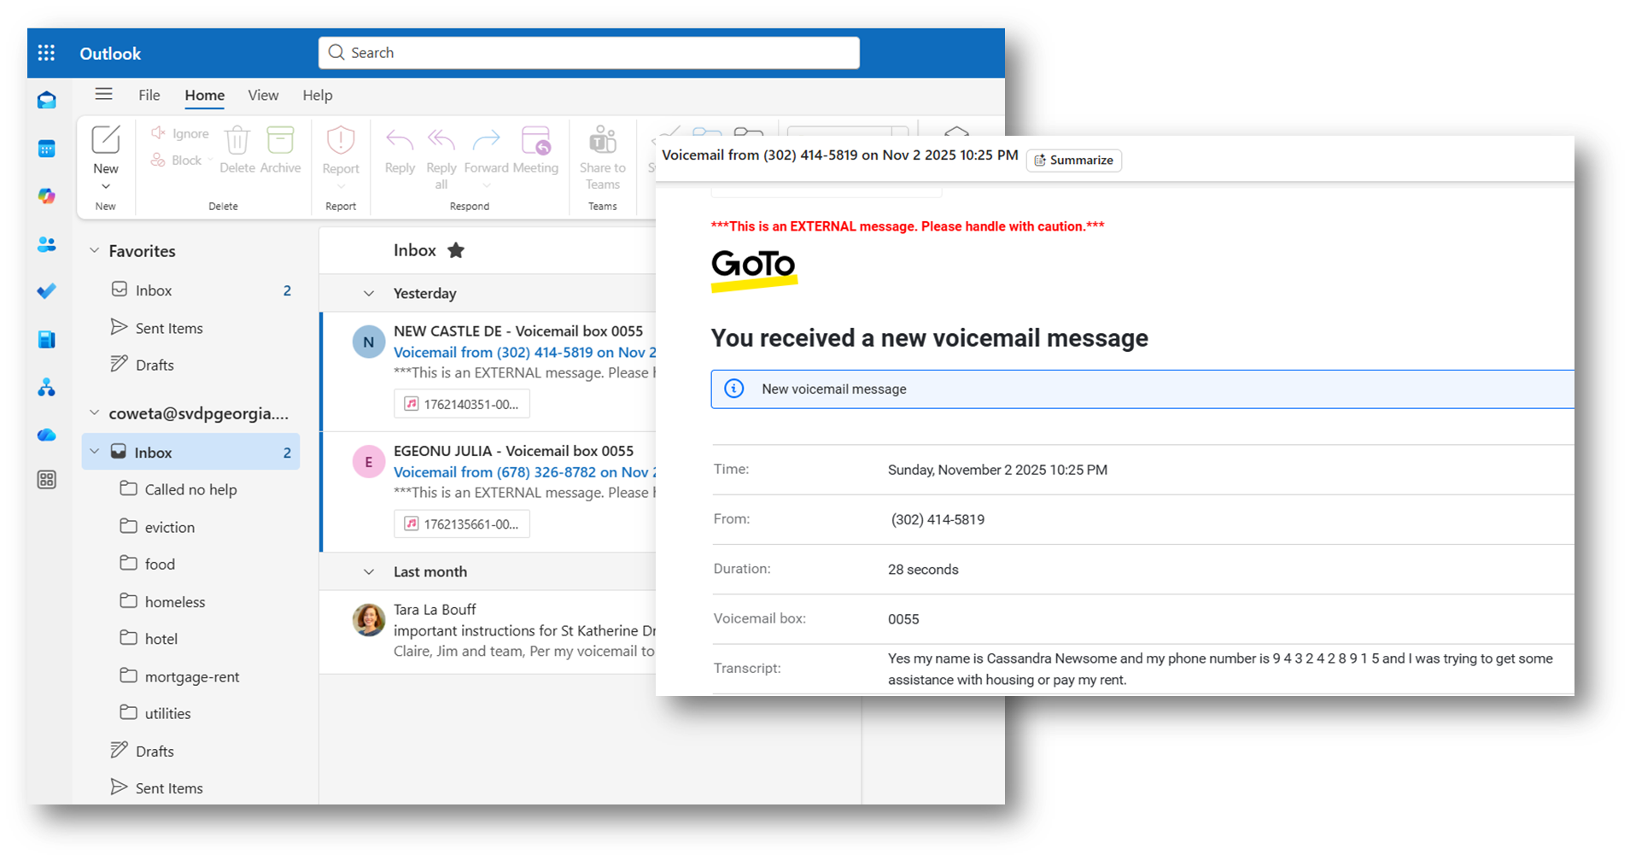
How Volunteers Retrieve Messages
Conference name here@svdpgeorgia.org
Voicemails are now Emails
Volunteers share one email account for Intake
Accessible anytime, anywhere
Synchronized in real time
Caller ID captured for reliability
Clarity & accuracy
Save time
Easy to Forward
Notes:
Includes
transcript & audio file
time & date
caller ID – name and #
Reduces time spent screening / listening
Easy to Forward
to a caseworker
to another Conference
Includes Outlook features
Calendar for volunteer schedules
Contact directory
Council-absorbed cost
Every Conference has a new email account ready to go right now.

Slide 73


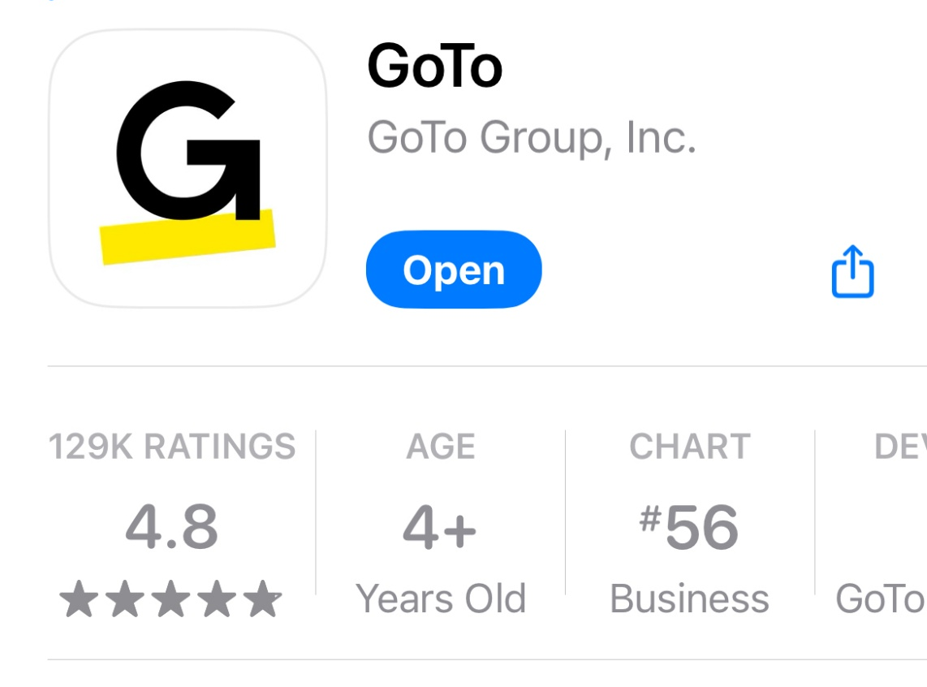
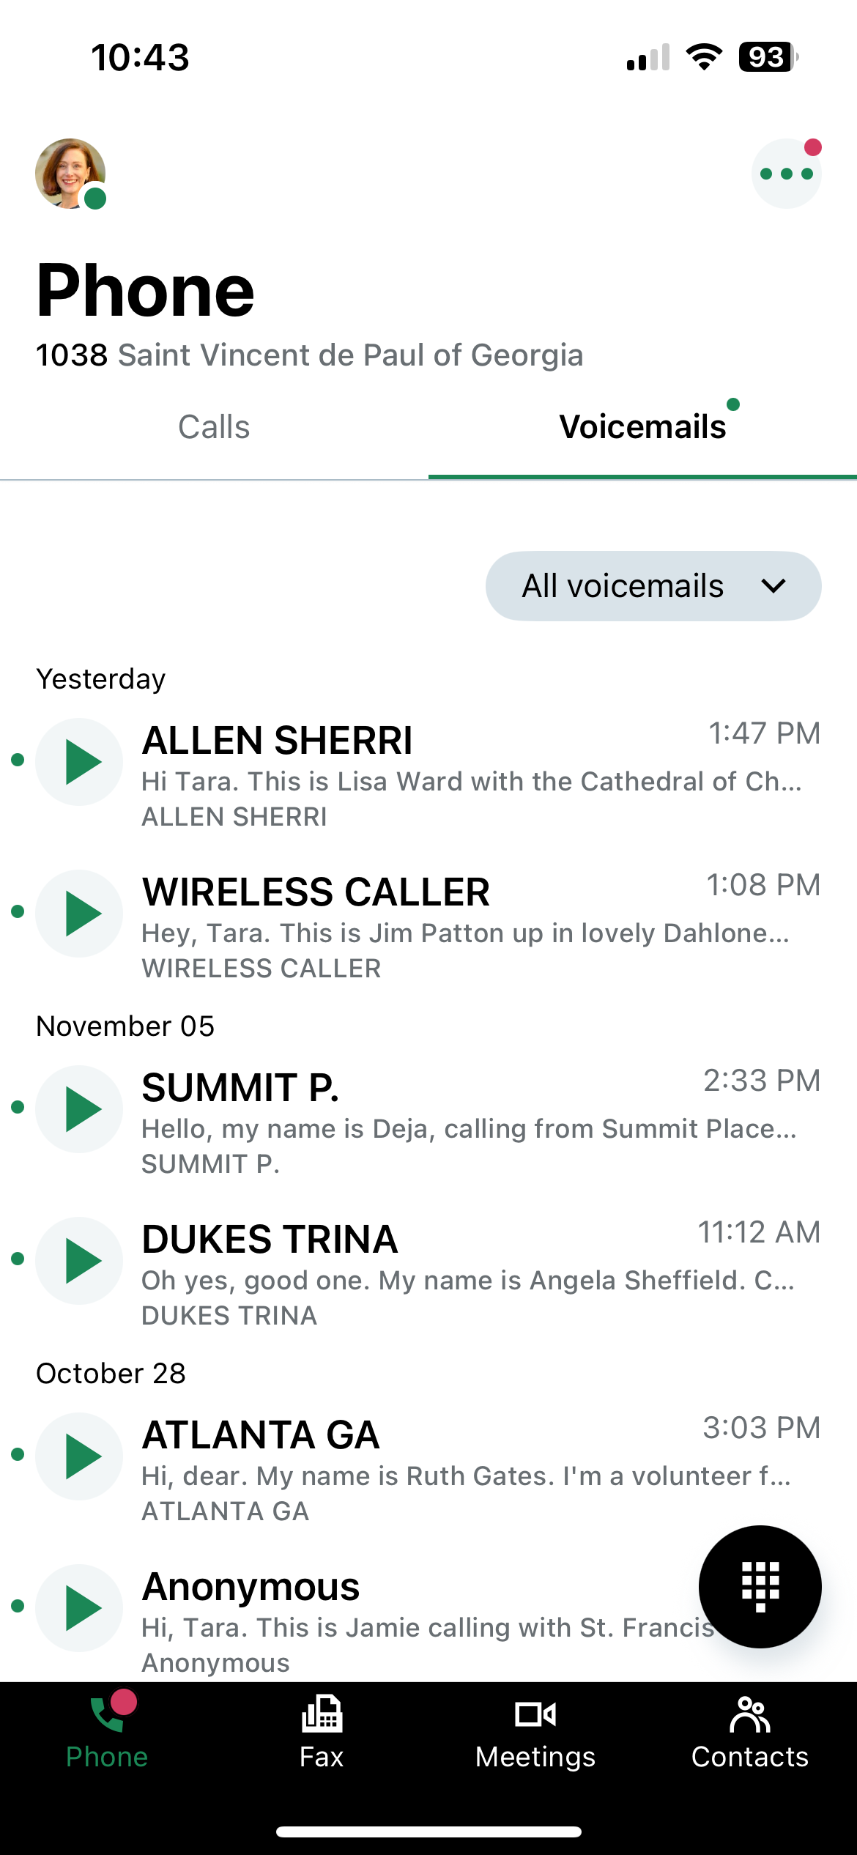
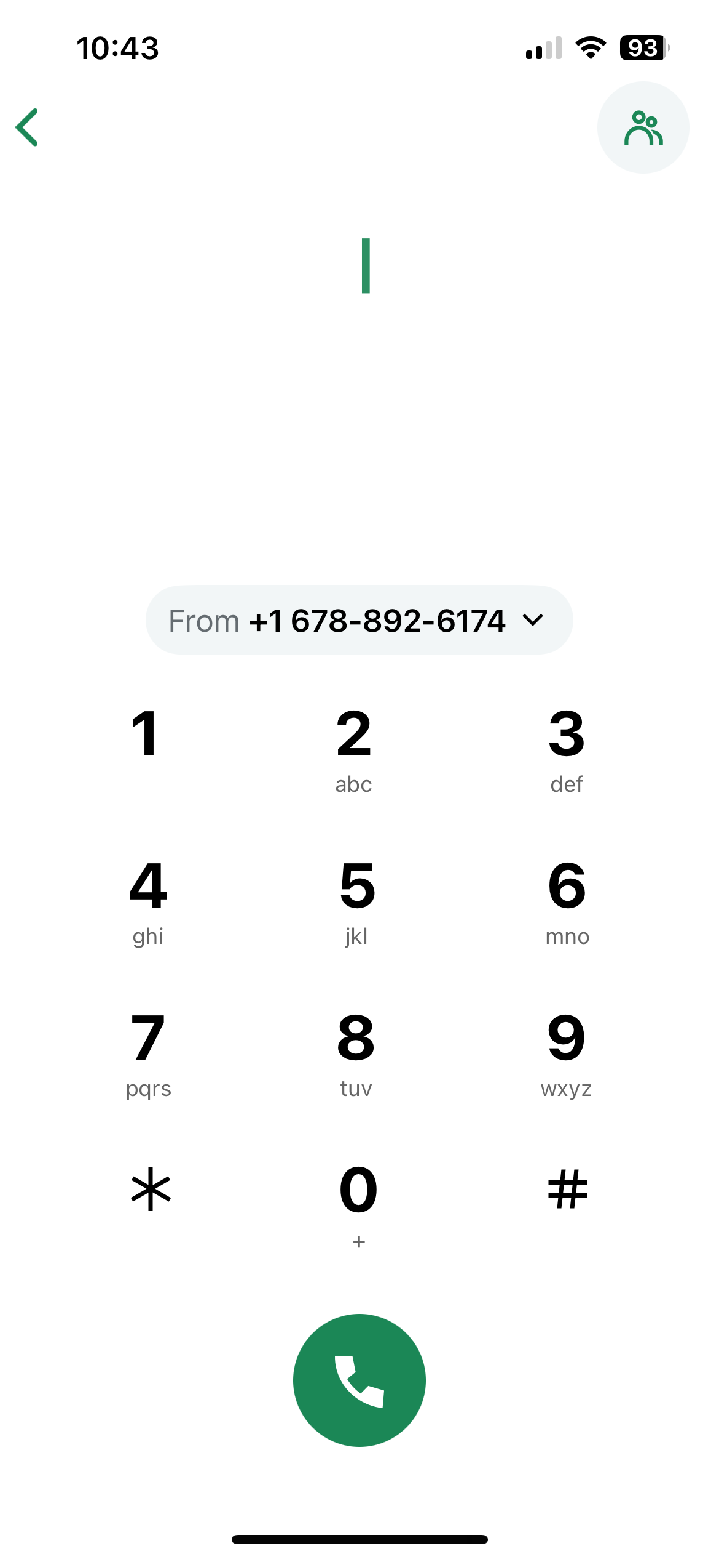
How Calls Are Returned
Dialing via ‘SoftPhone’
How to call using your Conference Phone Number
1. Download the GoTo App
2. Open the GoTo App on a smartphone, laptop, or tablet
3. Tap the phone keypad icon
4. Confirm that your Conference phone number appears on the dial screen
5. Dial, then tap the green phone icon to connect
Notes:
Avoid missed calls because they don’t recognize your number.
Caller ID as “SVdP …name of Conf….”

Slide 74
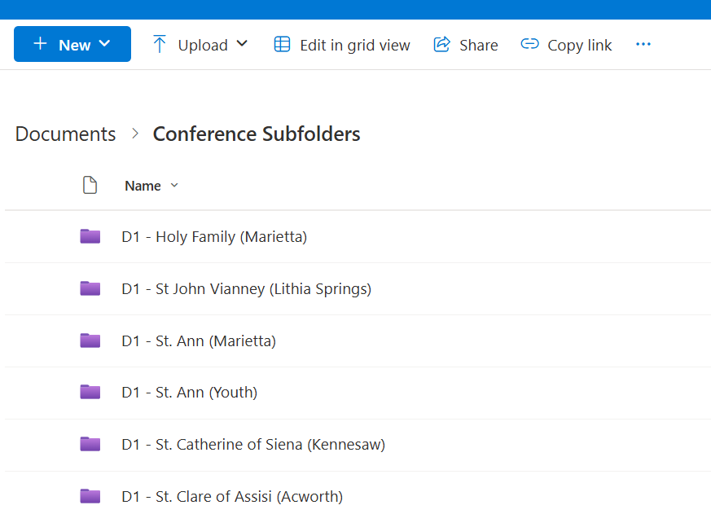
Also Available: File Space in the Cloud
Microsoft Sharepoint
Dedicated file space for your Conference
Store files in the Cloud
Longevity beyond any one Officer
Seamless file-sharing with Council or with other Conferences

Slide 75
Summary of Benefits
Save time for volunteers
Messages can be reviewed anytime, anywhere
Clear caller ID
Professional email address
Easily transfer Neighbors to another Conference
4-digit dialing between Conferences*
*if all adopt

Slide 76
But How? Neighbor-Centric Methods
Keep your phoneline "on" / Allow messages
Collect intake voicemails via email
Invite new Vincentians to monitor incoming email and assist Intake.
Create a contact list in Outlook for neighboring Conferences.
Call back at least some of those you can't help.
Resource List for the Area
Invite to try again on ___ date
Tap caseworkers to make calls back
We can help with:
Standard Script
Standard Email reply
Webforms
Notes:
New Vincentians: Listen one day a week. Familiarize themselves with the requests. Initiate dialog with a Vincentian about what they
Our role is to allow people to have a voice, share what they need to share.
Add an auto-responder with resources
"We're closed" is counter to our mission.
We're mission focused when we're here and present and available.
How we can help & help each other… now discuss each other.

Slide 77
Conference Examples
Immaculate Heart of Mary – Spanish & English webforms and mailboxes
St. Oliver – Saving time
St. Catherine of Siena – organized subfolders
Mary Mother of God – using softphone for calling back

Slide 78
Table Talk Exercise Three
Group Sharing

Slide 79
Dessert, Beverages &
Group Discussion

Slide 80
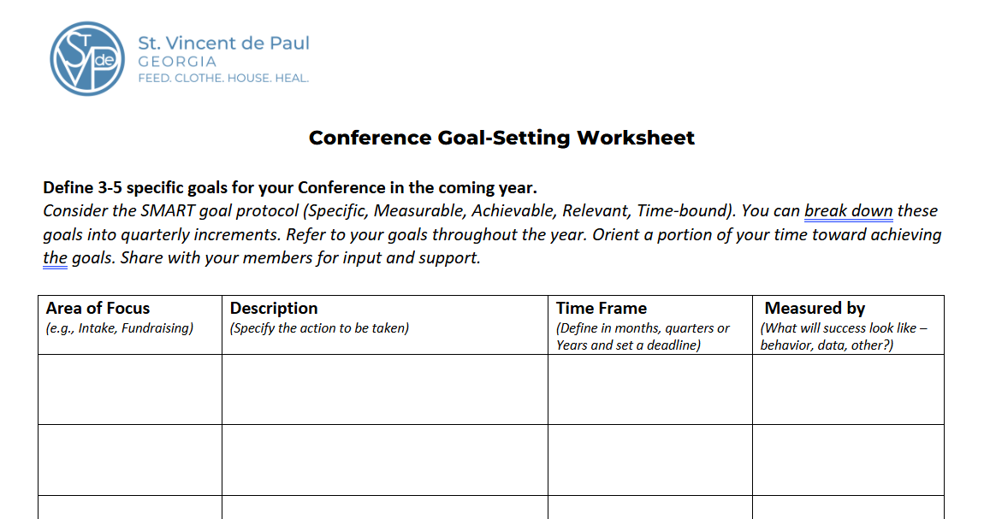
Goal-Setting
Define 3-5 Conference goals in the coming year
Contemplate how the Council can best serve your Conference and you as a leader
Notes:
List two questions here
Ask people to share 1-2 pieces of inspiration

Slide 81
Re-Commissioning

Slide 82
Re-Commissioning
Spiritual Advisor: Let us ask the Holy Spirit to be with us as we once again renew
our Vincentian Commitment to the Society of St. Vincent de Paul.
All: Come Holy Spirit, live within our lives.
And strength us by Your Love.
Spiritual Advisor: Send forth your spirit and new life will be created.
All: And the whole face of the earth will be renewed.
Spiritual Advisor: In response to the call of Christ who invites you to follow him,
do you promise to be a witness to his boundless love for the poor, the lonely, the suffering and deprived, those without faith and those who feel unloved?
All: I do, and I ask for the grace to grow in holiness of life and to share in a longing for spiritual growth and enrichment.

Slide 83
Re-Commissioning
Spiritual Advisor: Do you firmly resolve to treasure the warm friendship and unity which was from the beginning a hallmark of our Society?
All: I do, and I ask for the grace to grow in humility and simplicity so that true friendship may grow in my heart.
Spiritual Advisor: Do you promise to seek and find the forgotten, the suffering or the deprived so that you can bring them your love.
All: I do, and I ask for the grace to be sensitive to their vulnerability, to respect and not to judge or blame them.
Spiritual Advisor: Do you promise to be generous with your time, your possessions and yourself in your mission of charity.
All: I do, and I ask for the grace to always serve in justice and charity so that I can be an advocate and a voice for the poor.

Slide 84
Re-Commissioning
Spiritual Advisor: Do you promise to persevere in regarding your home visits as a sacred trust?
All: I do, and I ask for the grace to be more aware of the blessings I receive from those I visit.
Spiritual Advisor: Let us seek the intercession of the Blessed Virgin Mary, patroness of our Society, as we say,
All: Hail Mary, full of grace…(continue)
Spiritual Advisor: Let us ask for the spirit of St. Vincent de Paul and Blessed Frederic Ozanam to fill our hearts as we pray to the Father in the words Jesus gave us,
All: Our Father…(continue)

Slide 85
Re-Commissioning
Spiritual Advisor:
Let us pray together:
Lord Jesus, you who willed to become poor, give us eyes and a heart directed toward the poor. Help us to recognize you in them - in their hunger and thirst, their loneliness and suffering.
Enkindle within us the fire of love that burned in the hearts of St. Vincent and Blessed Frederic, so that we will live our mission and core values with integrity.
Grant us the grace to be faithful to the Society of St. Vincent de Paul, so that we will grow in spirituality, friendship and service to our suffering brothers and sisters.
Amen

Slide 86
Closing Prayer

Slide 87
Show Me My Neighbor
Lord of All Love,
As I step out the door,
show me my neighbor.
As I read the news,
show me my neighbor.
As I pray,
show me my neighbor.
On my left, on my right
Perhaps turning to me right now,
Show me my neighbor.
Where my eyes have passed before and then turned away,
Show me my neighbor.
Where my ears have heard cries that I have ignored
Show me my neighbor.
As they share a story that is different from my story
Help me to listen as if it is my own.
Show me my neighbor.
Notes:
As we start out Home Visit section, we should begin in prayer as we would a before a Home Visit.
We have the most unique perspective because of our home visits. No other agency has our understanding of what is happening to cause need in our communities – we need to use that perspective to influence public policy and advocate – Voice of the Poor

Slide 88

Show Me My Neighbor
And then let me love them
In their joy and in their distress
That their delight be mine
And their pain be mine too.
Let me love them
As completely and mercifully
as you love me.
In true solidarity
Singing our songs together
until a new song emerges,
Let me love them.
I look up now, Lord.
Show me my neighbor.
Notes:
As we start out Home Visit section, we should begin in prayer as we would a before a Home Visit.
We have the most unique perspective because of our home visits. No other agency has our understanding of what is happening to cause need in our communities – we need to use that perspective to influence public policy and advocate – Voice of the Poor

Slide 89


Slide 90


