Slide 1
Town Hall
February 29, 2024

Slide 2
Agenda
Prayer and Reflection
Mike’s Message
Program Presentations
Spring to Life
Top Hat Nominations
Twinning and Grant Funds
Conference Growth Campaign
Conference Marketing and Helpful Tools
Chaplaincy Program
Voter Voice/Voice of the Poor
Food Pantry Update
Upcoming Events
Open Forum Q&A
Closing Prayer

Slide 3
Prayer and Reflection
Deacon Bill Boyd

Slide 4
Annual Assembly 2024 - Saturday, April 27
St. Pius X High School
2674 Johnson Rd NE, Atlanta, GA 30345

Slide 5
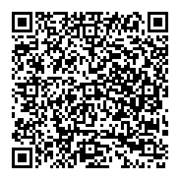
Annual Assembly 2024 - April 27
Schedule
7:30am Registration and Breakfast
Part 1- General Assembly & Keynote Speaker
Part 2- Breakout Session A
Lunch
Part 3- Breakout Session B
Part 4- Breakout Session C
4:00pm Vigil Mass
Complete the survey to share your input on session topics!

Slide 6
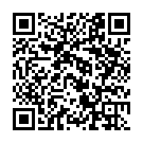
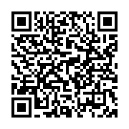
Top Hat Nominations
Conference presidents are invited to submit one nomination per Conference to their District President no later than March 10, 2024. Click for forms in Word or PDF format.
District Presidents will email each submitted nomination form to their Conference Presidents and schedule a vote prior to April 10, 2024.
Each District’s nominee is due to the Conference Support Center (CSC) no later than April 15, 2024.
Word
PDF

Slide 7
Top Hat Nominations
All 2024 Top Hat Finalists will be announced in a special eblast.
CSC will email all finalists to each Board Member,
so they are prepared to vote for their choice of
the Top Hat Award Winner.
Board of Directors will vote for the Top Hat Award
Winner at the April 22, 2024 board meeting. The
Top Hat Award will be presented at Spring to Life
on Saturday, April 27, 2024, at St. Pius X.
Thank you, ALL, for your participation in this process.
It is always a trial for those involved because there are
so many devoted, deserving, and humble Vincentians that it is hard to declare a “winner,” but
we want to recognize the great efforts of our Vincentians.

Slide 8
Twinning and Grant Funds
A recent grant from Georgia Power has been contributed to the Council Twinning Fund to provide additional resources for Conferences struggling financially.
Funds are available for rent and utility assistance, but do not need to be accounted for separately. Data will be pulled from CMS by Council staff to report to Georgia Power.
Conferences that are low on funds and wish to utilize the Twinning fund should send a request to their District President (DP).
Once the DP has reviewed and approved the request, the DP forwards the request to the Council for funding. Funds will be sent directly to the Conference via ACH, generally the next business day.

Slide 9
Conference Growth Campaign
Purpose:
The Vincentian growth and outreach plan is designed to help grow Vincentian membership throughout Georgia with strategic communications and outreach tactics to support conference-level recruiting for those conferences that choose to participate.

Slide 10
Conference Growth Campaign
Purpose:
The Vincentian growth and outreach plan is designed to help grow Vincentian membership throughout Georgia with strategic communications and outreach tactics to support conference-level recruiting for those conferences that choose to participate.

Slide 11
Conference Growth Campaign Objectives
Create communications which build the Vincentian identity as a means to grow in Catholic faith and service to God and our neighbors
Help build awareness and credibility within parish communities and beyond; educating on the impact St. Vincent de Paul is making, and its relevance to the vast needs of neighbors throughout our state
Provide a response mechanism in ads and announcements, encouraging action and engaging conferences in follow-up
Create messaging which broadens the appeal to serve by encouraging diversity, including those with limited time to give

Slide 12
Conference Growth Campaign Timing
Campaign Kick-off: Anniversary of the Society, April 23
Campaign Close: Feast of St. Vincent de Paul, September 27

Slide 13
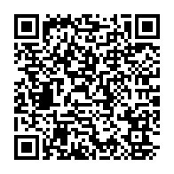
Conference Marketing Materials
Conference Brochures for
Ministry Fairs and Recruiting
Contribution Reports
Name Tags
Conference Flyers
Formation and
Governance Materials
And More!

Slide 14
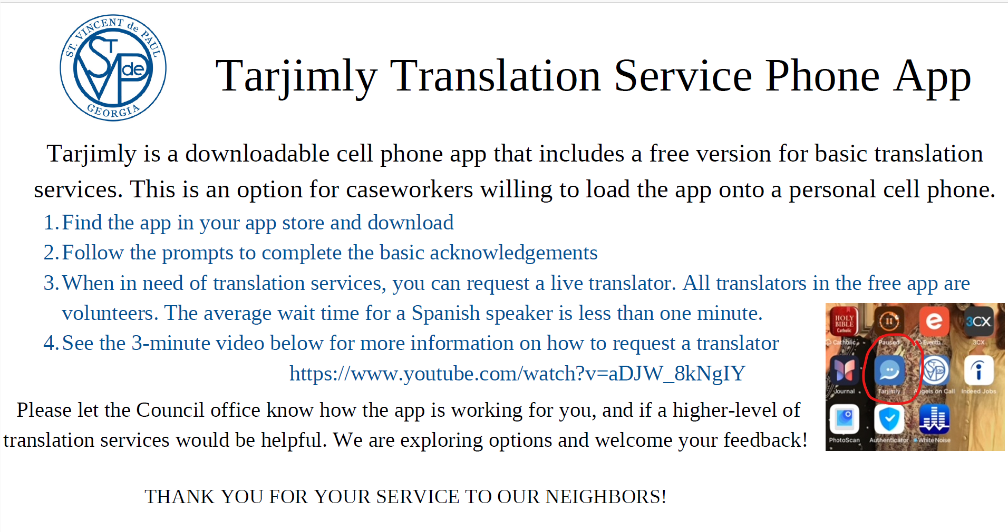
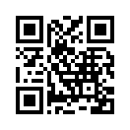
Conference Helpful Tools
CLICK HERE!

Slide 15
Conference Helpful Tools
Spanish voicemail greetings should be available to your helpline callers when they phone in.
Spanish speakers often contact the Council because they are unable to understand Conference voicemail greetings.
Please email gwilson@svdpgeorgia.org if your Conference needs assistance with a Spanish script.

Slide 16
Conference Helpful Tools
The Georgia Power Energy Assistance portal is a free web-based tool for agencies, churches, and public and private charitable organizations to utilize while assisting Georgia Power customers with their energy costs. Many SVdP Conferences who pay GA Power bills utilize this online assistance portal. If your Conference is not yet signed up, we encourage you to do so!
Use the energy assistance portal 24 hours a day, seven days a week to easily view customer information, as well as make payments or pledges without needing to call, fax or mail.
To access the energy assistance portal, visit energyassistance.southerncompany.com from your desktop, tablet or mobile device.
When signing up for a portal account for your Conference, be sure to use your Conference-specific contact information for the account, not Council contact information.

Slide 17
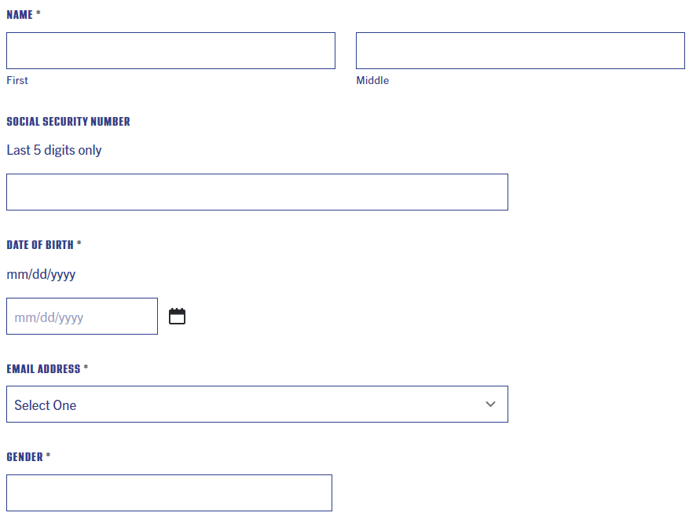
Conference Helpful Tools
The Conference-specific request for assistance form is a great tool for streamlining the Intake process.
Callers are directed to a webform where they can enter information specific to your Conference needs.
Individuals who do not live in your Parish area will be redirected back to the Help Line.
Forms can be created in multiple languages to assist Conferences who struggle with finding bilingual volunteers.

Slide 18
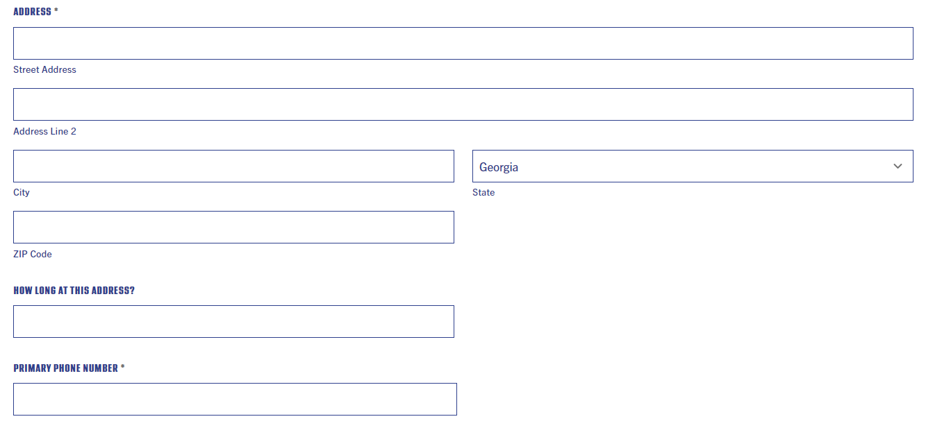
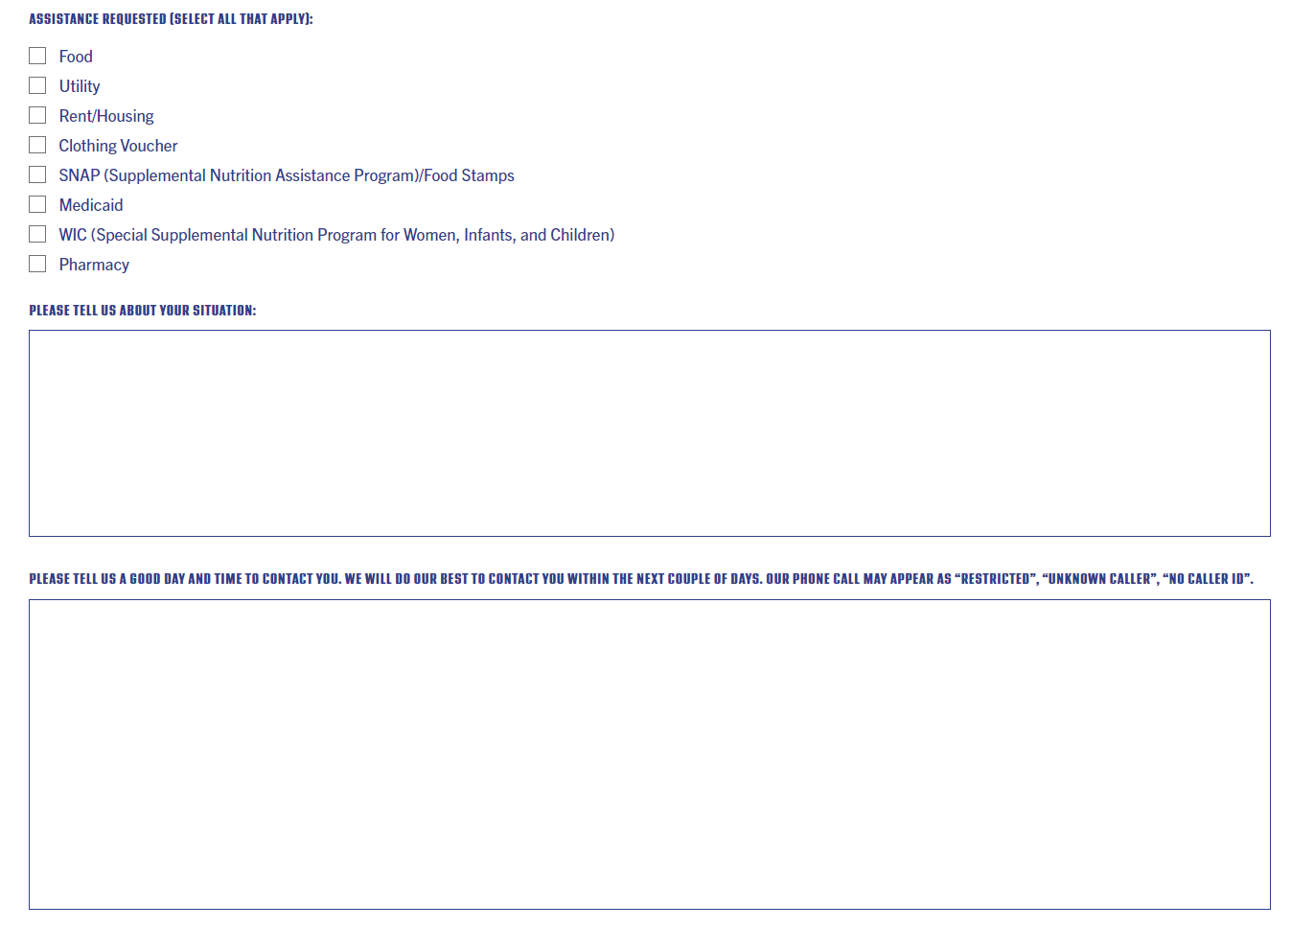
Conference Helpful Tools
Intake workers are then able to read the Neighbor’s contact and demographic information as opposed to struggling with listening to a voicemail.
The Intake Call should occur as normal, but without misspellings an incomplete demographics. Neighbors can also instruct us as to when to call, which alleviates the number of return calls your intake worker makes.

Slide 19
Chaplaincy Program
Council Spiritual Deacon Bill Boyd will be regularly on-site at our Chamblee Conference Support Center to help meet the spiritual needs of our staff, Vincentians, volunteers and neighbors in need. Deacon Bill will be in the office most Thursdays from 9:00AM-3:00PM and will be available for private consultations.
If you are experiencing “compassion fatigue”, struggling with your Vincentian vocation, or dealing with a particularly emotionally-challenging case and want to discuss it confidentially, feel free to contact Deacon Bill at bboyd@svdpgeorgia.org or Click Here to schedule a time.
For those who are not local to Chamblee, Deacon Bill can also schedule a virtual meeting either on Thursdays or at another mutually-convenient time. Just email him directly.
If you are assisting a neighbor in need who is struggling in his or her faith, Deacon Bill is also available to meet with our neighbors, who may also sign up for a time with Deacon Bill through the web form – www.svdpgeorgia.org/spiritualformation .

Slide 20
Voice of the Poor
Voice of the Poor (VOP) is the advocacy arm of the Society of St. Vincent de Paul. With members representing every section and demographic of the nation, we identify issues critical to those living in poverty and need and help bring attention to them so communities and elected officials can help develop strategies and tactics that will provide the most effective and efficient means to reduce or eliminate poverty.
Jack Murphy, Voice of the Poor Chair

Slide 21
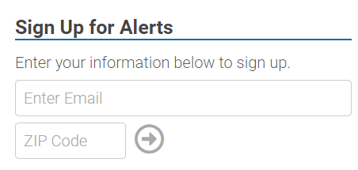
Voice of the Poor
Society Action Center: https://votervoice.net/SVDPUSA/home

Slide 22
Mandated Reporting
House Bill 404: Safe at Home Tenant Protection
Today - ask members of the Georgia Senate Judiciary Committee to vote DO PASS when the “Safe at Home Act,” House Bill 404, comes before them in committee this MONDAY.
What Does House Bill 404 Do?
House Bill 404:
Requires that rental properties are fit for human habitation.
Includes cooling as a utility that cannot be shut off prior to an eviction action.
Prohibits landlords from requiring a security deposit that exceeds two months’ rent.
Allows a tenant three business days (following a written notice) to pay owed moneys prior to an eviction proceeding being filed. (This is called a “right to cure.”)
Requires that an eviction notice be posted conspicuously on the property door in a sealed envelope and delivered via any methods agreed to in the rental agreement.
Why It Matters:
In FY32, 20% of foster care placements cite inadequate housing as a reason for removal of a child from the home.
The COVID-19 pandemic has increased housing insecurity in Georgia, which directly impacts children.
According to the U.S. Census Household Pulse Survey, as of May 2022, approximately 21% of Georgia households with children surveyed reported little to no confidence in their next rent or mortgage payment on time.
Black students make up a disproportionate amount of Georgia’s homeless student population at nearly 52%, followed by White students at almost 30% and Hispanic students at nearly 13%.
When kids experience housing instability, unsafe homes or homelessness, they struggle with so much more, such as:
Asthma
Good nutrition and hunger
School attendance, learning and high school completion
Fear and trauma
Check out our Homelessness and Children in Georgia
What to Say (CALLING WILL WORK BEST!)
Dear Senator ,
Please vote DO PASS on House Bill 404 when the “Safe at Home Act,” House Bill 404, comes before you in committee this MONDAY. In 2021, 20% of foster care placements cite inadequate housing as a reason for removal of a child from the home. Children who experience housing instability, unsafe homes, or homelessness often also struggle with asthma; school attendance, learning, and completion; as well as fear and trauma resulting from the insecurity caused by where they are going to sleep at night. This bill ensures that landlords, in various rental agreements, will maintain habitability for tenants, sets a maximum security deposit amount, and sets procedure for breach of contract. Thank you for your thoughtfulness on behalf of Georgia’s children with regards to this bill.
Who to Contact
Members of the Senate Judiciary Committee
Sen. Brian Strickland, Chair | 404-463-6598 | Brian.strickland@senate.ga.gov
Sen. Bill Cowsert, Vice Chair | 404-463-1366 | Bill.cowsert@senate.ga.gov
Sen. Mike Hodges, Secretary | 404-463-1309 | Mike.hodges@senate.ga.gov
Sen. Steve Gooch (Ex-Officio) | 404-656-5039 | Steve.gooch@senate.ga.gov
Sen. Bo Hatchett | 404-651-7745 | Bo.hatchett@senate.ga.gov
Sen. Harold Jones, II | 404-656-0036 | Harold.jones@senate.ga.gov
Sen. John Kennedy | 404-656-6578 | John.kennedy@senate.ga.gov
Sen. Elena Parent | 404-656-5109 | Elena.parent@senate.ga.gov
Sen. Michael “Doc” Rhett | 404-656-0054 | Michael.rhett@senate.ga.gov
Sen. Ed Setzler | 404-656-0256 | Ed.setzler@senate.ga.gov
Sen. Ben Watson | 404-656-7880 | Ben.watson@senate.ga.gov

Slide 23
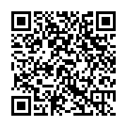
Food Pantry Updates
Chamblee Food pantry is open 10am-2pm Monday-Friday.
We request that clients arrive between 10am and noon.
Conference meat orders should be sent to Adam Seeley at aseeley@svdpgeorgia.org.
PLEASE SUBMIT REQUESTS AT LEAST 3 BUSINESS DAYS
IN ADVANCE
For Conferences with food pantries, CLICK or scan here
to complete a brief survey on your operation. Replies can be sent to Adam.

Slide 24
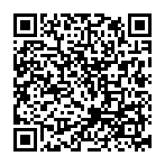
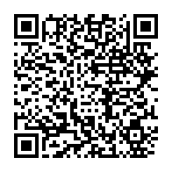
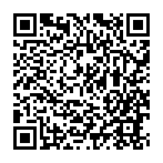
Upcoming Events
Ozanam Orientation - February 29/March 7; 6-pm
St. Jude the Apostle, Dunwoody Register Here
Hunger Walk - March 10; 12 Noon- 4pm
The Home Depot Backyard
1 Backyard Way, Atlanta, GA 30313 Register Here
Housing Lunch & Learn - March 20 12:00 Noon
House of Dreams and St. Michael’s House Register Here
Spring to Life - April 27; 9am-4pm
St. Pius High School – Fill out our survey here
Ozanam Orientation
Hunger Walk
Housing Lunch n Learn
Spring to Life

Slide 25
Thank You

