Slide 1
Spiritual Advisor Training
2023

Slide 2
Please Note…
Registration & Attendance
We will start and end on time
Breaks
Food & Beverage
Restrooms & Emergency Exits
Notes:
Welcome to the annual spiritual advisor training. We are glad you joined us today. Please keep your microphones muted throughout the training. If you have questions, please submit them through the CHAT function.
Four speakers of the spirituality committee will present the training to you today. They are myself, John Kirksey, Charles Jones, and Deacon Bill Boyd.
Introduce the first speaker

Slide 3
Opening Prayer
Relax and become aware of God’s presence.
L: In the name of the Father…
ALL: Amen
L: Come, Holy Spirit, live within our lives.
ALL: And strengthen us by your love.
L: Send forth your spirit and new life will be created.
ALL: And the whole face of the earth will be renewed. Our Father prayer…
L: Let us reflect on the words of Our Lord Jesus Christ, recalling
His unity and presence among us: “Where two or three are
gathered together in My Name, there am I in the midst of them.”
Short Silence – Light Candle
continued…
Notes:
We will begin with the SVdP opening prayer that is recommended by the national office to use at conference meetings.
I will pray the prayer on the next two slides, and all of you can follow along.
This is how Vincentian meetings are facilitated, with opening and closing prayers.
L is leader, who is your spiritual advisor, and All is everyone else, praying in unison.
You can either light the candle in the middle of the prayer, as is shown here, or you can light it at the beginning of the prayer. As spiritual advisors, you will have the flexibility to choose from a couple ways of doing things, and this is one of them. I personally chose to light the candle before the prayer begins so as to not interrupt the flow of the prayer.

Slide 4
Opening Prayer
ALL: Lord Jesus, deepen our Vincentian spirit of friendship during
this meeting, make us responsive to the Christian calling to
seek and find the forgotten, the suffering or the deprived so
that we may bring them Your Love. Help us to be generous
with our time, our possessions and ourselves in this mission
of charity. Perfect in us Your love and teach us to share more fully
in the Eucharistic Sacrifice offered for all. Hail Mary prayer…
L: St. Vincent de Paul, St. Louise de Marillac.
ALL: Pray for us.
L: Blessed Frederic Ozanam, Blessed Rosalie Rendu.
ALL: Pray for us.
L: All Holy and Blessed members of the Vincentian Family.
ALL: Pray for us.
(There is NO SIGN OF THE CROSS at the end of the Opening Prayer, because the entire meeting is a prayer.)

Slide 5
Mission Statement
As a reflection of the whole family of God, members, who are known as VINCENTIANS, are drawn from every ethnic and cultural background, age group and economic level. Vincentians are united in an international Society of charity by their spirit of poverty, humility and sharing, which is nourished by prayer and reflection, mutually supportive gatherings and adherence to a basic Rule.

Slide 6
Mission Statement
Respecting the DIGNITY of each person, St. Vincent de Paul Georgia brings hope and help to those in need so they may find stability and move toward self-sufficiency.
Notes:
What is the most important word of our mission statement? (pause) Dignity.
As spiritual advisors, we help fellow Vincentians focus on the dignity of the person when we are working with clients/neighbors.

Slide 7
Vision
The vision of the Society of St. Vincent de Paul Georgia is to change the face of charity by offering hope and help to those we serve through the guidance of the Holy Spirit.
Notes:
This clearly speaks to the role of the spiritual advisor, and the spirituality of our work.

Slide 8
What’s in This Training?
Highlights of the 2021 Spiritual Advisor Handbook
(download to your computer from SVdP national website and read, then attend virtual national spiritual advisor training)
Breakout Sessions with Fellow Vincentians
Spiritual Advisor Resources
  SVdP Georgia Spiritual Advisor Resources
  (contents should have been be emailed or mailed to you)
  References to SVdP National Website, www.svdpusa.org
  (download resources, or order items for sale from this website)
Notes:
In this training, we will cover some of the highlights of the newest spiritual advisor handbook. You will need to download the 2021 spiritual advisor handbook from the SVdP national website, to your computer hard drive, as you will be referencing this document on a regular basis. If you are not able to download or to print the handbook, ask the Georgia staff for a printed copy.
Some of you may want to also print it and add it to a binder, then purchase a numbered tab index to organize the documentation.

Slide 9
2021 Spiritual Advisor Handbook Table of Contents (abbreviated)
The Spiritual Advisor in the Society
Our heritage
Founders
Vincentian Spirituality
Role and Responsibilities of the Spiritual Advisor
The Spiritual Advisor at Conference Level and Council Level
Vincentian Reflections
Serving in Hope Series
Apostolic Reflection
Discernment
Spiritual Advisor Resources
Vincentian Prayers
Spiritual Advisor Commissioning
Notes:
This slide is an abbreviated list of the handbook, and as you can see, there is a lot of information that is useful to the spiritual advisor and presidents.
There are times when presidents may need to fill in for spiritual advisors, so it is important for presidents to learn about the role, responsibilities, and resources that the spiritual advisor can share at the conference.
All the resources that a spiritual advisor needs to do their job are at the national website, which is www.svdpusa.org, with special emphasis on the 2021 spiritual advisor handbook, and the national training.

Slide 10
SVdP National Training – Spiritual Advisor
The St. Vincent de Paul national office provides annual (and possibly semi-annual) training, and is for:
New Spiritual Advisors
Existing Spiritual Advisors
Presidents
Virtual
Recent national virtual training was thorough and comprehensive.
Spiritual Advisors and Presidents need to attend:
Learn more about what this role is truly about.
Learn more about the resources that are available.
Notes:
Watch for the next available virtual, national training for spiritual advisors, in the SVdP national newsletter, and sign up for this.
It is very important that spiritual advisors and presidents continue to increase their knowledge of what the national office teaches.
Equally important is that presidents and spiritual advisors work together to increase the spiritual growth of their conferences.
In the following slides, we will spend some time on the highlights of the St. Vincent de Paul national training, and review of resources.

Slide 11
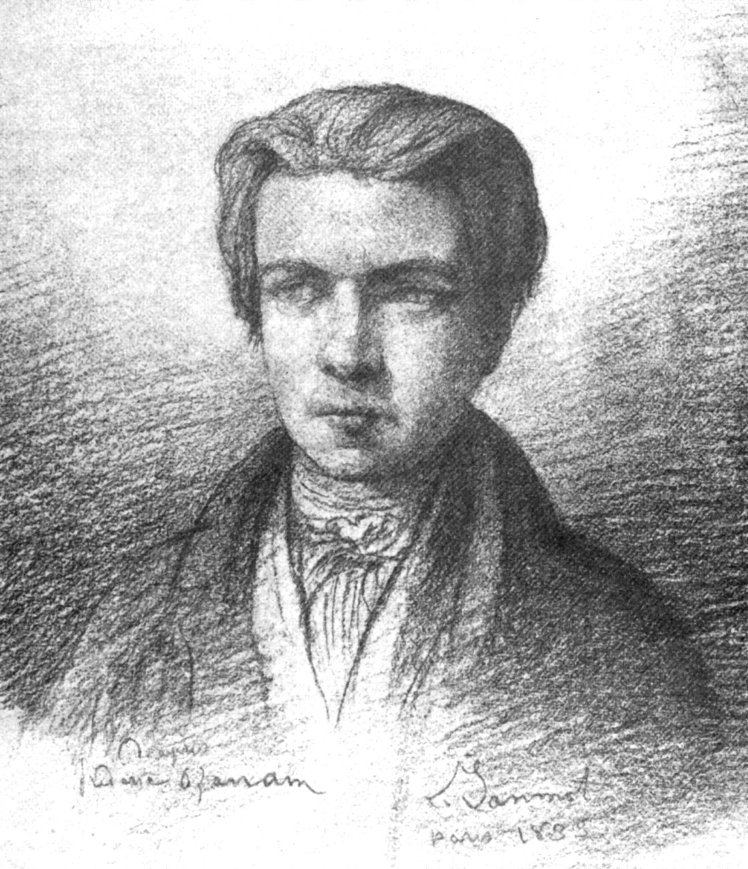
The primary purpose of the Society of St. Vincent de Paul –
TO INCREASE THE HOLINESS OF ITS MEMBERS
(Manual, section 2.5)
9
(Frederic Ozanam)
Notes:
Our primary purpose as a society is to grow in holiness ourselves, AND THEN to serve those who are poor. This may seem self-oriented but remember that holiness is to do the will of God, serving the least of our brethren (Matthew 25). That is the holiness we are striving to achieve.
Striving to become more holy means to FIRST welcome Jesus into our hearts, to open our hearts, minds, and souls, to receive the Holy Spirit of God.
Our growth in spirituality is then transferred to those who are in need, and through prayer with them, we have the opportunity to plant seeds of faith.

Slide 12
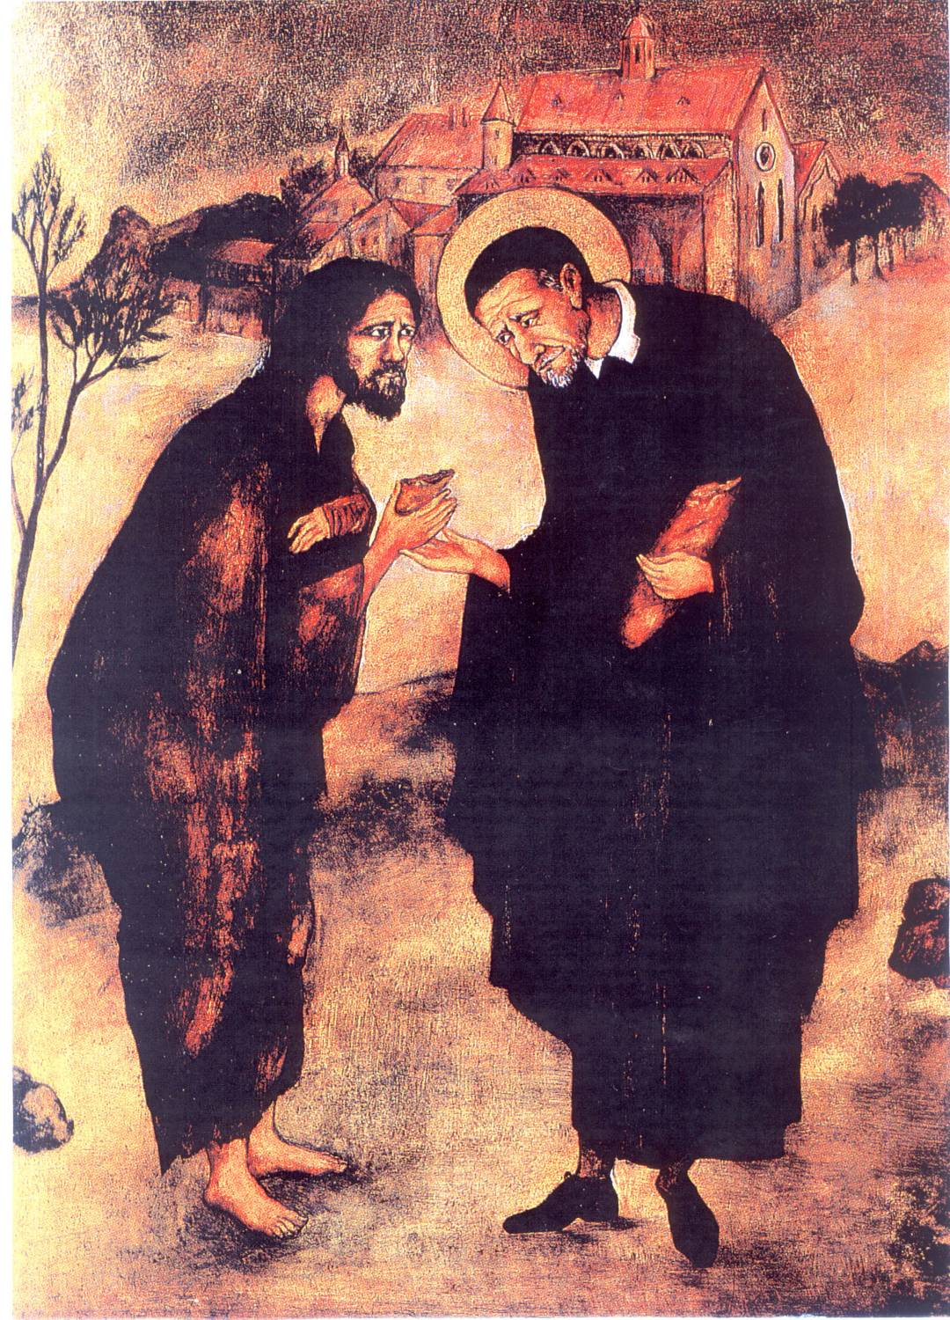
The most important truth of Vincentian spirituality is that Jesus is present in the poor.
Why do we say that? Answer: We are all divine creations of God.
Formation for Spiritual Advisors – Serving the “Suffering Christ”
Notes:
In anything we do as Christians, we focus on Jesus first, because it is through his teachings, that we learn HOW to become more holy.
St. Vincent always turned people to Jesus in every situation, as we should do today.
To explore what it is to be a spiritual advisor, we remember we are forming ourselves in a certain way – the Vincentian way.
We are helping members stay in touch with this most important truth of Vincentian spirituality; that is, that Jesus is present in the poor. Why? Because we are all divine creations of God.

Slide 13
Spiritual Advisors are Committed to…
Jesus & the Gospels
Vincentian spirituality
SVdP Rule book, mission & ministry
Personal witness in their own spiritual life
Catholic Social Teachings
Leading prayer and sharing
Praying with clients
Notes:
We are committed to the things that are listed here.
Becoming a spiritual advisor may seem overwhelming at first, or it may seem as though we aren’t worthy, or it can seem that we don’t possess the wisdom or gifts to be one. The fact is that we all begin somewhere, then we continue to grow through our experiences as spiritual advisors.
A spiritual advisor should be able to commit to these things or at least be willing to develop them.
Catholic social teachings are the church’s instruction, and based upon the Gospels and tradition. The main themes can be found on the website of the United States Conference of Catholic Bishops (www.usccb.org).

Slide 14
What is the Role of the Spiritual Advisor?
Spiritual Animator
Assist Vincentians with development of Vincentian spiritual life
Inspire & challenge others to create new works
Provide guidance on spiritual matters
Keep focus on practical love toward the poor
Notes:
The role of a spiritual advisor includes several things.
Being a spiritual animator means to bring to life, to stir hearts, minds, and souls, to motivate individuals, spiritually. That is what we strive to do as spiritual advisors.

Slide 15
What Are Our Responsibilities?
Meetings – Facilitate opening and closing prayers. Also prepare and facilitate spiritual reflection during meetings, including discussion.
Plan & execute special prayers & sessions (retreats, formation, and commissioning services, for example).
Help Vincentians and clients to deepen their faith.
Notes:
Once we get used to the routine of being a spiritual advisor, the responsibilities become easier.
We help other Vincentians and our clients with a deepening of their faith if they welcome this.
St. Vincent and the other founders evangelized as they served those in need.

Slide 16
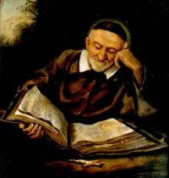
Assist Vincentians with Development of Spiritual Life
Imitate lives of the Founders
Love God “in the strength of our arms &
the sweat of our brow”
See Christ in the Poor
Be led by the Spirit, then trust in God’s Providence.
Live our Virtues – Simplicity, Humility, Zeal, Gentleness, and Selflessness
St. Vincent de Paul
Notes:
The Vincentian way of spirituality is a certain way of being. These are the 5 important components of Vincentian Spirituality.

Slide 17
Assist Vincentians to reach deeper faith awareness of their ---
Participation in the mystery of the Church.
Need for openness to other Vincentians.
Vocation to serve and minister to others and each other as Vincentians.
Identification with the poor.
Notes:
We are Catholic first, drawn into the mystery of the Church through the Eucharist and sacred scripture. As spiritual advisors, we arrange, as possible, to attend the Mass together on St. Vincent de Paul Society feast days. The dates are in your spiritual advisor handbook. Add these dates to your calendar, inform your conference of these dates, then invite them to attend Mass together on these days. A spiritual advisor, in coordination with president and pastor, may also arrange for a Vincentian altar server, lector, and Extraordinary Ministers of Communion, and ask the pastor to give a homily on Vincentian spirituality.
Spiritual Advisors call Vincentians together as a faith community, loving & accepting one another in Christ, as friends.
We must continually nurture our belief of Christ’s presence in the poor, by serving them in-person, if this is possible.
We meet the poor on a very personal level. They are the neighbors of our conferences.

Slide 18
What else helps our fellow Vincentians grow in their Vincentian spirituality?
Attend Vincentian gatherings (retreats, etc.) dealing with spirituality whenever possible.
Learn about Vincentian resources on spiritual development (reflections, contemplations, books, movies).
Actively pursue your own spiritual growth in the Vincentian vocation.
As spiritual advisors, maintain ongoing communication with the president and pastor, as needed.
Notes:
One example of a spiritual Vincentian gathering is a retreat (see retreat checklist in SVdP Georgia Spiritual Advisor Resources at the end of this training).
Examples of resources are the Serving in Hope series, Vincentian spiritual reflections, and Vincentian celebrations and books. We will review a list of resources towards the end of this presentation.
Number 3 of this slide includes not only personal prayer and receiving the Eucharist, but also reading Vincentian materials, sacred scripture, and participating in Bible Study classes, for example.
The presence of the church pastor can infuse additional spiritual insight into Vincentian meetings, and can make the conference a more cohesive family of Vincentians. This can also help to develop a healthy relationship between the conference and the hosting Catholic Church. Consider inviting the pastor to attend Vincentian meetings to learn more about this ministry.

Slide 19
Meetings and Other Vincentian Interactions
As the spiritual advisor, strive to maintain, with the president, that ALL meetings AND Vincentian interactions are conducted in a spirit of Vincentian friendship.
If differences arise, add a sense of calm if that is possible, listening to one another, and attempting to resolve differences.
Vincentians can “agree to disagree.”
Keep the focus on loving those who are poor, as Christ did (be kind, gentle, and non-judgmental, for example)
Encourage fellow Vincentians to be open to the Holy Spirit, for new or revised approaches to case management, and all other matters of business.
Notes:
This is a list of helpful guidelines of how to maintain friendly conference meetings.
Number 3 is especially effective when two people seem to be polarized on a particular issue.
Number 4 is essential to understanding how to remain spiritually-grounded – turning to Jesus in all matters.

Slide 20
Desired Vincentian Spirituality Outcomes of the Conference
We can see the link between service and holiness.
We can see conference members as a faith community.
We can see each moment as an opportunity for holiness.
We can see the face of Christ in everyone we serve.
We can see that our ministry is no longer just a business transaction; instead, we can see growth of spiritual friendship (1) between Vincentians, and (2) between the Vincentians and their clients.
Notes:
This slide helps us to see where we want to be eventually.
We evaluate our effectiveness as spiritual advisors by seeing our members grow in these desired outcomes.
We achieve spiritual growth through the Eucharist, praying unceasingly, and meditating and reflecting on sacred scripture, as a minimum.
Of course, there are many other ways to grow spiritually.

Slide 21
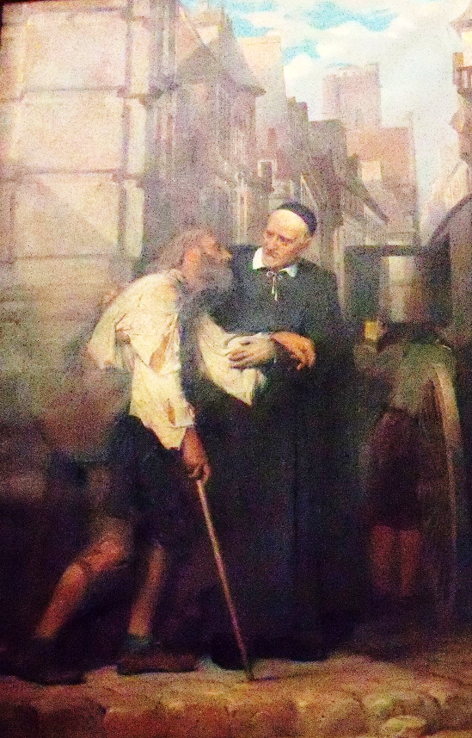
What are the ideal characteristics of Spiritual Advisors?
Individuals with ongoing experiences with God, who have a strong prayer life, and can witness to their own spiritual growth.
Balanced persons.
Persons capable of being a spiritual companion, mentor and friend.
Persons committed to the Rule, mission and ministry of the Society.
Notes:
Generally, you can sense when you are around someone you consider genuinely spiritually-grounded in their faith.
The Spiritual Advisor needs to be capable of good human interaction.
The Spiritual Advisor must become very familiar with the Rule of the Society and Vincentian spirituality, and be compliant with it.
Inform the candidate that they will need to sacrifice personal time to study the resources.

Slide 22
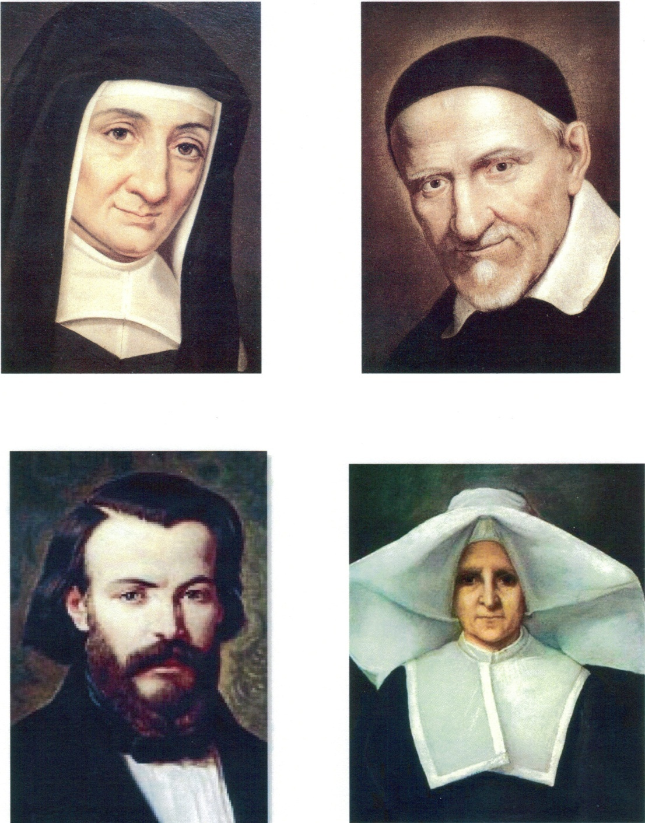

Models for Spiritual Advisors
They were animators
Offered recommendations
Attended meetings
Offered assistance
Encouraged creativity
Successful plans originated through sacred scripture.
Personally enriched by those who shared their mission.
Notes:
St. Vincent de Paul & St. Louise de Marillac are wonderful models for a spiritual advisor to follow.
They were present and listened in person or by mail, to those who shared their mission.
They encouraged the creative development of many types of new works based on the needs presented to them. Their lives were centered in Jesus, and they were servants & evangelizers of the poor, while they strived to imitate Jesus.

Slide 23
What are some of the obstacles to finding a Spiritual Advisor?
Title of spiritual advisor may seem intimidating.
Person may be unclear about the role.
May feel inadequate for the role or feel unworthy.
Meeting structure cuts off the spiritual reflection, not allowing adequate time for thought and discussion.
Members might be reluctant to discuss their thoughts and feelings.
Notes:
Presidents should be aware that these are some obstacles that might make it difficult to find a spiritual advisor for a conference.
Presidents may need to help candidates feel more comfortable about the divine calling of being a spiritual advisor, assuring them that God will provide for their needs.
Presidents may need to budget more time for spiritual reflections to allow for more full discussions.
Presidents may need to help the spiritual advisor in making Vincentians feel comfortable about sharing their thoughts and feelings during meetings, and as friends working together to serve the suffering Christ.

Slide 24

Questions for Reflection – 10 mins.
How has the role of spiritual advisor been carried out in your conference at this point?
What new knowledge of the role of spiritual advisor have you gained so far in today’s presentation?
Notes:
Please take 10 minutes to share your thoughts about these questions with others in your break out session.
2. After 10 minutes - Would anyone like to share their thoughts with our larger group? (allow 2 minutes for larger group)

Slide 25
Appointment of Conference Spiritual Advisor
Conference president, in consultation with the pastor, appoints the conference spiritual advisor (and an associate as needed).
Conference holds a commissioning service.
Register conference spiritual advisor on national data base and with the SVdP Georgia Vincentian Services Manager (Gina Wilson).
Lapel pins may be requested from Vincentian Services and used during the commissioning.
Notes:
The conference may identify a spiritual advisor either from the conference itself, or another spiritually-grounded group. The president approves the choice after consultation with the pastor, then commissions the new spiritual advisor during a Vincentian meeting.
The commissioning service documentation is in the Spiritual Advisor Handbook. Singing the “Servant Song” (for example) by all Vincentians adds to the commissioning service. Copies of the song can be handed out before the commissioning begins. Lapel pins may be given to those who are commissioned, and are available at the national web site.
The conference president, or whoever is responsible in the conference for submitting notice to SVdP-national of the appointment, does so after the commissioning ceremony, so that the name of the new spiritual advisor will be added to the national database. Notice should also be given to Amanda Stricklin of our SVdP Georgia staff.

Slide 26
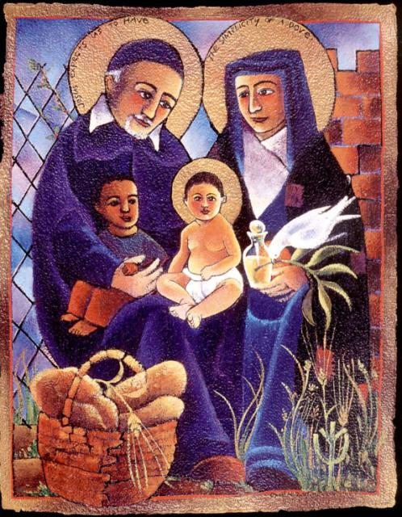
Providing Support to Spiritual Advisors
The conference needs to:
Budget time at the conference meetings for prayer & spiritual reflection (15-30 minutes,15-minute minimum).
Provide funds for resources.
Provide books on the Vincentian founders and spirituality.
Notes:
It is important that the conference president & members support the spiritual advisor in these ways.
There should be a minimum of 15 minutes for prayer & reflection at conference meetings. 30 minutes is preferable, because the primary purpose in being a Vincentian is to grow in spirituality. Our opportunity to do this is while we are meeting together to discuss, not only funds management, but also specific challenging cases, and as we grow in our spirituality, we begin to see things differently, as with the eyes of Christ, and we learn how to serve, while respecting the dignity of the client.
The conference also budgets to provide funds for spiritual resources, as needed.

Slide 27
Providing Support to Spiritual Advisors
The conference needs to:
Ensure that spiritual advisors are included in service to the needy, who address spiritual needs of the poor, and encouraging Vincentians to pray with willing clients.
Express appreciation for the spiritual advisor’s contribution.
Keep spiritual advisor in the loop of difficult cases, service issues, and friendship challenges, seeking their advice.
Notes:
All conference members, including the spiritual advisor, give thanks to one another for each others’ work with the poor, in the spirit of developing friendship with one another, remembering that friendship is one of the essential elements of being a Vincentian.
The president should let the spiritual advisor know of case problems, service issues, and friendship challenges, that need prayer and reflection by the group, as well as possible helpful advice from the spiritual advisor.

Slide 28
RESOURCES
SVDP National Office Resources – www.svdpusa.org
Vincentian Spiritual Reflections & Contemplations
Serving in Hope
Rule & Manual
Vincentian Celebrations
Vincentian Discernment
Vincentian Formation
Home Visitation
Other Tools
Young Vincentian Activities and Resource Guide
Voice of the Poor
Books, Videos & Music, Vincentian Website
Notes:
This is a list of the most-often used resources of the spiritual advisor.
Most of these resources are found on the national website. A few are found at other websites.
Contemplations are a different resource than spiritual reflections, and are also found at the national-SVdP website.

Slide 29
How to Lead Vincentian Reflections (15-30 minutes)
(download from www.svdpusa.org)
Provide a copy of the Sunday/Feast Day reflection for each member.
Each section read aloud by different person, or all read by Spiritual Advisor, who makes this decision.
Quiet reflection (at least one minute)
Optional sharing
Closing prayer of the reflection, prayed together.
Notes:
Some may not find the given discussion questions of the reflections to be helpful. Alternatively, you can create your own questions, such as “What surprised you, or what struck you?”
Be sure to tell the conference members about taking at least one minute for quiet reflection.
And sharing is usually optional; however, I have found that going around the room, asking everyone to contribute their thoughts, is not unreasonable to ask. Sometimes we need a little nudge to move out of our comfort zones. Then they might find that their contributions are as valuable as the next person’s thoughts are!
Try to stretch the conference in 5-minute increments with each meeting, to take more time with spiritual reflections.

Slide 30
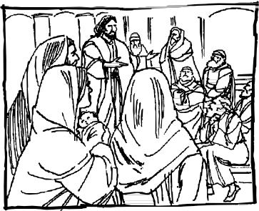
EXAMPLE-SPIRITUAL REFLECTION (HANDOUT FOR TRAINING)
FOURTH SUNDAY IN ORDINARY TIME
January 31, 2021
Gospel: (Mark 1:21-28)
Jesus entered the synagogue on the Sabbath and began to teach. The people were spellbound by his teaching because he taught with authority and not like the scribes. There appeared in the synagogue a man with an unclean spirit that shrieked: “What do you want of us, Jesus of Nazareth? Have you come to destroy us? I know who you are—the Holy One of God!” Jesus rebuked him sharply: “Be quiet! Come out of the man!” At that the unclean spirit convulsed the man violently and with a loud shriek came out of him. All who looked were amazed. They began to ask one another: “What does this mean? A completely new teaching in a spirit of authority! He gives orders to unclean spirits and they obey him!” From that point on, his reputation spread throughout the surrounding region of Galilee.
Reflection:
From that point on, they remembered, and told the story, and his reputation spread throughout the surrounding region of Galilee. “Remember” is a word that is often on our lips when we pray, and when we speak to our friends. Sometimes we also feel ourselves to be better people when we remember the goodness of others to us - their generosity, their unselfishness, their tenderness, their thoughtfulness. This word “remember” is important, for Jesus has also done great things for us. (Living Liturgy, p.42)
Vincentian Meditation:
The little word, remember, is at the heart of our greatest prayer, the Mass. The Mass is the great prayer in which, along with Jesus, we ask God the Father to remember the life, sufferings, death and resurrection of His only Son. Christians gather together and offer Mass, renewing again and again the great act of remembering, while at the same time making present again the offering that Jesus made of Himself on the cross. In doing so, we are bringing down upon the entire world, whether we know it or not, an uncountable number of graces, favors and blessings. Every day we hear some frightening things about the cruelty and wickedness of this world. What would the world be like if it did not have the Sacrifice of the Mass? Always remember that there is no grace, no joy, no good thing in this world that has not come to us through Jesus Christ. (McCullen, Deep Down Things, p.587-588)
Discussion: (Share your thoughts on the readings after a moment of silence)
Remember and share some stories of the great things that Jesus has done for you.
Closing Prayer:
  Christ, healer of hearts,
  -teach us compassion for others.
  Christ, maker of peace,
  -help us bring peace to all people.
  Christ, the light of life,
  -show us the path of life. Amen
Notes:
Here is an example of what a typical Vincentian spiritual reflection looks like. If you find typographical errors, you can, of course, correct them, then print enough copies for your Vincentian meetings so that everyone has a copy at the meeting.

Slide 31
A Word about Stillness
SVdP Georgia Community Pharmacy
Psalm 46:10 - “Be Still and Know That I Am God.”
Part of our role as spiritual advisors is to spiritually motivate our fellow Vincentians.
Facilitate the spiritual reflection, giving your own thoughts first. Then invite everyone to share.
THEN (YOU) BECOME QUIET, CREATING A STILLNESS. Even if it is uncomfortable, it is important to give the Vincentians time to think about what the reflection is about, and how the Holy Spirit may be stirring their hearts, minds, and voices. It takes time for this to happen.
Notes:
After the spiritual reflection has been read, the spiritual advisor will read the discussion question.
1. Share your own thoughts and feelings in the most genuine way, speaking from your heart, to motivate them. That is a function of our role as spiritual advisors.
2. Open the discussion, inviting EVERYONE to share their thoughts and feelings.
3. When there is a lull in the conversation, BE QUIET, resisting the temptation to speak. BE STILL. Let the Holy Spirit work through everyone, to stir their hearts, minds, and voices.
4. Keep in mind that the Holy Spirit will likely speak to each person differently. That is okay, because this is how God works.

Slide 32
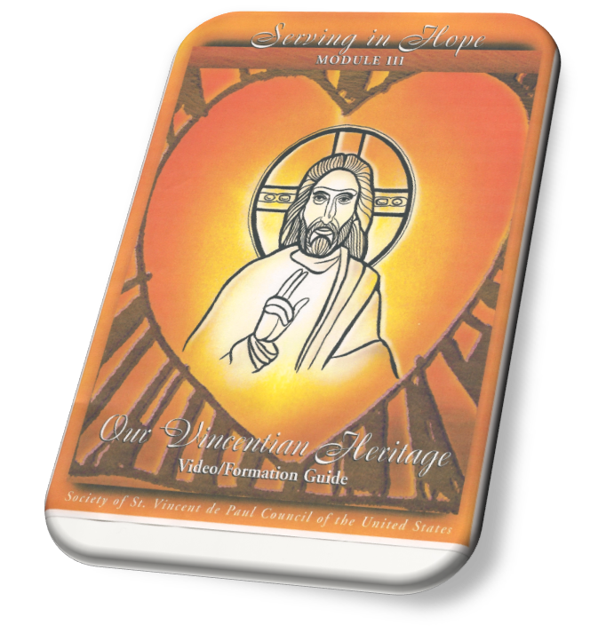
Serving in Hope – What is this?
A SVdP formation program to move us from our heads to our hearts.
Its purpose is to root us in Vincentian Spirituality.
This is a new resource for ALL members.
Six 20-minute sessions in each module.
A formation guide is available at the national website as well.
Notes:
Serving in Hope is a St. Vincent de Paul resource, used for the formation of the Vincentian.
The purpose of this particular program is to root us in Vincentian spirituality.
It can be used during the spiritual reflection part of Vincentian meetings, or separate meetings, or retreats could be scheduled just to focus on this material.
If you would like to use this for your conference, you will need to order it directly from the national web site, which is
www.svdpusa.org, then click on shop.

Slide 33
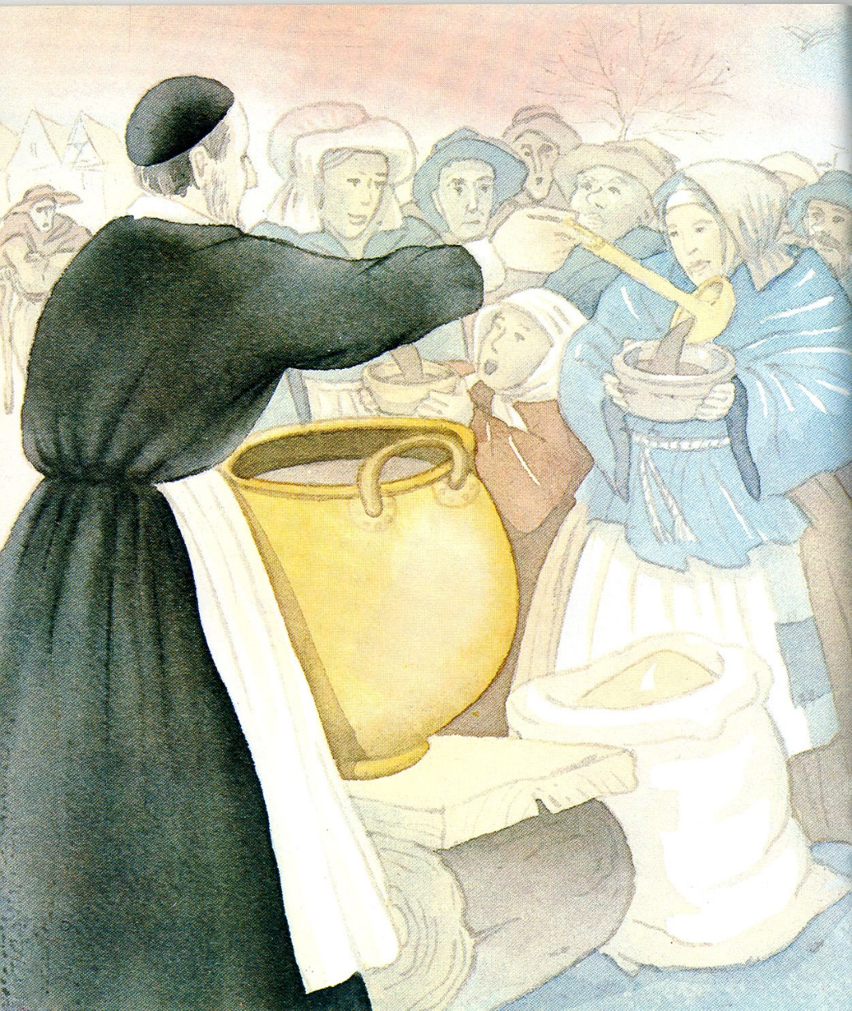
Serving in Hope Modules
Vocation
Spirituality
Heritage
Mission
Rule
Conference Life
Our Vincentian Home Visit
Notes:
These are the modules of the Serving in Hope series. Each module is a booklet.
Our spirituality committee led a 1-day spirituality retreat using module #2, titled Spirituality, at the Ignatius House, and it was a spirit-filled, educational, and enlightening day.
Towards the end of the day, we also prayed the Vincentian Stations of the Cross together outside. These can also be found at the national web site under programs, then tools, then formation, then prayers. We also provide printed copies in the Spiritual Advisor Resources we provided to you for this training. We will give you resource links at the end of this training.

Slide 34
Reflection & Sharing – 10 minutes
If you have used Vincentian reflections or Serving in Hope in your conference:
    What worked well?
    What were the difficulties?
    What suggestions would you offer others?
If you have not used the Vincentian reflections or Serving in Hope modules, what are you using during the spiritual reflection time of your meetings?
    As Vincentian spiritual advisors, we infuse the Vincentian way into our spiritual reflections.
Notes:
Please share your thoughts with others about these questions in the 10-minute breakout session.
After sharing, allow 2-5 minutes (total) for 1 or 2 people to share with the large group.

Slide 35
Rule & Manual
Study the Rule and Manual.
The spiritual advisor should study the parts of the Rule & Manual that pertain to their role, especially parts that deal with heritage, vocation, the poor, & spirituality (Rule: pages 6-13; 16-17; Manual: Chapter 1-4).
Consider reflecting upon parts of the Rule and Manual together, during conference meetings, and lead a discussion on it.
Ideally, the spiritual advisor and president decide together what will be offered at Vincentian meetings, based upon the agenda and timing of the meetings.
Notes:
And it is okay to facilitate the spiritual reflection AND to discuss a part of the Rule or Manual during conference meetings.
Highlight the importance of working with the conference president to identify what will be offered in the way of spirituality at the meetings, and set aside adequate time for this.

Slide 36
The Rule
Part 3, Statute 4 of the Rule:
The commissioning of new members should take place at an appropriate time & occasion.
All members shall annually renew their promise of service.
Commissioning & renewal may be done at Mass, coordinated with the pastor.
Statute 9 of the Rule:
Conferences may celebrate Mass together on six Vincentian feast days. (note: A conference may also celebrate a Mass together for members and families, for deceased Vincentians, and to pray for the poor.)
Notes:
Renewing Vincentian promises of service during Mass, and with permission of the pastor, can highlight the importance of the commitment of the Vincentian.
Renewing vows during Mass makes this a holy event, as it takes place in the presence of the tabernacle of Jesus Christ.
Please note that a Mass can be facilitated not only with the renewal of promises, but also a reading of the names of deceased Vincentians, and to pray for the poor.

Slide 37
Vincentian Feast Days
January 4: St. Elizabeth Ann Seton
February 7: Blessed Rosalie Rendu
May 9: St. Louise de Marillac
September 9: Blessed Frederic Ozanam
September 27: St. Vincent de Paul
November 28: St. Catherine Laboure
Notes:
10Min

Slide 38
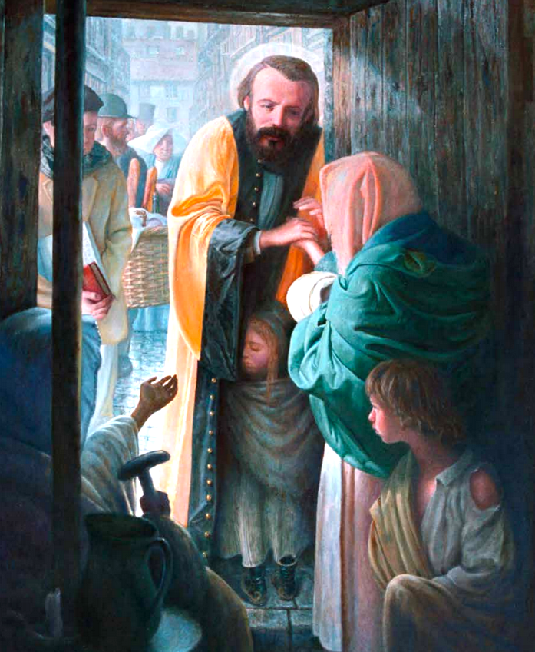

Notes:
7min – Tim Williams explains HV
https://vimeo.com/525784479

Slide 39
Commissioning and Liturgies (Rituals)
Commissioning Information: Included in the 2021 Spiritual Advisor Handbook and SVdP Georgia Spiritual Advisor Resources.
Liturgies for Feast Days and Other Reasons: Included in the 2021 Spiritual Advisor Handbook and SVdP Georgia Spiritual Advisor Resources.
Note: Presidents commission spiritual advisors; spiritual advisors commission presidents; presidents commission all others.
Notes:
You will need the commissioning documents, which have already been mailed or emailed to you for this training, along with the liturgies for feast days and other reasons.
If you are not sure who-commissions-who, the note at the bottom of this slide gives you that information.

Slide 40
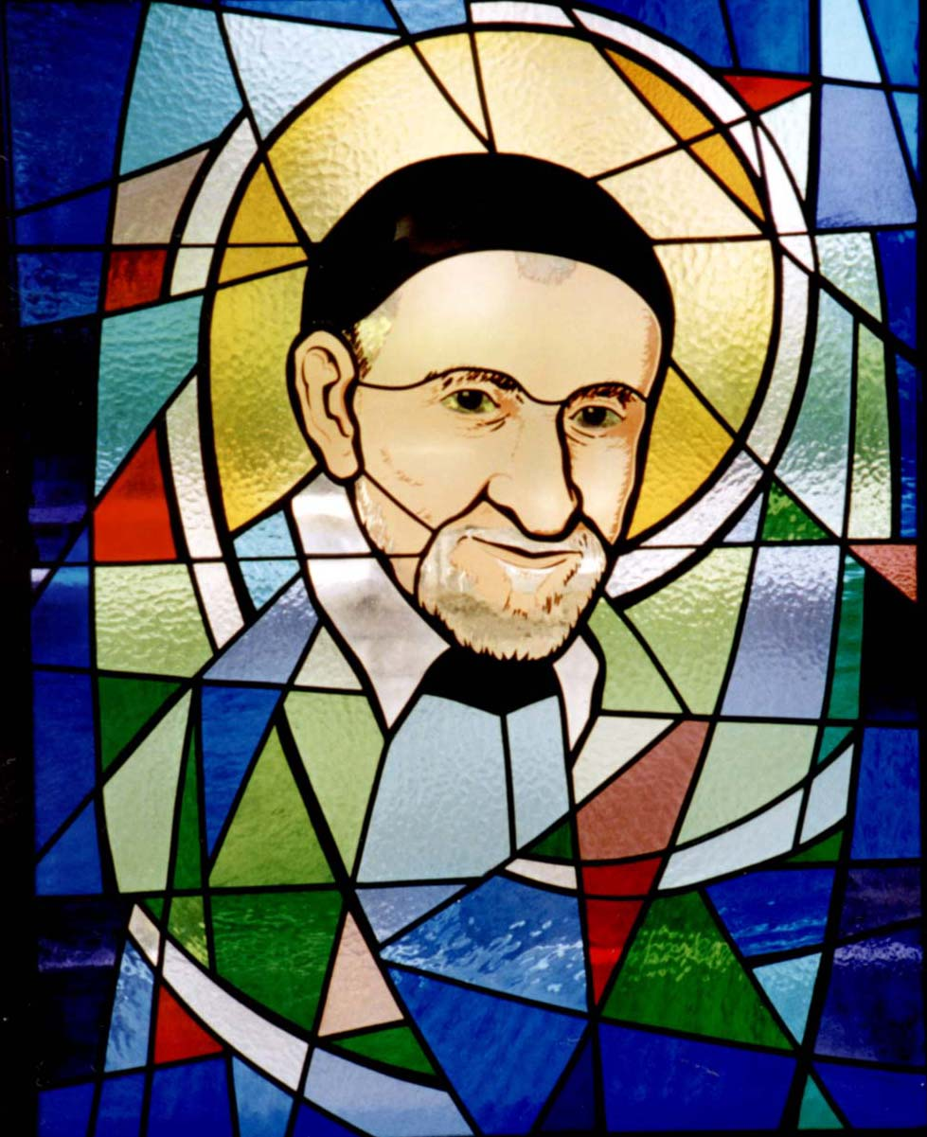
Discussion – 10 mins
Are you facing any obstacles in carrying out your role as spiritual advisors?
What will you try to change or improve when you return home?
What new insights did you receive today?
Notes:
Please take about 10 minutes to reflect on these questions with others in your breakout session.
After 10 minutes, ask for 1 or 2 volunteers to share their thoughts with the large group (2 mins for this – total combined time).

Slide 41
As a reminder…
The primary reason to give you this training was to share the highlights of the virtual, national, Spiritual Advisor training.
We request that new and experienced Spiritual Advisors attend the national virtual meeting.
We also highly recommend that all new and experienced Presidents attend the national virtual training.
**New information and resources are available in the training.**
Notes:
Review this with attendees.

Slide 42
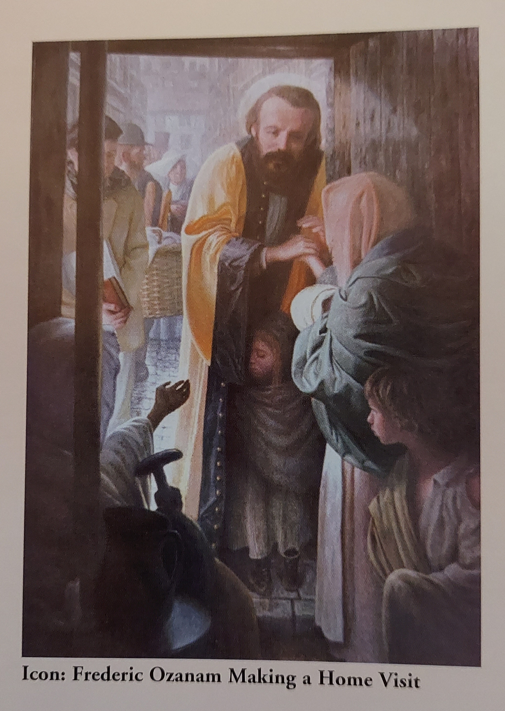
Virtual National Spiritual Advisor Training
IMPORTANT: Be sure to register for the virtual national spiritual advisor training as it will go into greater detail on many areas, including:
Vincentian Spirituality
Vincentian Discernment
Home Visits
Learning How to Facilitate a Group & Group Dynamics
Negotiate through Personality Differences
…and many more topics…
Notes:
We cannot stress enough, the importance of virtually attending the national spiritual advisor training, as it is the most comprehensive training of the St. Vincent de Paul Society.
We mailed or emailed to you, a collection of the most important resources, Spiritual Advisor Resources, and they should accompany your national spiritual advisor training file, whether this is a saved document on your hard drive, or one that is printed and added to a binder.

Slide 43
Now we will spend some time on the resources that were previously mailed or emailed to you by the SVdP Georgia staff.
Please go to the Table of Contents at this time.
Notes:
The next three slides are the table of contents of the Spiritual Advisor Resources that we mailed or emailed to you.

Slide 44
Spiritual Advisor Resources – Georgia SVdP
1. Opening and Closing Prayers
2. Vincentian Spiritual Reflections for the Current Year
https://members.svdpusa.org/members/Programs-Tools/Tools/Spirituality-Formation/Vincentian-Reflections
Sample of St. Vincent de Paul Contemplations (may be used for spiritual reflection during Vincentian meetings)
https://members.svdpusa.org/members/Programs-Tools/Tools/Spirituality-Formation/Vincentian-Contemplations
4. Commissioning and Renewal Ceremonies, Funeral Services, Prayer Services, Vincentian Celebrations (under Vincentian Celebrations – Rituals and Ceremonies)
https://members.svdpusa.org/members/Programs-Tools/Programs/Vincentian-Formation
5. Liturgies
https://members.svdpusa.org/members/Programs-Tools/Tools/Spirituality-Formation/Vincentian-Liturgy
6. The Rule and Manual books (if not already issued to you during Ozanam training)
https://members.svdpusa.org/members/Programs-Tools/Programs/Vincentian-Formation
Notes:
This collection of documents is what we consider to be the most helpful spiritual resources that are found at the national web site, to serve as a spiritual advisor.
Some resources will need to be purchased by your conference for you and the Vincentians of your conference, and some can be downloaded to your hard drive.
When you get to the national web site, you will see very quickly, which ones can be downloaded, and which must be purchased.
Every year, a new set of spiritual reflections are made available by the national office, and are found at the national website. Make sure you retrieve these at the beginning of the new (calendar) year to use at each conference meeting.

Slide 45
Spiritual Advisor Resources – Georgia SVdP
Other Resources found at the SVdP National Website or Other Websites
St. Vincent de Paul Prayer Person Instructions (an example)
Spiritual Advisor – Additional Information document based upon one person’s experience (an example only
Vincentian Retreat Checklist
Vincentian Stations of The Cross
  https://members.svdpusa.org/members/Programs-Tools/Tools/Spirituality-Formation/Vincentian-Prayers
List of St. Vincent de Paul Georgia Contacts for Spirituality Committee and Staff Support; and how to request hard copies of resources.
Notes:
Number 10, the Vincentian Stations of The Cross, is a beautiful collection of reflections and prayer, with focus on those who are in need of assistance. This resource may be used at the end of a retreat, using the Serving in Hope Modules. Together, these resources provide Vincentians with a beautiful, spirit-filled day of reflection.
Number 11, the Vincentian Retreat Checklist, is a handy tool to use in planning and facilitating retreats.

Slide 46
Spiritual Advisor Resources – Georgia SVdP
***NOTES***
The new 2021 Spiritual Advisor Handbook can be found at https://members.svdpusa.org/members/Programs-Tools/Programs/Vincentian-Formation.
Please download the 2021 handbook to your hard drive and become familiar with it. You are likely the only person in your conference who knows what SVdP resources are available to help your conference strive to become more holy. The 2021 handbook may also be printed, then set up in an index-tabbed binder, for quick and easy reference.
Notes:
Discuss both notes.
Please take the time to study the Spiritual Advisor Resources we gave you, and become familiar with them.

Slide 47
Closing Information
The contact list for the spirituality committee is in your Spiritual Advisor Resources that were mailed or emailed to you.
Share what you learned from this training, with your conference presidents and fellow Vincentians. Pray, meditate, and reflect on the areas that need improvement. Then meet with your conference president to discuss your training and ideas.
Training survey will be sent to you from SVdP Georgia staff.
THANK YOU FOR ATTENDING!
Notes:
The contact list is included in your Spiritual Advisor Resources that we either mailed or emailed to you. Feel free to contact us with questions.
Discuss your training and ideas for change, with your conference President and fellow Vincentians.
The training survey will be emailed to you.
And we thank you for attending this training! Please pray, meditate, and reflect on the information we shared with you today.
Now we will end with the closing prayer.

Slide 48
Closing Prayer
Notes:
10Min

Slide 49
Closing Prayer
L: Father, grant that we who are nourished by the Body and Blood of Christ in the Holy Eucharist may realize the depths of our needs, respond more spontaneously to the suffering of others, and come to love you more deeply by service to our neighbor.
ALL: Grant us also the wisdom and strength to persevere when disappointed or distressed. May we never claim that the fruitfulness of our apostolate springs from ourselves alone. United in prayer and action, may we become a visible sign of Christ and may we give witness of His boundless Love which reaches out to all and draws them to love one another in Him.
L: We thank you, Lord, for the many blessings which we receive from those whom we visit. Help us to love and respect them, to understand their deeper needs, and to share their burdens and joys as true friends in Christ.

Slide 50
Closing Prayer – continued
ALL: Lord, it is through your inspiration that so many people are generous in providing us with the resources to serve those in need. Bless and protect our benefactors who sacrifice and share so that our hands will be filled with gifts.
L: That the cause for the Canonization of Frederic Ozanam, who excelled in the virtue of Christian love, be advanced.
ALL: Lord, hear us.
L: In the Name of the Father…
ALL: Amen

