Slide 1
Council Town Hall
December 15, 2023

Slide 2
Today’s Topics
Prayer and Reflection
Mike’s Message
Program Presentations
Vincentian Services
Conference Fundraising
Pregnancy/Postpartum resources
Warming shelters
Chamblee Support Center
Pharmacy Update
Open Forum Q&A
Closing Prayer

Slide 3
Opening Prayer
St. Vincent de Paul, your love of Christ and of the poor served as an Inspiration to Blessed Frederic Ozanam and the founders of the Society that bears your name. We humbly ask for your intercession that the Holy Spirit will give us the grace to put into practice your virtues in our Daily life.
May we approach problems with simplicity with our intention focused on God
May we follow Jesus’ example of humility by being meek and humble of heart.
May we practice selflessness, to deny our desires so we may better serve others.
May we practice gentleness so we may be warm and inviting to all those we encounter.
May we have zeal in our ministry to serve God’s people even as we balance our other responsibilities.
We ask you to take this prayer to our Lord, Jesus Christ, and if it is in the Father’s Holy Will, our petition be granted.
Amen

Slide 4
Reflection
Our Gospel this weekend for the 3rd Sunday of Advent, is the story of St. John the Baptist, "A man named John who was sent from God." John played a pivotal role in salvation history as he was able to lead from "the second chair." When discussing John, Jesus refers to the "greatness" of John as Jesus went on to say, "yet the least in the kingdom of Heaven is greater than he." Jesus was letting it be known that all those who follow Him, accept His teachings and work for the betterment of others and this world are numbered among the greatest. Vincentians, our Lord is also speaking to all of us with this message. Each of us, in our Vincentian calling, has the ability to submit to the Will of our Father, and in our Vincentian Virtues, especially in our simplicity and humility, we follow our Lord as He command us: " Love God and Love your neighbor." Utilizing the gifts we have been given by God, we all have the opportunity to bring Hope and the Love of Christ to our neighbors. During this Advent season of expectation, may we use our gifts that we have been given to help our neighbors feel the Joy, Hope and Love of this Season. Thank you for your Yes to our Lord and may God bless you and your families.

Slide 5
FY 2023 Impact Measuring Success

Slide 6
FY 2023 Impact Measuring Activity

Slide 7
Vincentian Activity
Neighbors Helped
191,638
+ 24.9%
153,379
Visits Conducted
28,477
+ 30.2%
21,868
Volunteer Hours (est.)
> 550,000
+ 10.0%
> 500,000
FY 2022
FY 2023

Slide 8
Value of Assistance
Programs & Services Value
$23.8 million
+ 12.8%
$21.1 million
Total Direct Aid Value
$19.9 million
+ 18.5%
$16.8 million
Total Direct Fin. Assist.
$12.7 million
+ 10.4%
$11.5 million
FY 2022
FY 2023

Slide 9
Hunger Impact
Total Food Recovered
720,016 lbs. $1.38 million
+ 19.8%
601,094 lbs. $1.08 million
Total Food Distributed
1,961,996 lbs. $3.53 million
+ 22.6%
1,600,865 lbs. $2.87 million
FY 2022
FY 2023

Slide 10
Council Programs
M2H Families Perm. Housed
194 Families
+ 259.3%
54 Families
No. of Filled Prescriptions
15,004
+ 38.0%
10,868
Total Value of Prescriptions
$2.25 million
+ 78.5%
$1.26 million
FY 2022
FY 2023

Slide 11
Vincentian Services Overview

Slide 12
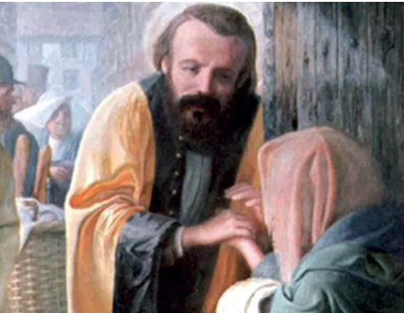
Member Website
Caseworker Resources
Newsletter Signup
Society Page
Events
Formation
https://svdpgeorgia.org/members/

Slide 13
Conference Fundraising
Lisa Regan, Brian Dooling

Slide 14
Conference Fundraising
Bea Purdue

Slide 15
Development Team
Senior Philanthropy Director - Bea Perdue
Gift Officers
Corporate – Ann Frazer
Grants & Contacts – Rene Bazel
Individual Giving – Tara LaBouff (Consultant)
Marketing & Communications Director – Brian Dooling
Development Support Manager – Elizabeth Ivey

Slide 16
Devo Mission & Purpose
Our DEVO Team purpose is to garner financial and public support for the St. Vincent de Paul Mission
The DEVO Team is expected to provide support for the conferences through enhanced financial support, highlighting and publicly promoting efforts that provide Help and Hope to neighbors served at the Chapter/Conference level
Collaborate to identify and secure maximum support opportunities that maximize the impact or our collective mission

Slide 17
Pregnancy and Postpartum Resources
Lisa Regan

Slide 18
Pregnancy and Postpartum Resources
Stable housing: critical for pregnant women
Rental eviction during pregnancy increases risks of adverse birth outcomes, which has been shown to have life-long multigenerational consequences.
Source: National Library of Medicine

Slide 19
Pregnancy and Postpartum Resources
Medical care: critical for pregnant women
Women without prenatal care are seven times more likely give birth to premature babies, and five times more likely to have infants who die.
-Baltimore City Health Commissioner

Slide 20
Pregnancy and Postpartum Resources
Pregnancy Centers through the state of Georgia. Most provide:
Free pregnant validation: proof of pregnancy is required for Pregnancy Medicaid
Free diapers and baby supplies
Free parenting classes and wrap-around support

Slide 21
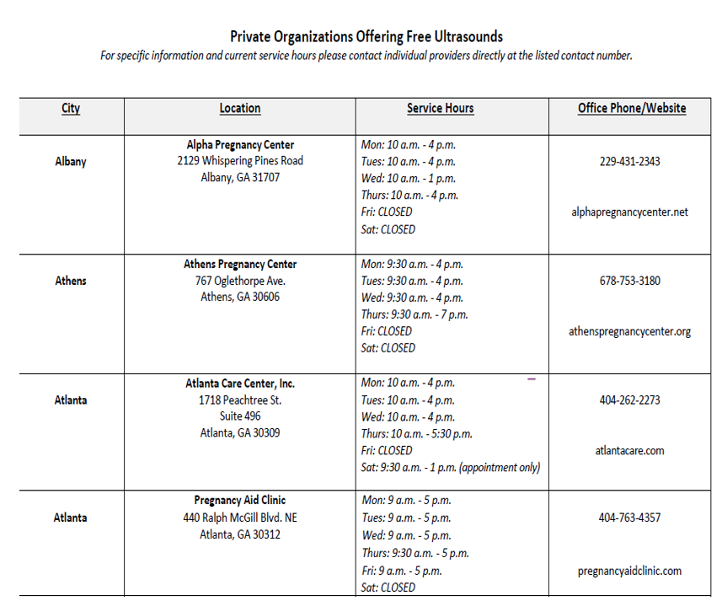
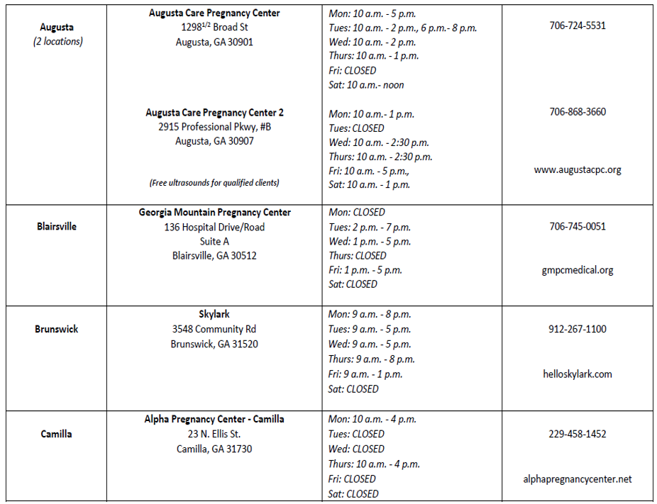
Pregnancy and Postpartum Resources
Georgia Department of Public Health lists pregnancy resource centers in more than 50 cities throughout the state
Archdiocese of Atlanta pregnancy center listing

Slide 22
Pregnancy and Postpartum Resources
Government applications: Pregnancy Medicaid, SNAP, WIC
Walking with Moms in Need: Ministries throughout Atlanta Archdiocese
https://www.walkingwithmoms.com/
https://svdpgeorgia.org/snap-benefits/

Slide 23
Warming Shelters
Mariel Risner Sivley

Slide 24
Council Office Updates
Christa Frye

Slide 25
Government Benefits

Slide 26
SVdP Application and Renewal Assistance for Government Services
Government Benefits
SNAP
Early deposit
For those who receive benefits on the 19th , the deposit will be made on the 17th
For those who receive benefits on the 21st-23rd, the deposit will be made on the 19th
Medicaid
PATHWAYS – expanded Medicaid program for those 19-64 who would not otherwise qualify
Household income up to 100% of the poverty level.
WIC
Special Supplemental Nutrition Program for Women, Infants and Children
CAPS
Childcare and Parent Services
TANF
Temporary Assistance for Needy Families

Slide 27
How to Request Assistance
Walk-in to the SVDP CSC:
2050 Chamblee Tucker Rd., Chamblee, GA 30341
10am – 2pm Monday – Friday
Send a request to: Benefits@svdpgeorgia.org
Request SNAP assistance through the website: SNAP Benefits - SVDP Georgia
Request a benefits rep to come to your conference

Slide 28
SNAP Eligibility
In most cases, your household must meet both the gross and net income limits described below or you are not eligible for SNAP and cannot receive benefits.
Gross income means a household's total, non-excluded income, before any deductions have been made.
Net income means gross income minus allowable deductions.
A household with an elderly or disabled person only has to meet the net income limit, as described on the elderly and disabled page.
If all members of your household are receiving Temporary Assistance for Needy Families (TANF), Supplemental Security Income (SSI), or in some places other general assistance, your household may be deemed “categorically eligible” for SNAP because you have already been determined eligible for another means-tested program.
The information provided in the table below applies to households in the 48 contiguous states, the District of Columbia, Guam, and U.S. Virgin Islands that apply for SNAP between Oct. 1, 2023, through Sept. 30, 2024.
Table 1: SNAP Income Eligibility Limits - Oct. 1, 2023, through Sept. 30, 2024
Household Size Gross monthly income Net monthly income Household Size Gross monthly income Net monthly income (130 percent of poverty) (100 percent of poverty) (130 percent of poverty) (100 percent of poverty)
1 $1,580 $1,215 5 $3,807 $2,929
2 $2,137 $1,644 6 $4,364 $3,357
3 $2,694 $2,072 7 $4,921 $3,785
4 $3,250 $2,500 8 $5,478 $4,214
Each additional member +$557 +$429

Slide 29
For More Information
Services | Georgia Department of Human Services Division of Family & Children Services
Georgia Gateway - Homepage Screen
Supplemental Nutrition Assistance Program (SNAP) | Food and Nutrition Service (usda.gov)
WIC | Georgia Department of Public Health
AppendixA-CAPS Maximum Income Limits by Family Size.pdf (ga.gov)
GA Decal Bright from the Start
TANF Eligibility Requirements | Georgia Department of Human Services Division of Family & Children Services
Georgia Pathways | Georgia Department of Community Health

Slide 30
VITA
(Volunteer Income Tax Assistance Program)

Slide 31
SVDP TO PROVIDE VITA SERVICES
Free service for those with incomes $60,000 or less
Currently 4-6 physical sites (at conferences) and a virtual drop off/pick location
Season begins Jan. 29
Interested in becoming a volunteer/site?
Deadline for commitment – Dec. 22

Slide 32
Hunger Walk
March 10, 2024

Slide 33
Get Ready for Hunger Walk 2024!
SAVE THE DATE! March 10,2024
SVDP is a Benefiting Partner
SVDP receives a portion of all proceeds we raise, the other portion goes to the Atlanta Food Bank (the Atlanta Food Bank helps to supply our food pantry)
Registration to begin in early January
Champions Club
Those who raise $500 and above
Get special perks, opportunities, swag, and recognition
Returning Champions get 50% off their registration for this year

Slide 34
LIHEAP

Slide 35
LIHEAP
LIHEAP is a Low Income Home Energy Assistance Program that helps to keep families safe and healthy through initiatives that assist with energy costs.
Currently accepting appointments only from elderly households ages 65 and older or medically homebound. Accepting calls to schedule appointments for the General Public on January 2nd if funds are still available in that county.
Eligibility Requirements:
The applicant needs to be a U.S. citizen or legally admitted immigrant.
The applicant's total gross annual household income needs to be at or below 60% of the State's Median Income.
The applicant needs to have full responsibility for paying the cost of energy bills for the primary home heating source.
Statewide Provider Map:
https://dfcs.georgia.gov/document/document/liheap-lihwap-provider-map-revised-100621/download

Slide 36
Pharmacy Update
Dr. Samantha Ricks

Slide 37
Receiving Prescription Medications
How do patients receive their prescriptions?
Prescription Pick-Up directly from our Pharmacy
Delivery Services
Provided by volunteers every Wednesday and Thursday
Patients who live within a 20 mile radius of the pharmacy who are unable to pick up their prescriptions
Shipping via UPS
Patients who live outside of a 20 mile radius of the pharmacy and are unable to pick up their prescriptions

Slide 38
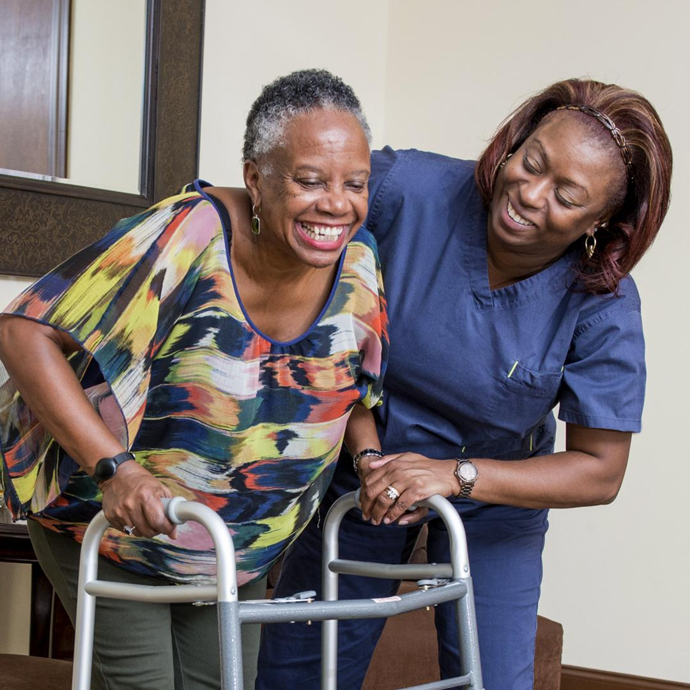
Additional Health Services
Over-the-Counter Medications No-cost over-the-counter medications to treat common ailments such as headaches, cough, colds, cuts and scrapes
Medical Equipment No-cost medical equipment such as wheelchairs, walkers, crutches, shower chairs/benches, ostomy supplies, rollawalkers and other essential medical devices
Health Services Referrals Referrals for low-to-no cost primary healthcare services and resources

Slide 39
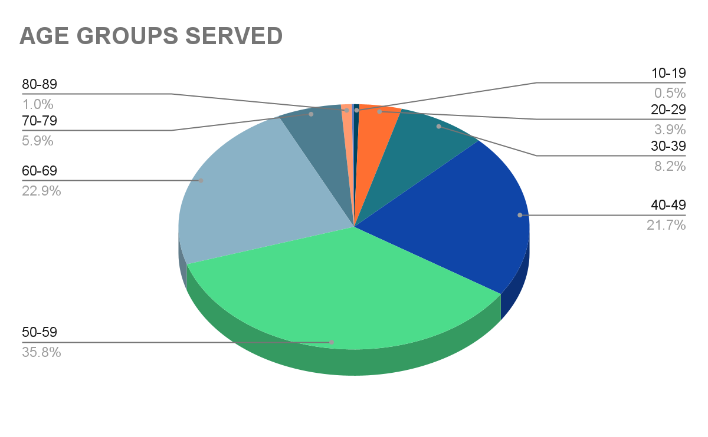
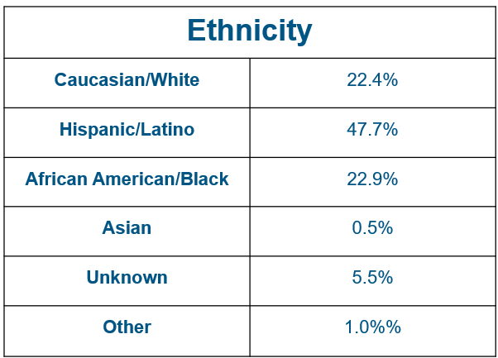
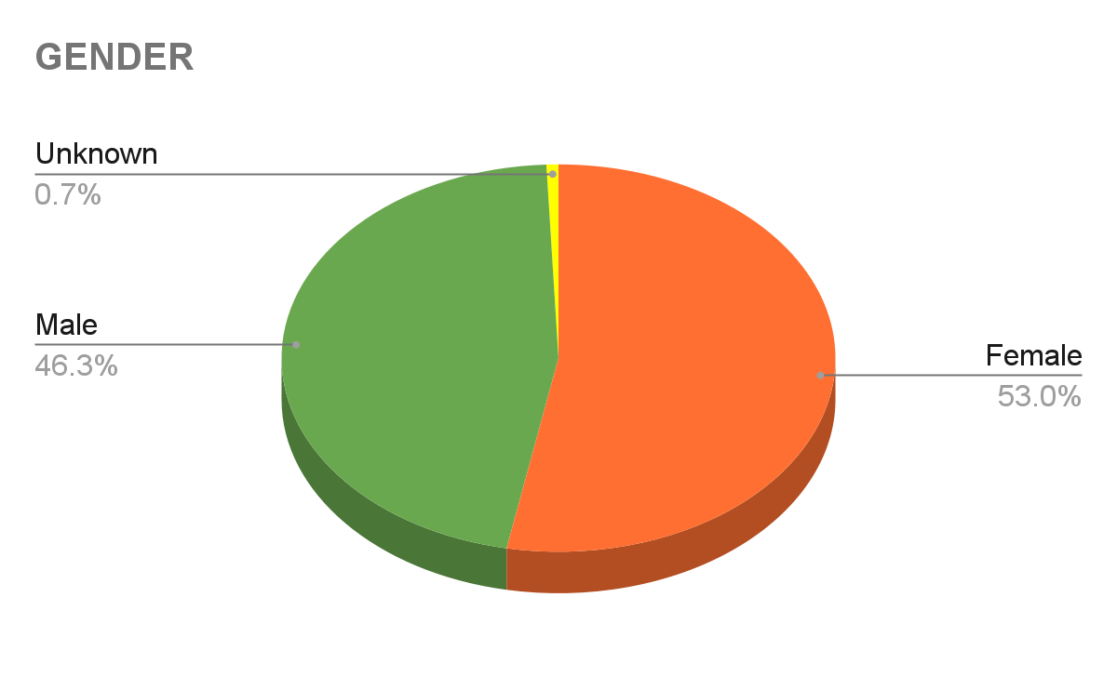
Who We Served In 2022

Slide 40
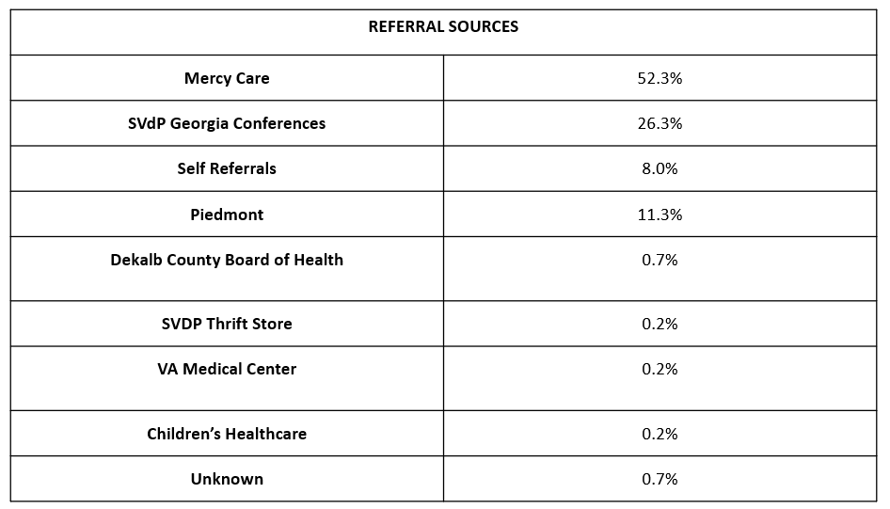
Where Do Patients Come From

Slide 41
How To Reach Our Pharmacy Team
Pharmacy Hours of Operation:
Monday-Thursday: 9am-3:30pm
(Closed for lunch 12:30pm-1pm)
Pharmacy Contact Information:
2050 Chamblee Tucker Road, Suite C
Atlanta, Georgia 30341
770-687-2610
Email: pharmacyapplication@svdpgeorgia.org
Director of Pharmacy:
Samantha Ricks, PharmD
678-892-6181
Email: sricks@svdpgeorgia.org

Slide 42
QUESTIONS?

Slide 43
Closing Prayer
Jesus is ever present with God, and ever present with us, and so we pray,
-Lord to whom shall we go? You have the words of eternal life.
We ask for strength to continue as your faithful disciples,
-and may we always let your word break into our consciousness and change us.
Amen.

Slide 44
Thank you!

